Slide 1
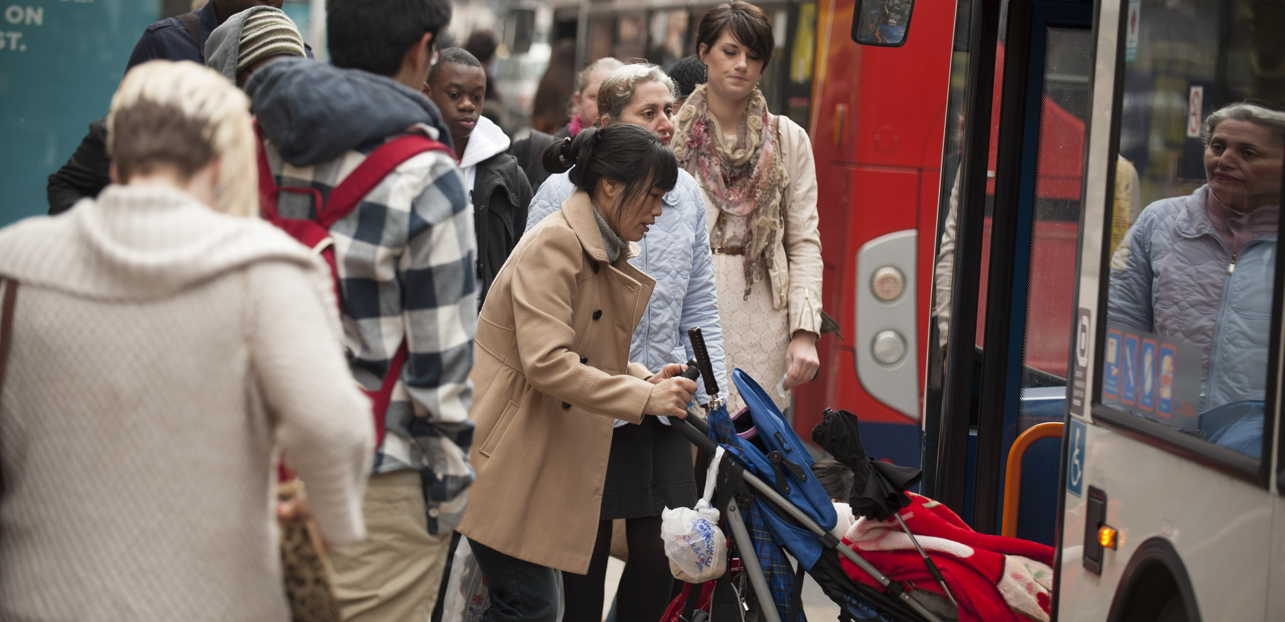
Passenger representation
David Beer, Senior Manager
June 2023

Slide 2
What is Transport Focus?
Transport Focus is the voice of Britain’s transport users
We work to make a difference for all transport users by:
Championing the needs of all transport users today
Ensuring that all transport users are at the centre of policy making and decisions for tomorrow
Facilitating and inspiring future transport thinking

Slide 3






Using evidence from research
Your Bus Journey – our new bus passenger experience survey
Continuous data collection, throughout 48-50 weeks of the year
Currently working in over 30 regions in England, plus mainland Scotland
Key principles in summary:
Passengers feed back about a single leg of a journey, made on day of recruitment
Pro-active recruitment of passengers, at point of usage
…. meaning face to face interception as passengers make journeys – verified and inclusive
Online as main method for survey completion – but offline options have a place
Questionnaire focusing initially on essential metrics – with follow-on more detailed questions optional, but encouraged
Structured questions about overall journey experience, with core measures carried over from previous Bus Passenger Survey.

Slide 4
Providing guidance and support
Bus Service Improvement Plans
Drawing on extensive experience and insight, we offered support to all Local Transport Authorities with a series of guides and online briefings
Passenger representation
Setting targets
Passenger charters
What passengers want
Further details are on our website
As a statutory consultee we have also responded to every authority’s Enhanced Partnership consultation and represent passenger interests on a number of EP boards and forums around the country

Slide 5
Working to make a difference
Challenging poor performance
Holding train operators to account at public board meetings, monitoring through experience and working to highlight improvements
Avanti West Coast
TransPennine Express
Transport for Wales
Making sure user voices are heard
Representing the interests of transport users and potential users, especially when changes are proposed
Amplifying the voice of those not often heard
Ensuring communication happens with user groups
Bringing stakeholders together – eg Chester concourse plans

Slide 6
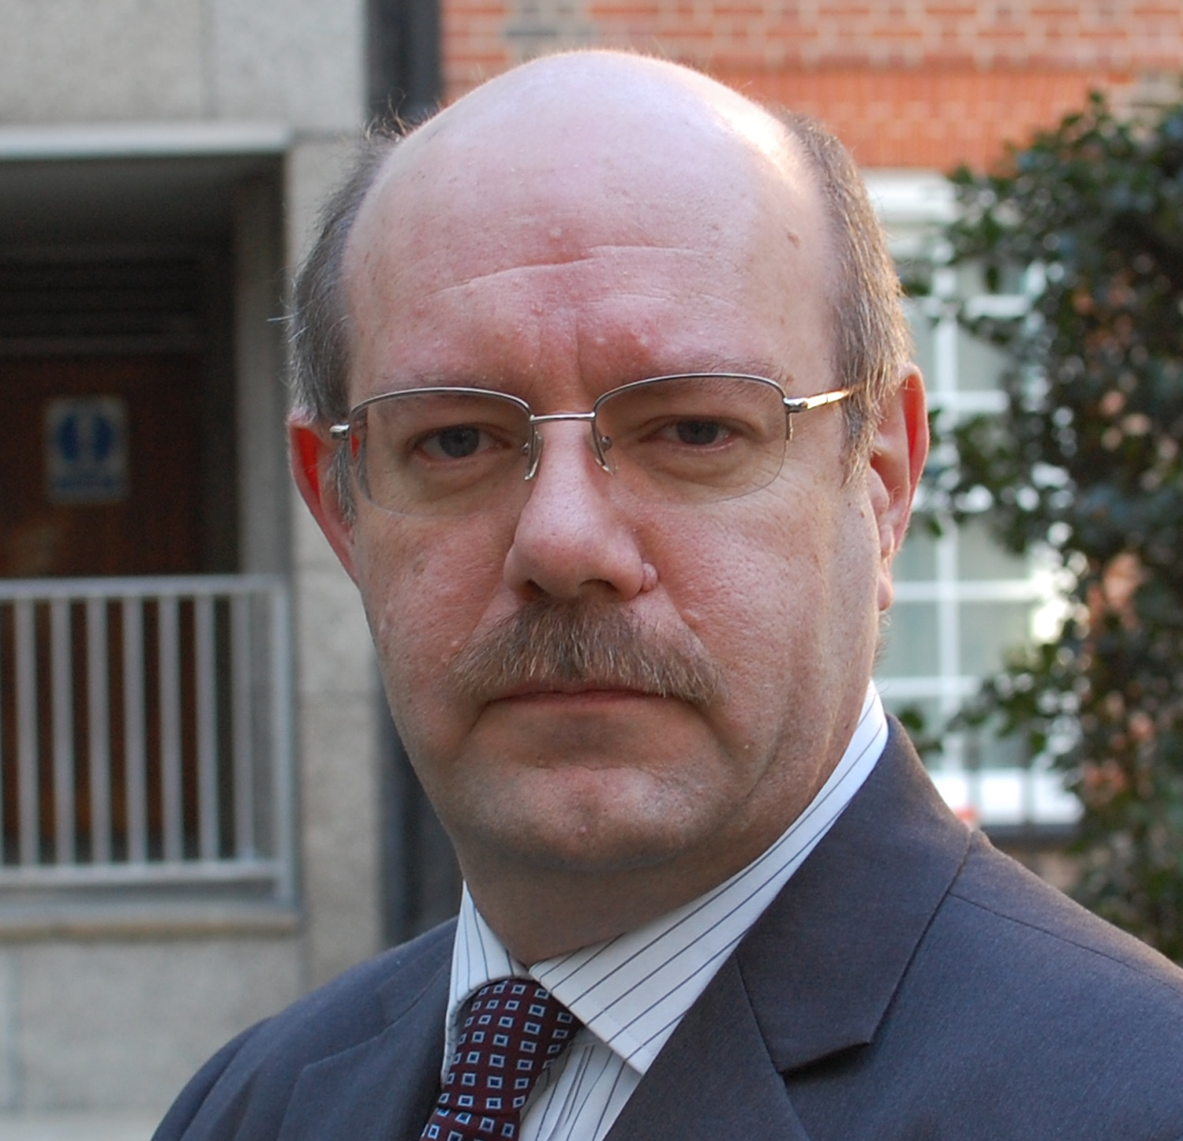
Further information
Contact:
David Beer
Senior Manager
david.beer@transportfocus.org.uk
07854 966411
transportfocus.org.uk
@transportfocus

