Slide 1

LANCASTER BUS USERS’ GROUP
THE VIEW FROM THE QUEUE
Jim Davies, Chair

Slide 2




Who are we?
A group of 39 individuals plus
three corporate members

Slide 3

Set up in 2014
The only active Bus Users’ Group in Lancashire
One of very few in the North West

Slide 4
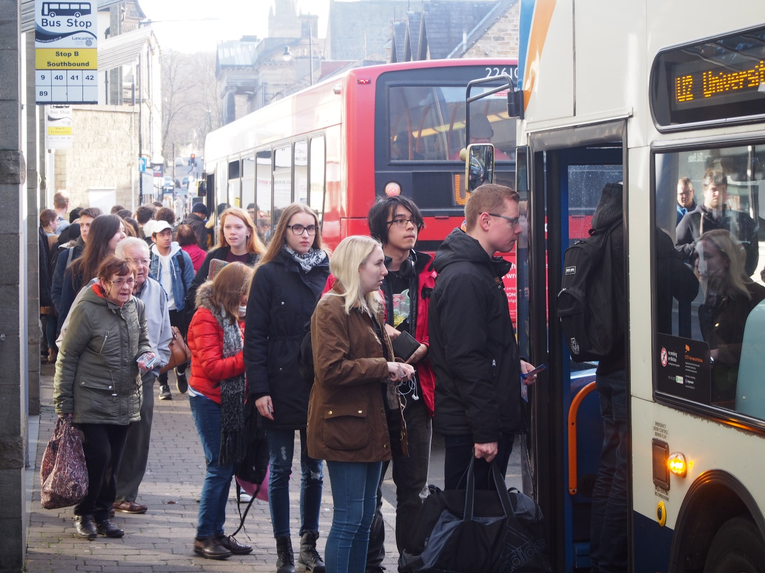

Our Aim
To further the interests of bus passengers throughout the Lancaster District, including Morecambe, Heysham, Carnforth and the surrounding rural area.

Slide 5

Our Approach 1
We seek to work with bus companies and councils and not against them
We have developed contacts at many levels within our local bus industry and the county council – not just senior management
We seek to be realistic in what we can achieve
We make full use of traditional and social media

Slide 6
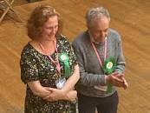
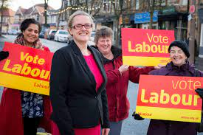
Our Approach 2
We have experienced campaigners
We have local politicians on board

Slide 7
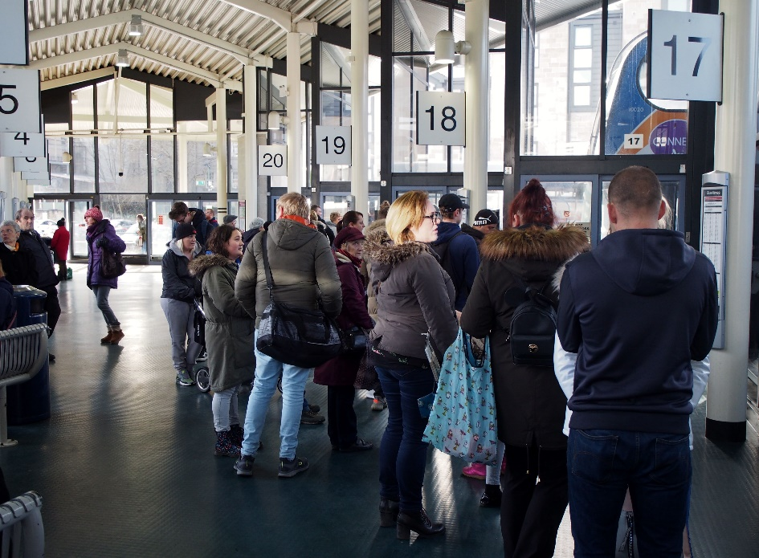
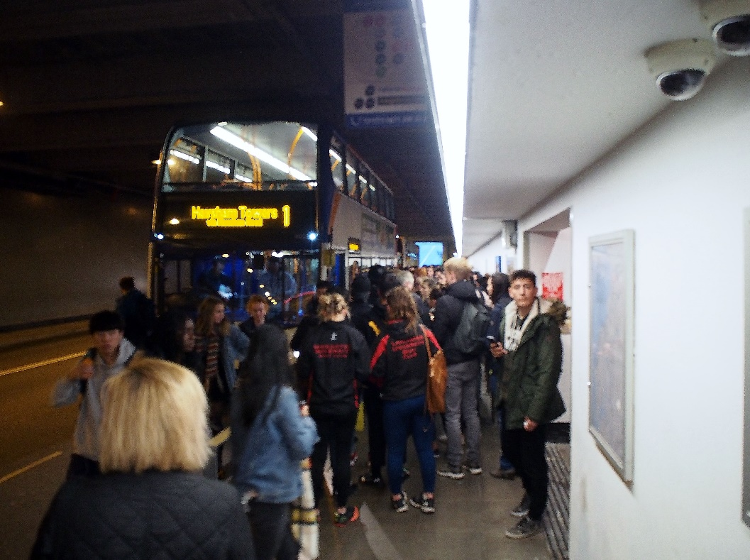
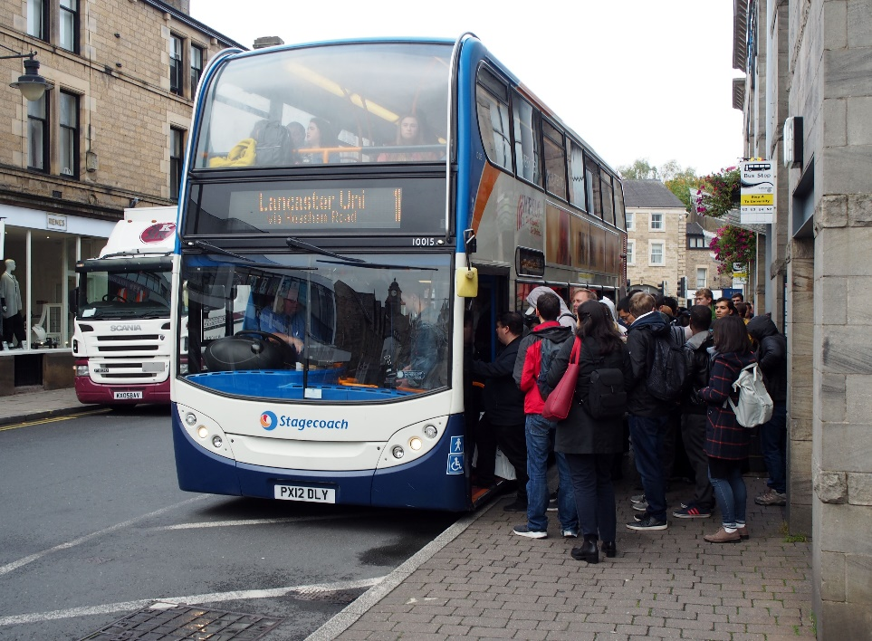
Our Approach 3
And we have bus users!

Slide 8




OUR CAMPAIGNS
High-Level Campaigning:
Members of Stakeholder Forum of the Lancashire Enhanced Partnership.
Respond to Consultations on Transport Matters
Notes:
Do flag, display case, traveline names match – timing points and fare stages A6 stops

Slide 9
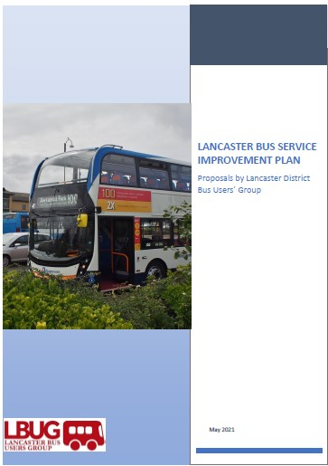
We don’t just respond. We are pro-active too.
A Bus Service Improvement Plan for Lancaster

Slide 10
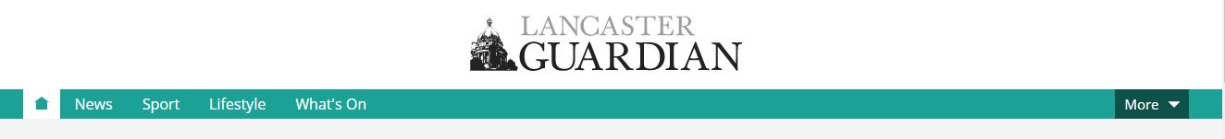
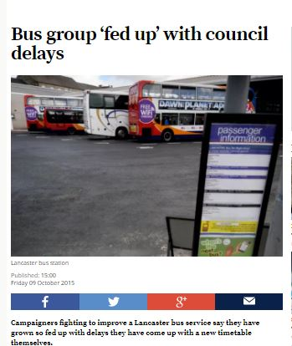
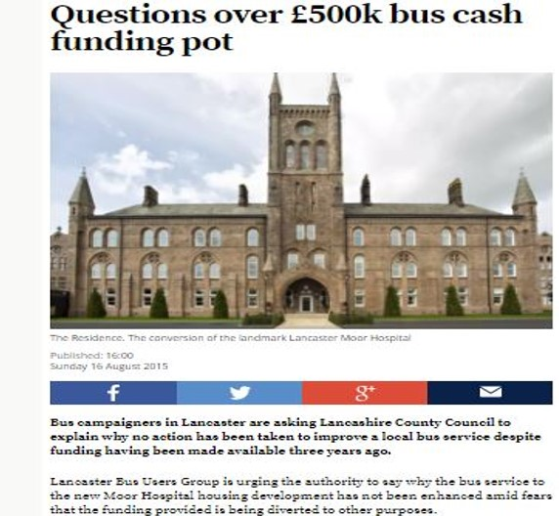
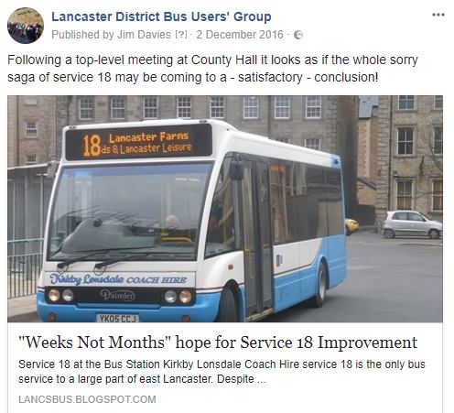

Notes:
Kept pressure up Found out about road works Gina asked Fillis for one-to-one

Slide 11
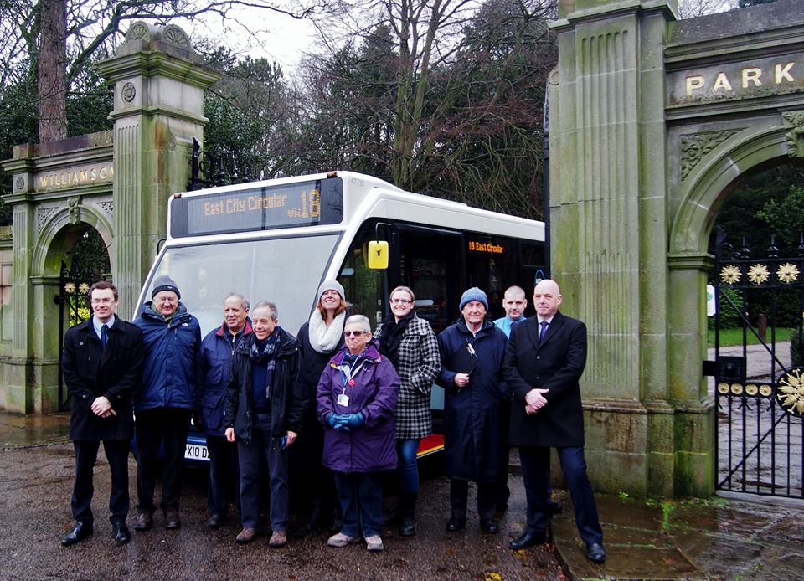

When you have a success . . .
. . . celebrate!

Slide 12
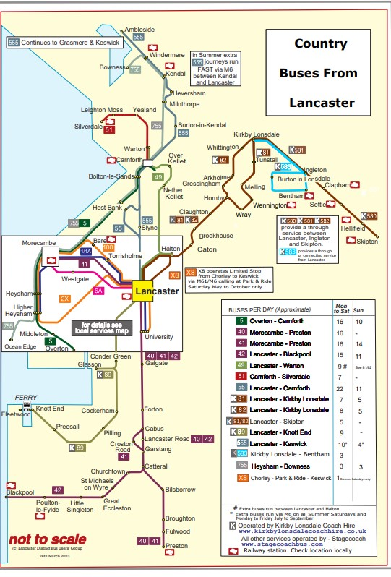
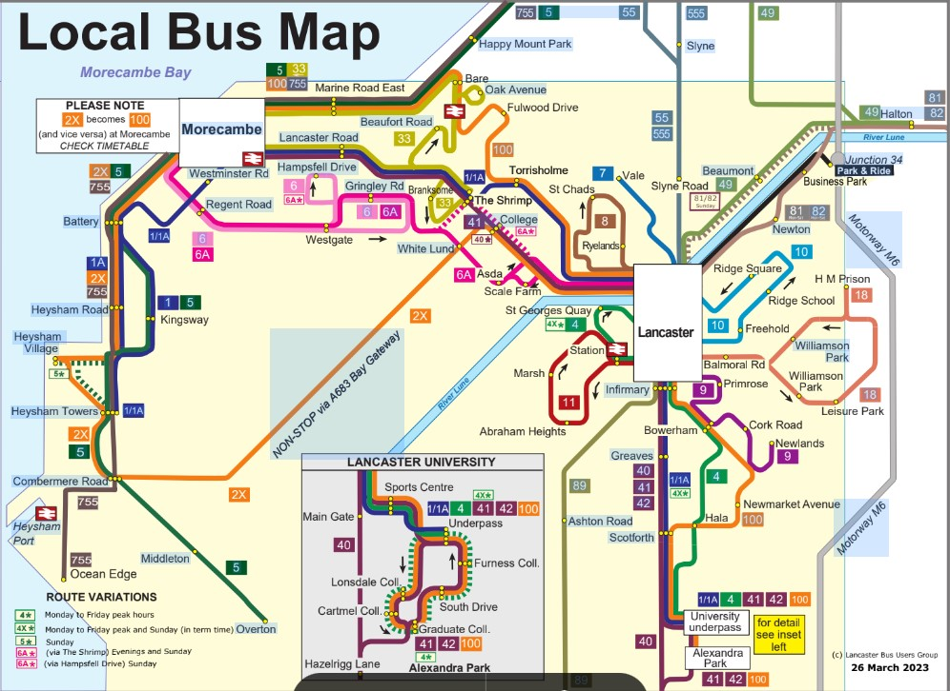
Because nobody else does it
All-operator bus maps for the city and beyond

Slide 13
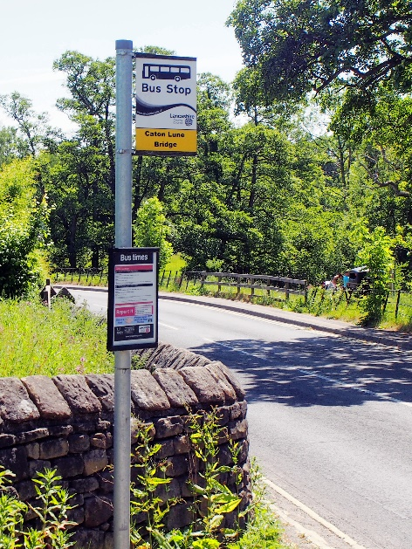
Little things that make a difference 1
New bus stop at the Crook o’ Lune

Slide 14
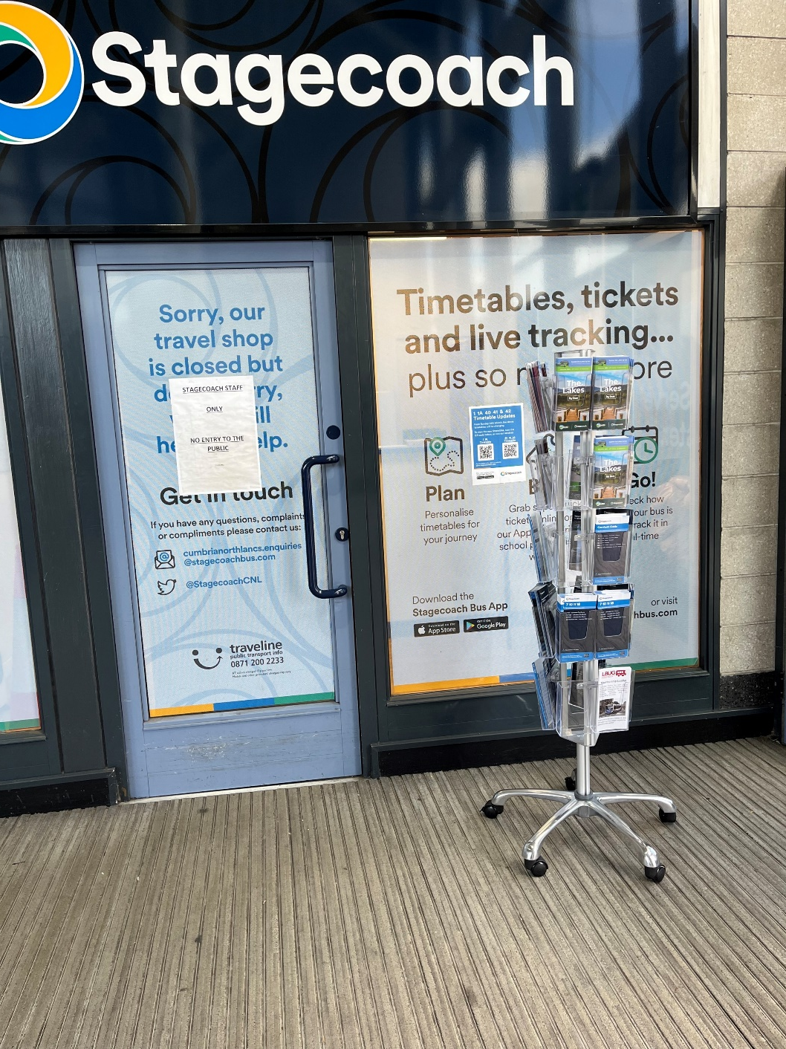
Little things that make a difference 2
Timetable rack at
Lancaster Bus Station

Slide 15
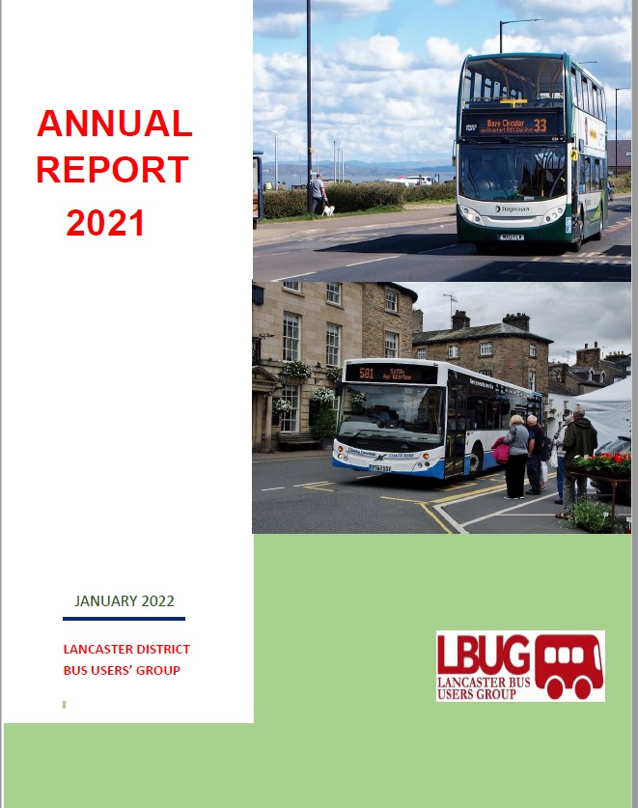
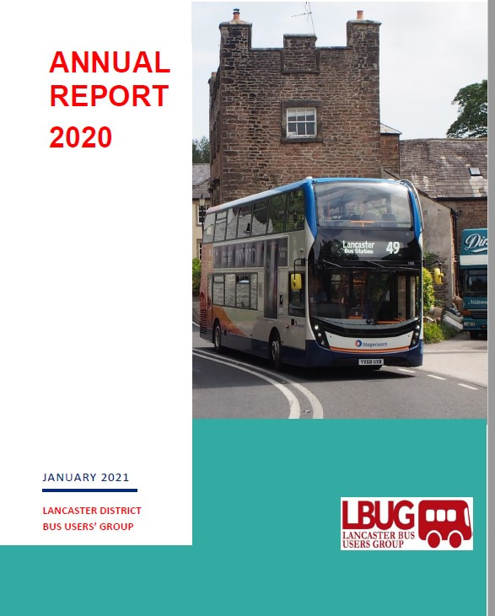
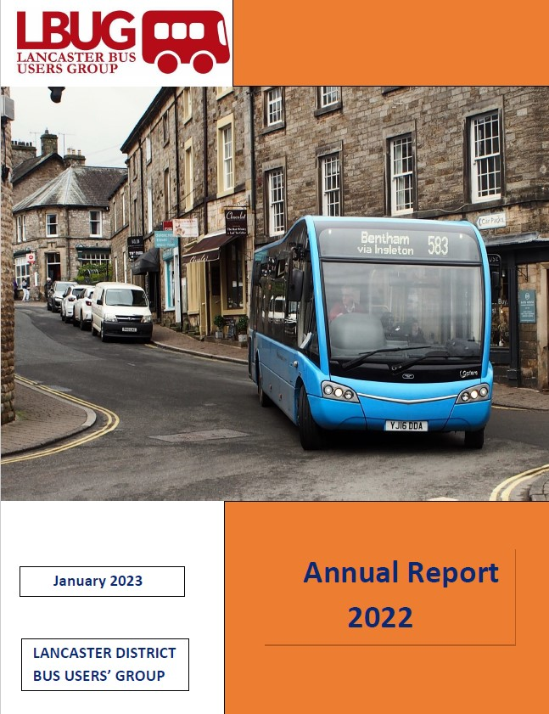
Telling People What We Do
www.lancasterbususers.com

Slide 16
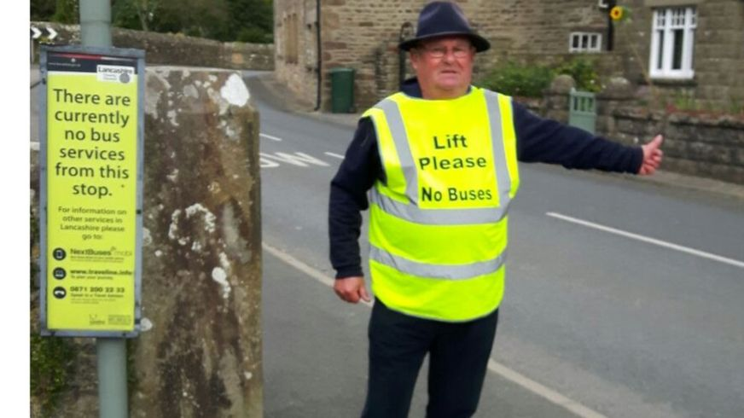

Campaigning should be imaginative – and fun!
Our member, Duncan – star of BBC News and the Daily Mail
Notes:
Duncan won’t have to hitch hilke whenever he fancies a trip to town. END

