Slide 1


TravelWatch NorthWest
Conference
20 June 2023
Working in Partnership
Notes:
Hello and thank you to Travel Watch North West for giving us this opportunity to speak today about Community Rail
I’m Dawn McGough and I’m the Community Rail Manager for Community Rail Cumbria

Slide 2



Community Rail Cumbria is made up of:
Cumbrian Coast Line CRP
Furness Line CRP
Lakes Line CRP
Notes:
Community Rail Cumbria is made up of 3 Accredited Lines – the Cumbrian Coast Line, the Furness Line and the Lakes Line
We were formerly hosted by Cumbria County Council and are now hosted by the new Westmorland & Furness Council who support the team with central resources eg payroll and IT
We also have a service level agreement in place to provide equivalent services to the new Cumberland Council
We continue to rely on external funding particularly from Train Operating Companies and stakeholder organisations
We have 3 individual Partnership Boards – one for each line – recognising the individuality of each line
But work together to provide a united voice for improving rail matters across Cumbria

Slide 3

National Governance
Community Rail Network
  Central resource supporting member organisations
  Accreditation
  DfT and Rail industry
Notes:
The Community Rail Network based in Huddersfield, and formerly known as ACoRP, are the Community Rail umbrella organisation
They provide training events, offer advice and guidance and resources and they coordinate CRP interests across the UK
They are also responsible for ensuring Community Rail Partnerships are formally accredited every year
And they are Community Rail’s key interface with the DfT and Rail Delivery Group working hard to embed Community Rail at the heart of franchise agreements and transport policy and strategy workstreams

Slide 4
National Governance
DfT - Department for Transport
- Funds Community Rail Network
- Community Rail Steering Group
- Community Rail Strategy – four pillars for CRPs to
focus on:
* Providing a voice for the community
* Promoting sustainable and healthy travel (the extra mile)
* Bringing communities together and supporting diversity and inclusion
* Supporting social and economic development
Notes:
In addition, the Department for Transport funds and governs the Community Rail Network and is part of the Community Rail Steering Group
The DfT published the Community Rail Development Strategy in 2019 – launched at Millom station in Cumbria
The Strategy has four key pillars which CRPs are encouraged to use as a foundation for their work and projects and I’ve listed these on the slide
The Strategy is a really important document for Community Rail and demonstrates the value of our work and the commitment of Government

Slide 5
What is Community Rail?
Building partnerships between the rail industry and local communities and businesses
Promoting the railway and increasing ridership
Influencing timetable changes in line with local demands
Promote Connectivity
Influencing rolling stock and seating capacity
Stimulating community involvement
Developing station building usage
Notes:
For those who perhaps don’t know too much about Community Rail I’ve listed here some of our key functions
The main priority I think for us is to act as an interface between the rail industry and our local communities to help put rail travel at the heart of travel choices and to bring a sense of pride and place around the stations
With over 70 CRPs across the country there are fantastic examples of CRPs working very effectively in the spheres of education, health, safety, capital programmes, place making, active travel and marketing and promotions

Slide 6
Projects
From A-Z a CRP has probably covered it!
Most ideas have merit and with time, research and above all FUNDING! they can be achieved
I’ve highlighted today three key projects which Cumbria has been proud to be part of
But there is a host of others across the county all of which deserve to be showcased
Notes:
CRPs are involved in many many projects and from Artwork to Zoology a CRP has probably tackled it
Generally, no idea is a bad idea but be aware that projects can take time and are reliant on people making them happen
As many of you will know the Furness Line and Lakes Line celebrated their 175th anniversary recently and we held numerous events and celebrations to mark this milestone – around 100 people were involved with the planning and we worked hard over two years to make those events happen
Some of the other key projects which Community Rail Cumbria has made happen include

Slide 7
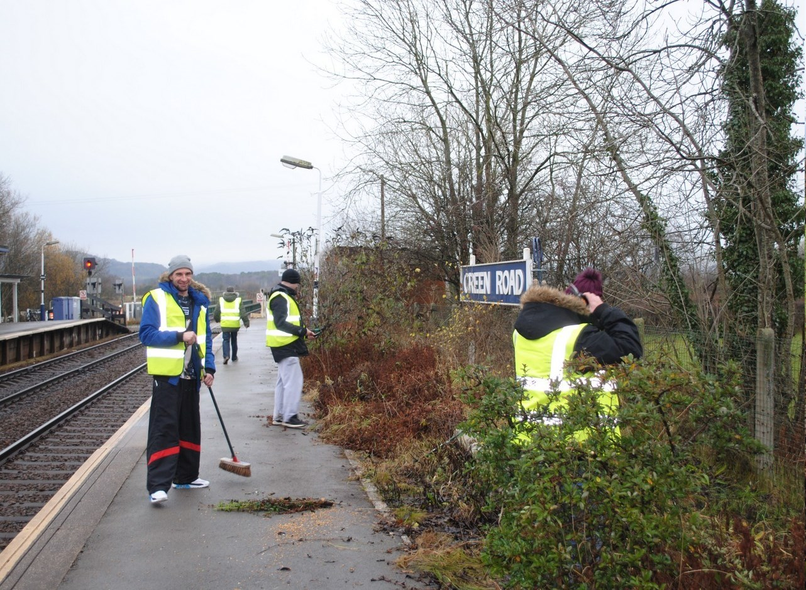
Turning Point at Green Road
Notes:
One of our most successful and ongoing projects is working with Turning Point, a drugs and alcohol rehabilitation centre in West Cumbria
The Rail Journey to Recovery and the Broken Lives Mended projects have been inspirational in helping people with their recovery and
Working at Green Road station is now embedded as part of the West Cumbria weekly rehab programme
Turning Point is a national Charity with centres throughout the UK and this is the first time the railway has become part of their work
Rail travel and working at stations have reaped many individual benefits for people who are trying to re-establish a positive path in life
Involvement with the railway has seen latent skills come back to life such as photography, woodwork and arts; induvial self confidence and self worth has been restored; and a feeling of giving back to the community rather than being a drain on society
So many positive outcomes and very much in line with the DfT pillars of:
Providing a voice for the community
Promoting sustainable and healthy travel
Bringing communities together and supporting diversity and inclusion

Slide 8
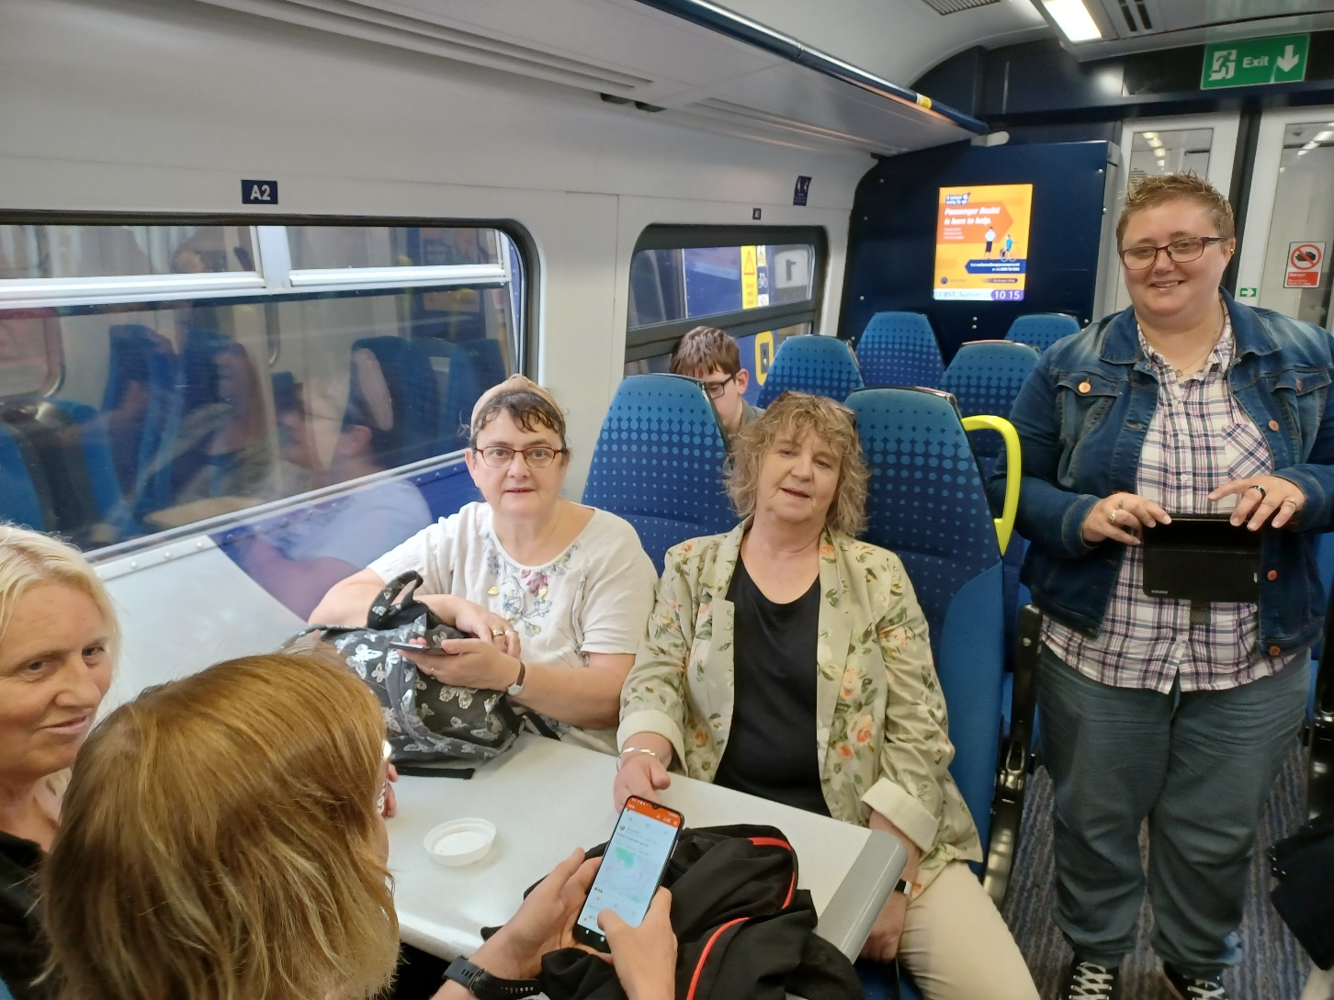
MIND enjoy a day trip to Morecambe
Notes:
Mindful Days Out is a project encouraging vulnerable groups, particularly those with mental health challenges, to take a rail trip out and reconnect with the ability to travel independently; visit places of nostalgia and rekindle old memories; enjoy quality time out with others and to take a break from the routine
Individuals have told of their joy at getting out and about safely and with a growing sense of confidence; their delight in remembering places they used to visit or exploring new destinations; and an increasing sense of social interaction and the confidence that goes with that
So again, very much meeting the DfT pillars:
Providing a voice for the community
Promoting sustainable and healthy travel
Bringing communities together and supporting diversity and inclusion

Slide 9
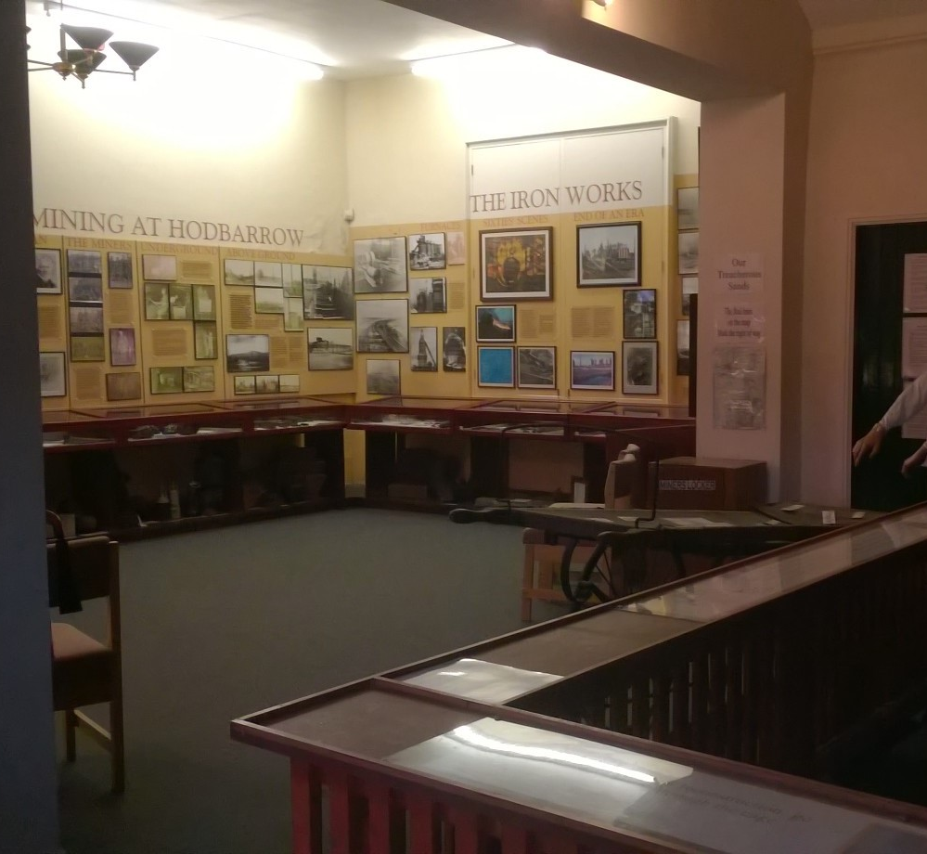
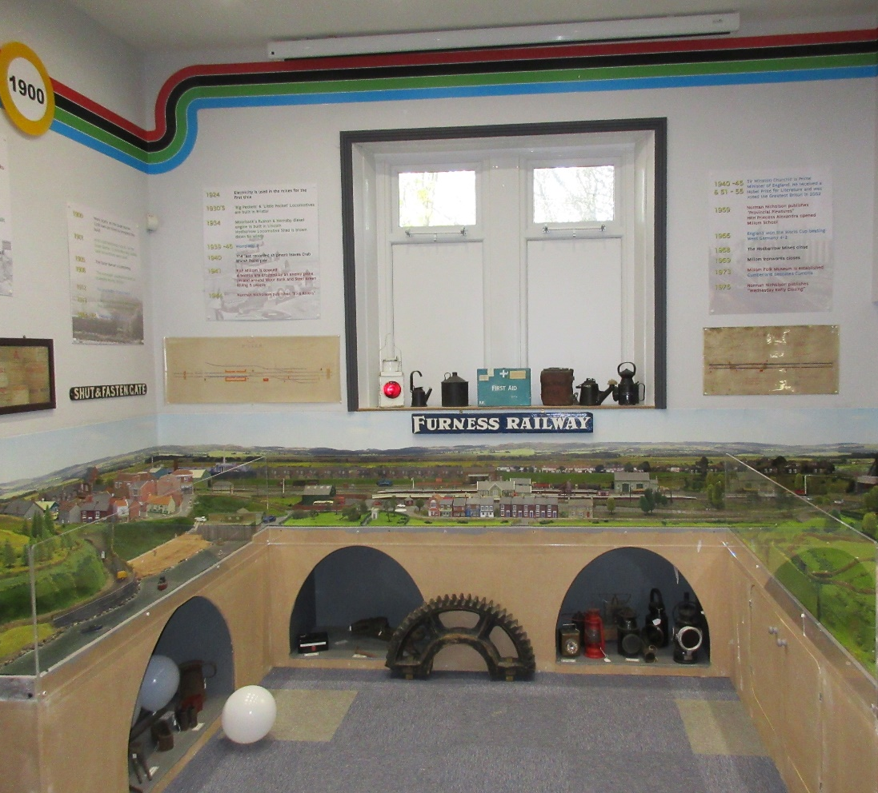
Millom Transformation
Notes:
Repurposing station buildings as social enterprises is a growing ambition for many communities
Millom Heritage and Arts Centre is an excellent example of this offering an interactive experience including the social and cultural history of the town, a rail education room, gift shop and cafe
The Trustees spent a lot of time during the covid lockdowns revitalising and transforming many of the historic displays into modern, brighter interactive exhibits for all to enjoy
So again meeting the DfT pillars I’ve already mentioned but this time very much
Supporting social and economic development

Slide 10
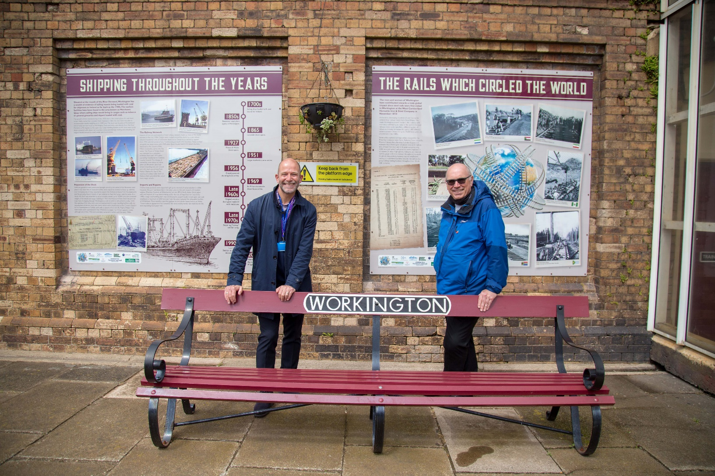
The rails which circled the world
Notes:
And finally for something a little different
The rails which circled the world is an exhibition of the industrial and social heritage of Workington on the West Cumbrian coast
17 displays celebrate the coal, iron, steel and shipping industries which made Workington a global name as they shipped rails around the world
The invention of the Bessemer was a turning point in the growth of Workington’s economy well being
The display is a powerful outside education space teaching young people about these important industries and the renown of this humble West Cumbrian town
The displays also evoke significant nostalgia as people identify with their parents and grand parents and days and ways of years gone by
I’d now like to hand over to my colleague and CRP Chairman Tim Owen who will talk to you about some other aspects of Community Rail

Slide 11
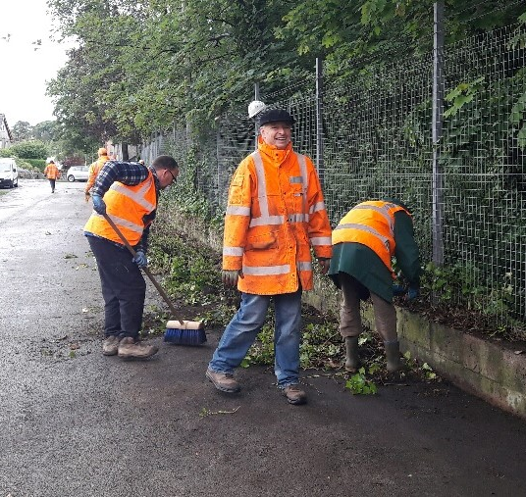
Station Adoption
Notes:
Long tradition of station adoption and all 38 CRP stations across the Cumbrian Coast Line, Furness Line and Lakes Line have a station adoption group
Groups include the local community, families, schools, mental health and social care

Slide 12
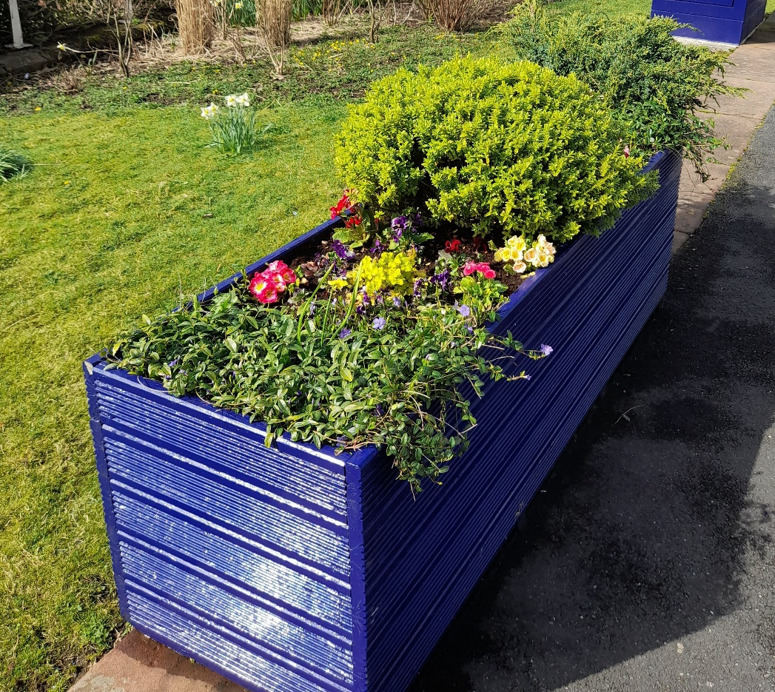
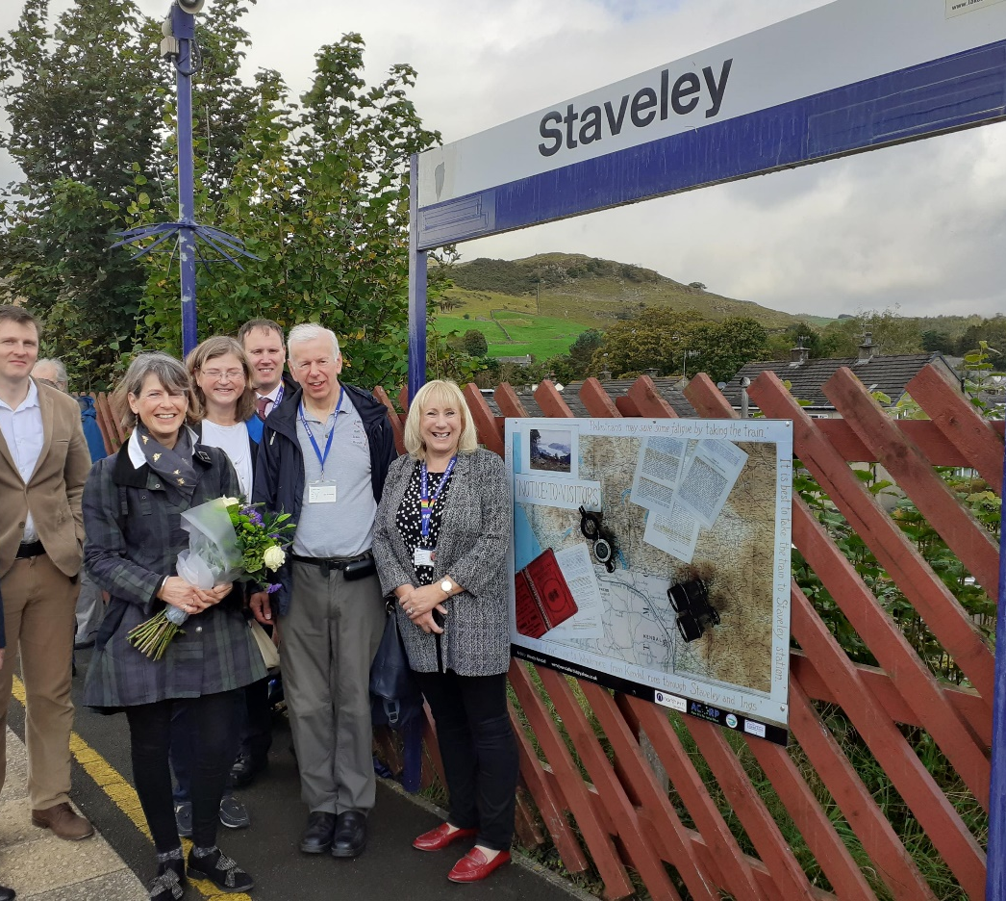
Station Adoption
Notes:
Activities range from Gardening to Landscaping
General tidying to Building Renovation
Art works to heritage displays
Grants available to bid for funding
Here we have a Kendal station planter and the Staveley art project both created and installed by Friends of the Lakes Line

Slide 13
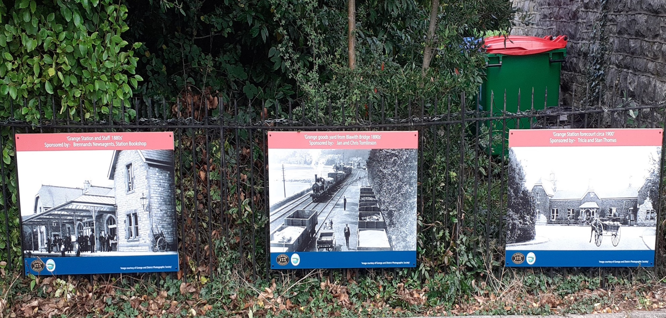
Grange Heritage Display
Notes:
Here we have the Grange station heritage display created by the Friends of Grange Station

Slide 14
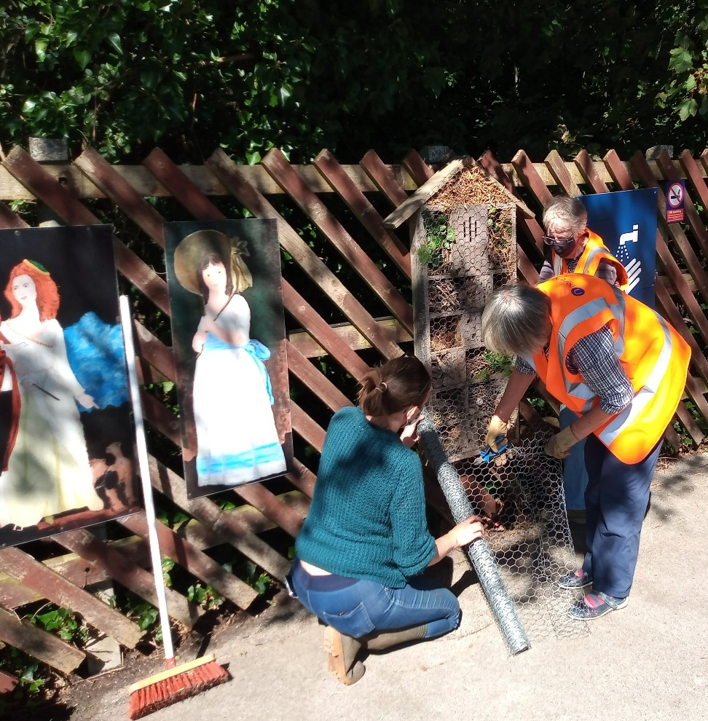
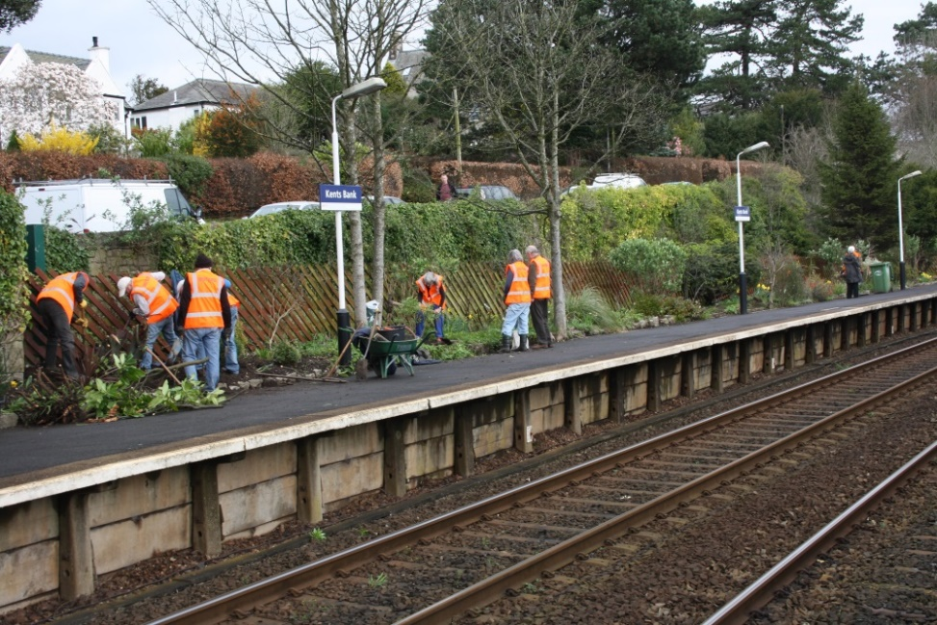
Station Adoption
Notes:
Friends of Kents Bank Station and Foreshore gardening Party
Friends of Dalton Station install their bug hotel created by the local secondary school

Slide 15
CRC Key Partners
Core Funders
Resources and Project Funding
Northern
TransPennine Express
Avanti
Local Businesses
Nuclear Industry
Local Authorities including LDNPA and Cumbria Tourism
Cumbria LEP
Community Rail Network
Network Rail
Other TOCs
Other CRPs
Parish Councils
Rail User Groups
Notes:
In order to bring about these amazing projects there are a range of key partners the CRPs work with across both the rail industry and our local communities
TOC funding is key to the existence of most CRPs and Local Authority input and support from Councils, National Parks and Tourism is vital

Slide 16
Strategic Plans
Furness Line – Furness Line Study resulted in 11 trains per day to Manchester International Airport
Lakes Line Capacity Study – submitted to DfT Summer 2022 in partnership with Cumbria County Council – 2 trains per hour
Energy Coast Rail Upgrade programme for CCL – submitted to DfT January 2023
South Cumbria Blueprint
Access for All – applications submitted 2022 for:
  Ulverston (Cumbria)
  Millom (Cumbria)
  Workington (Cumbria)
  Oxenholme (Avanti)
  Silverdale (Lancs CC)
  Carnforth (Lancs CC)
  Outcomes now expected Autumn 2023

Slide 17
Sustainable Travel
Links with Council Bus Officer and bus companies
Input to Active Travel planning eg LCWIPs
Town Deals – influence improvements to wayfinding signage to and from the stations
Modal shift – working with major companies eg Sellafield and BAE to encourage increased rail travel and reduce road congestion

Slide 18
Connections
ComREG – West region representative
Cumbria Better Connected
Morecambe Bay Partnership
Eden Project North
Importance of connecting people across organisations
Stimulating interest in public transport opportunities/ rail travel
Sharing our knowledge, experience and technical know how
Critical friend role
Links with neighbouring CRPs

Slide 19
Thank you
Working in Partnership
Notes:
Thank you to Travel Watch North West for enabling us to talk to you all about Community Rail
We would welcome any questions you may have
Thank you

