Slide 1

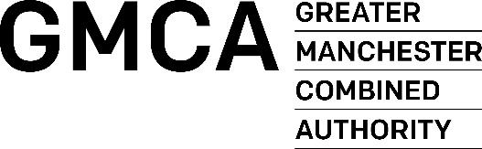
Delivering an integrated transport network for
Greater Manchester
Vernon Everitt
Transport Commissioner
Greater Manchester
Travel Watch North West Conference
2 March 2023

Slide 2
Commissioner priorities
Customer and Revenue
Operational Services & Networks
Funding
Organisational capability to deliver this transformation

Slide 3
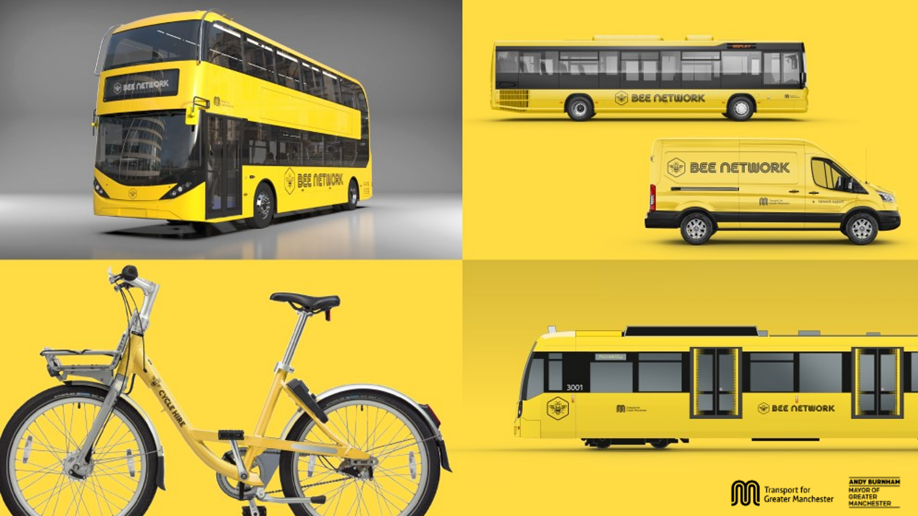

Slide 4
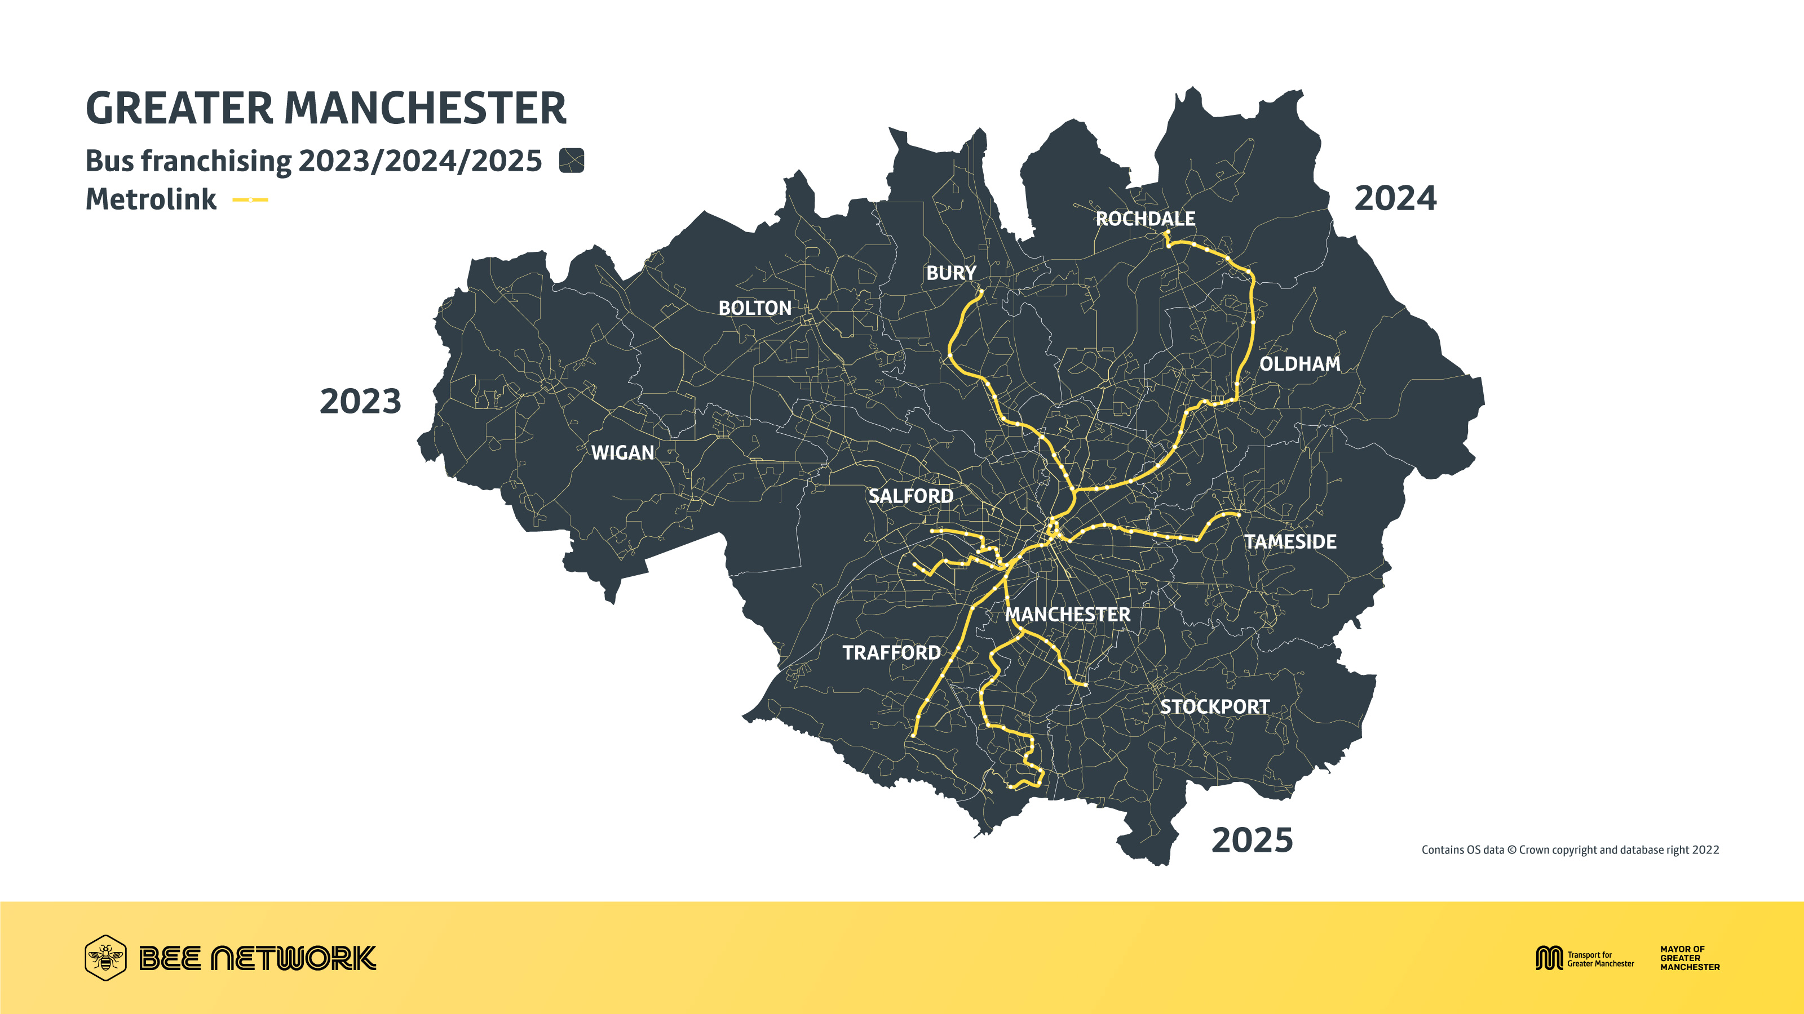

Slide 5
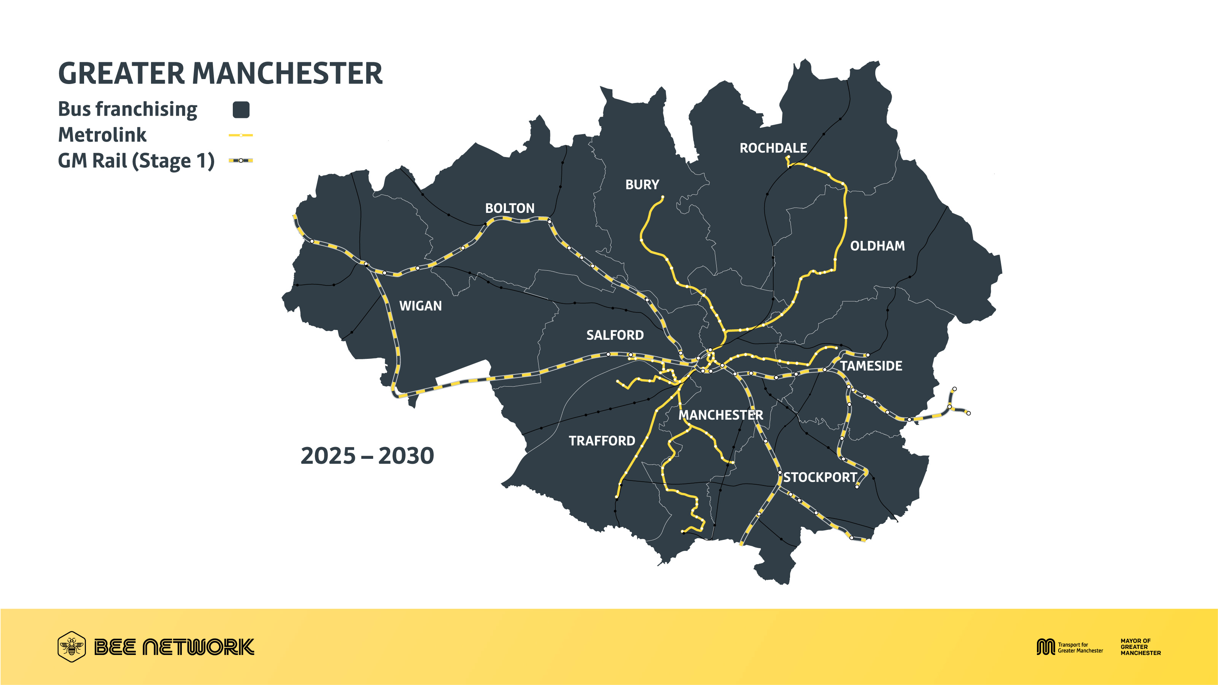

Slide 6
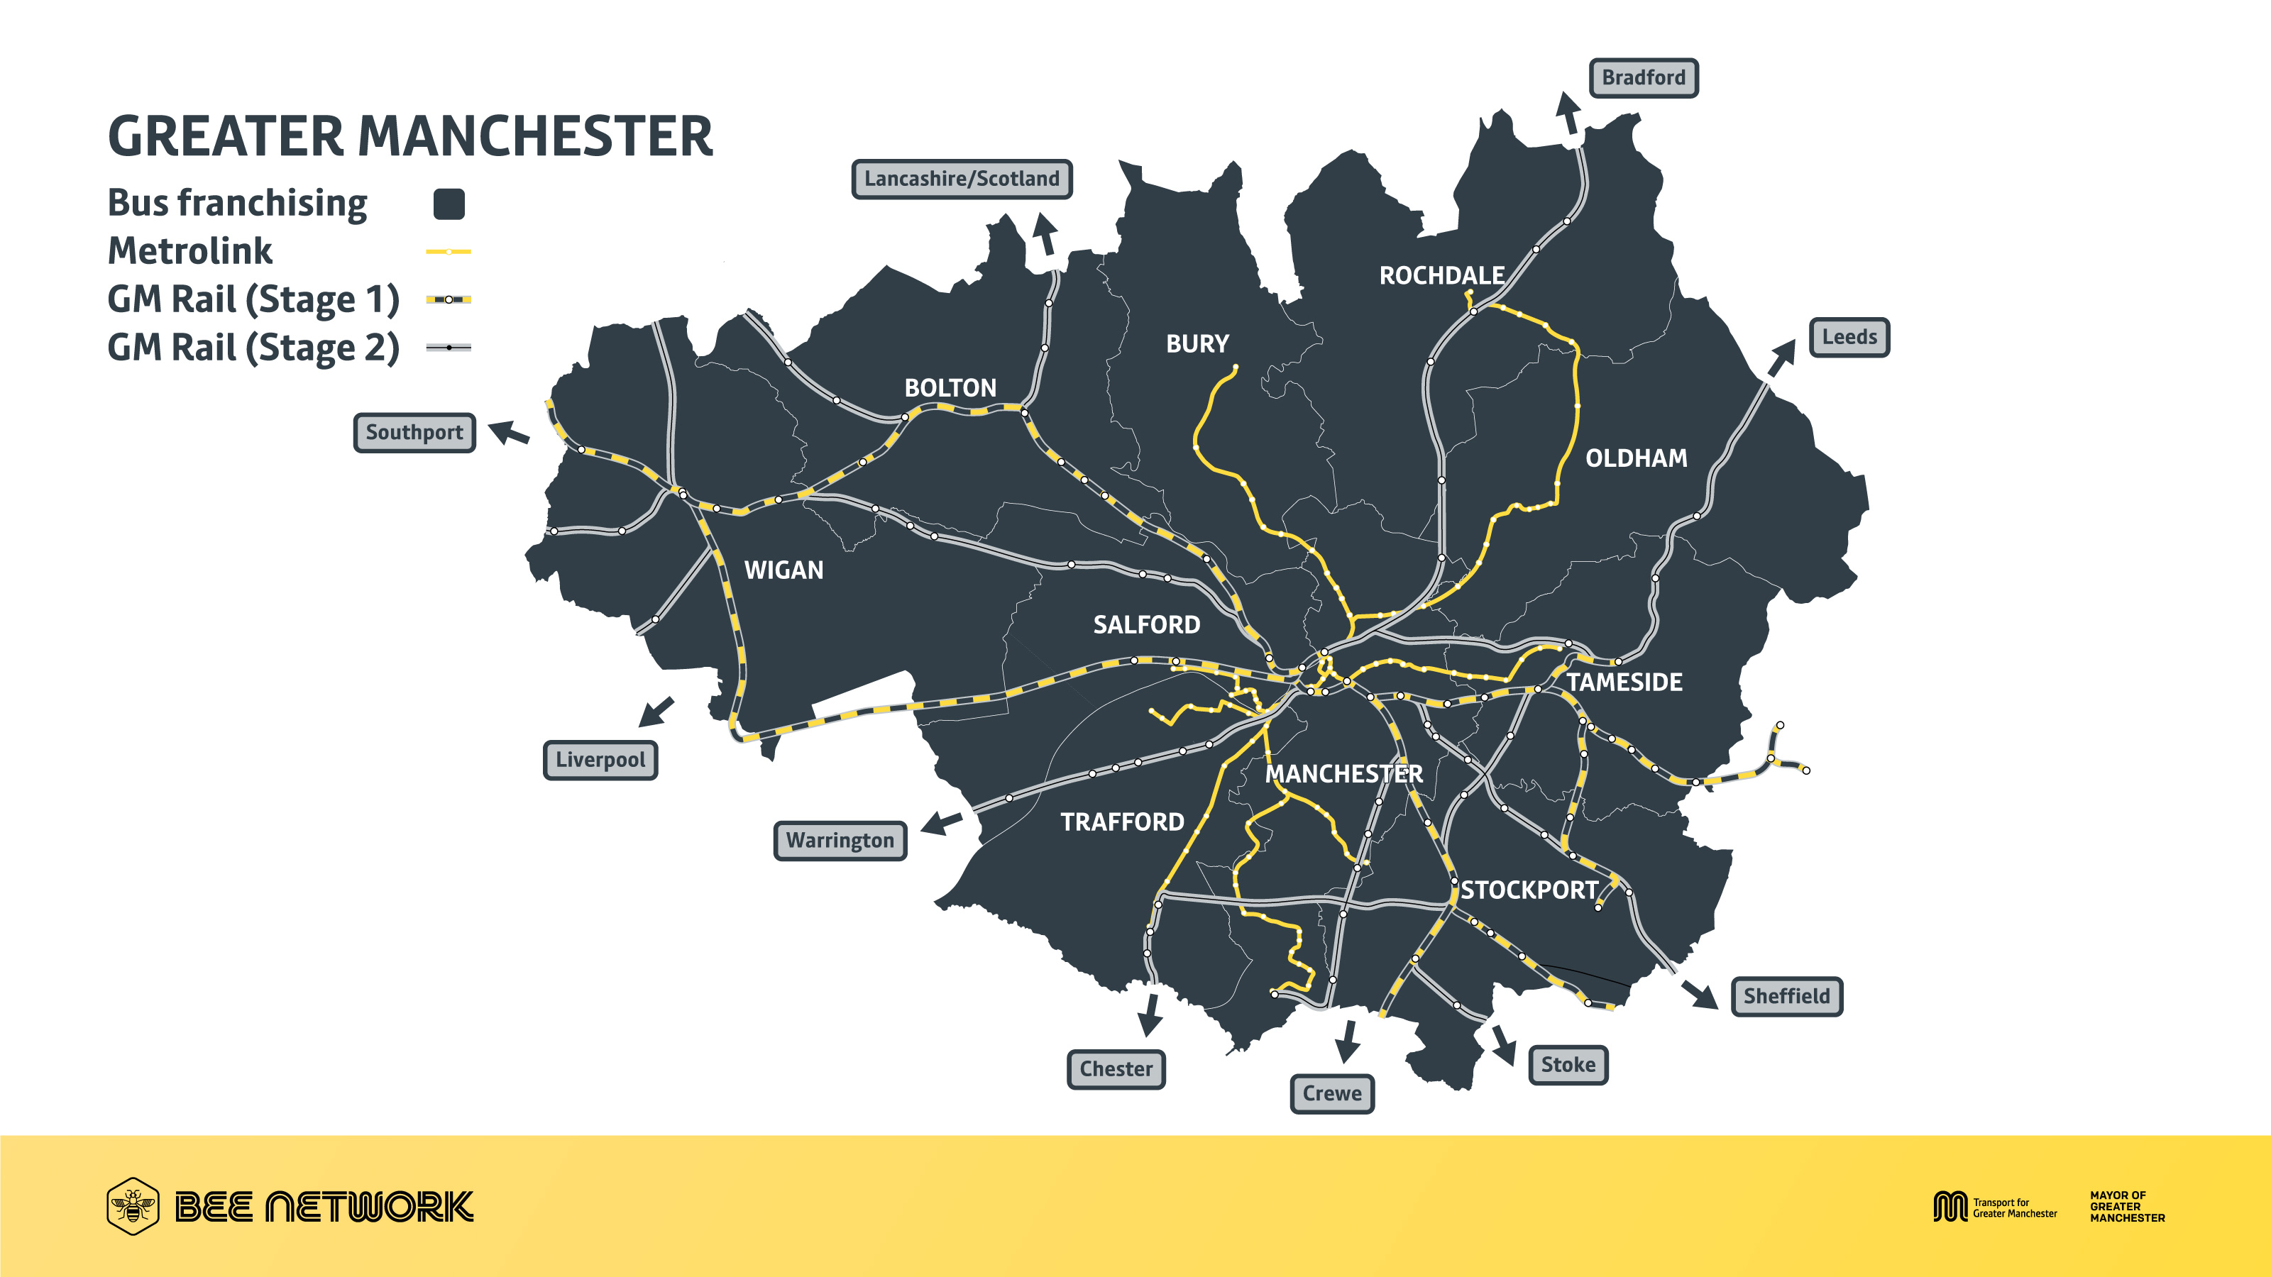

Slide 7
