Slide 1






Customer Delivery
(Planned Disruption)
Jonathan Orriss, Senior Project Manager (Customer) (TransPennine Express)

Slide 2











Who is involved?

Slide 3
TRU Customer Meeting Structure
Strategic Communications
Programme Strategy and Development Review (PS&DR)
Programme Performance Review (PPR)
Customer Strategic Evaluation Group (SEG)
Key Output Working Group (KOWG)
Communications Co-Ordination Group
Customer Experience Working Group (CXWG)
Lessons Learnt
Review
Stakeholder
/Media
Marketing (Digital)
Internal Communications
Customer Impact (Comms)
Commercial Impact & Customer Insights
Stations and Alternative Transport
Contingencies
Key Information Link
Notes
The link between PSDR and SEG is not direct, other meetings have been removed for simplicity purposes
The SEG develops the high level plan and hands over to the CXWG and Communications Co-Ordination Group who then deliver
Strategy and Development
Delivery

Slide 4








The Transpennine Route Upgrade Customer Manifesto
We will use proactive, honest and clear communication to all customers about the possible impact of TRU in good time to help them make informed decisions about their journeys.
We will ensure that timely information is made accessible for all customers through varied communication channels with a strong focus on digital and social.
We will use Net Promoter Score to understand how customers feel about the impact of TRU on their lives, and we will make customer feedback an essential and integrated part of the whole TRU programme.
We will keep our customers and colleagues safe during TRU with a particular focus on out of course processes and activities.
We will keep customers on trains as much as we can throughout the programme.
Our people will be there to provide information, advice and reassurance and a level of service that feels personal and welcoming. Our TRU Customer Delivery Managers will lead these plans.
We will only use road transport when there is no alternative; when we do use it, it will be of a high quality comparable to that of our new trains.
All stations affected by TRU will have clear and consistent customer information along with enhanced facilities and/or service for all customers
Notes:
Guiding principles in delivering for customers through TRU
NOTE – There is a review of this starting with supply chain issues limiting what we can provide in terms of alternative transport.

Slide 5
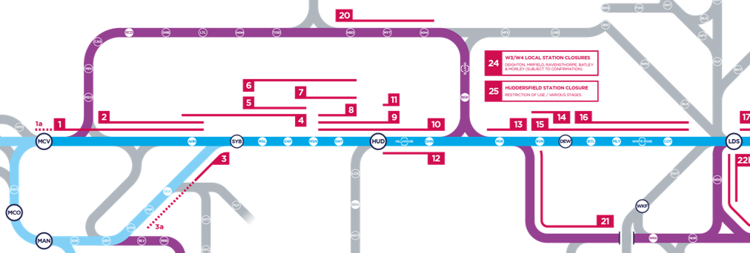
Key Customer Handling Plan Scenarios in 2023
Morley – 1st nine-day blockade (Feb 2023) is scenario 15 (Completed and lessons learnt compiled)
Stalybridge 26-day blockade (March/Apr 2023) is scenario 4 (Starts on 11th)
Morley – 2nd nine-day blockade (June 2023) is scenario 13 & 15 (1st two days) and scenario 16 for the reminder
Stalybridge to Huddersfield (Late Summer 2023 weekends, x11) is combinations of scenarios 2, 4, 6, 10 and 12
Notes:
These are the scenarios of access we expect. Each one has or will have a supporting customer handling plan

Slide 6
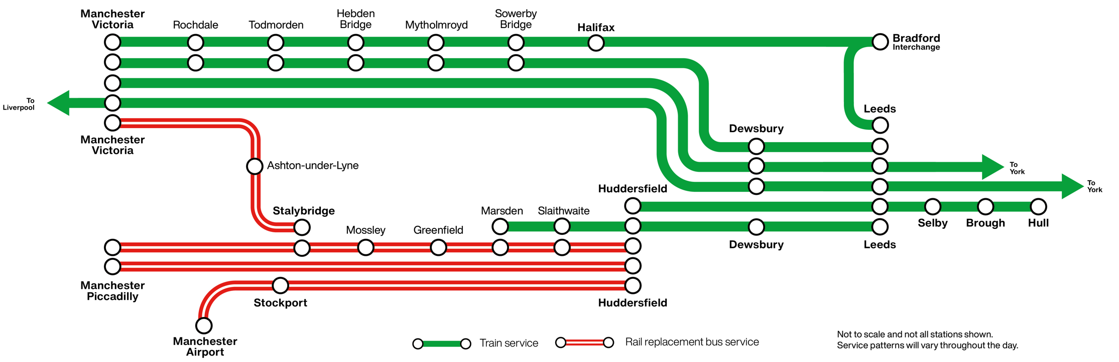
Starts with Train and Alternative Transport Plan
Stalybridge – March/April 2023
Notes:
Image 1 – Morley Artist impression
Image 2 – Dewsbury artist impression

Slide 7
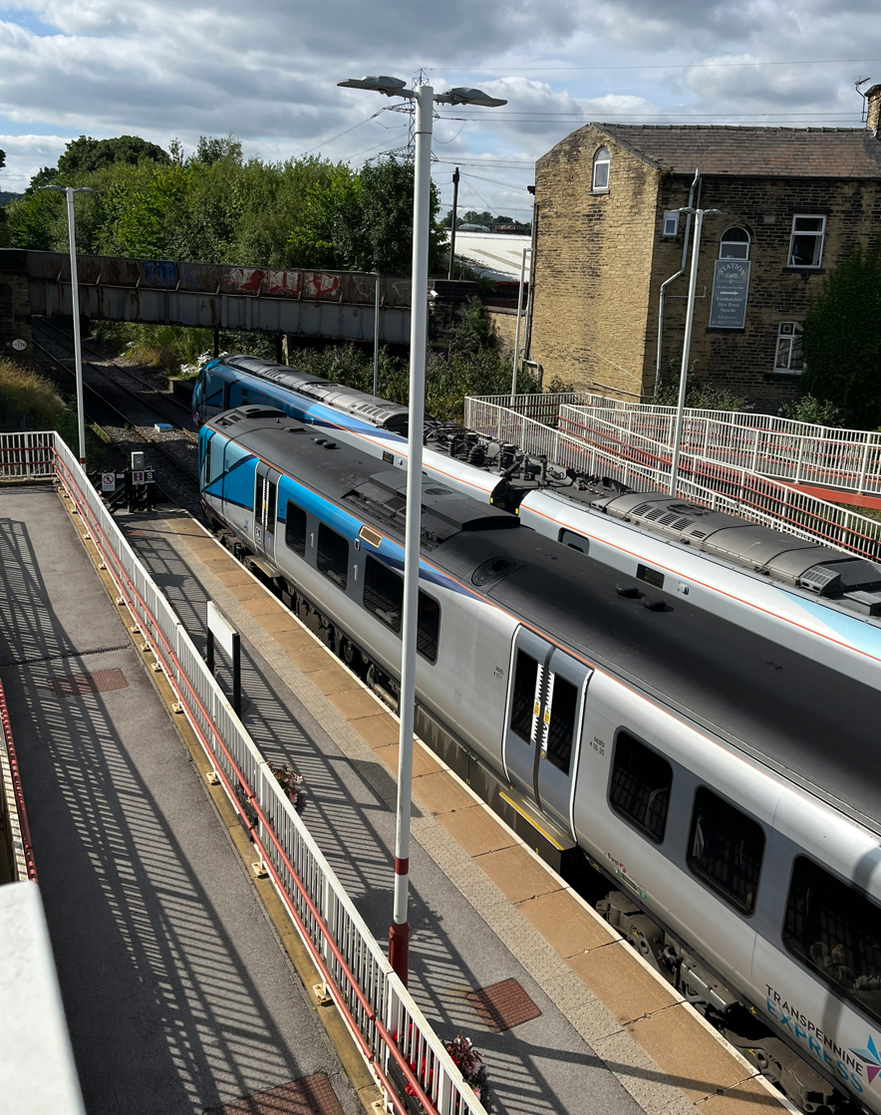
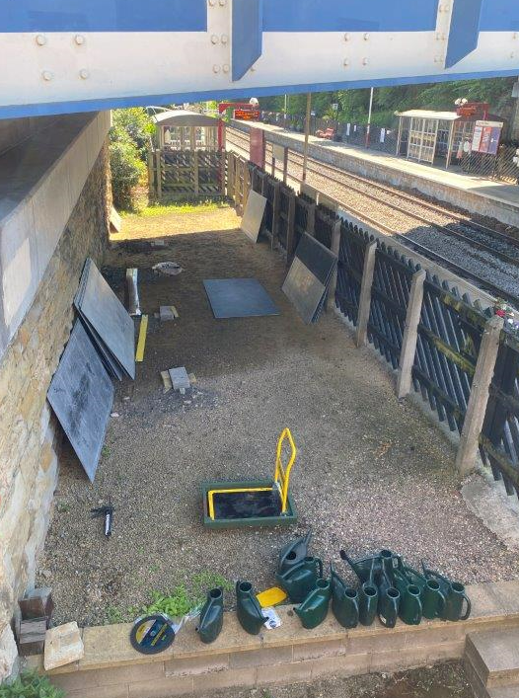
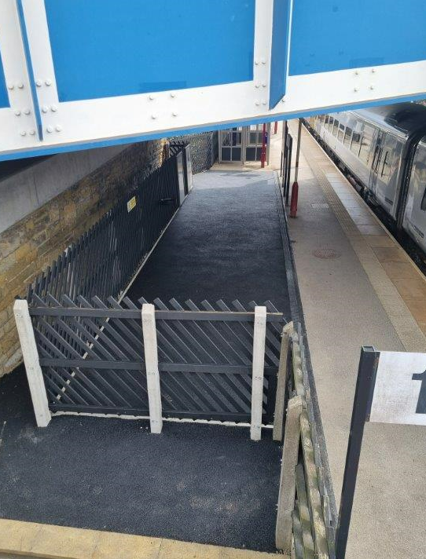
What we do to help Customers?
Deliver a suitable and consistent customer handling plan to all customers who are impacted by any planned disruption for every scenario using the customer manifesto in our planning. These involves lots of behind the scenes planning starting with the use of diversionary routes and improving key stations – this is Brighouse which was one of the first examples.
Notes:
Diversionary routes via the Calder Valley (Manchester to Huddersfield is blocked), Healey Mills (Dewsbury is blocked) and Castleford (Neville Hill/Garforth is blocked)
Brighouse – Two TPE services stopping and passing
Brighouse – Before and After work to increase the size of the waiting area after it was identified as being insufficient for dealing with the number of expected customers when used as a road/rail interchange as Huddersfield station was closed

Slide 8
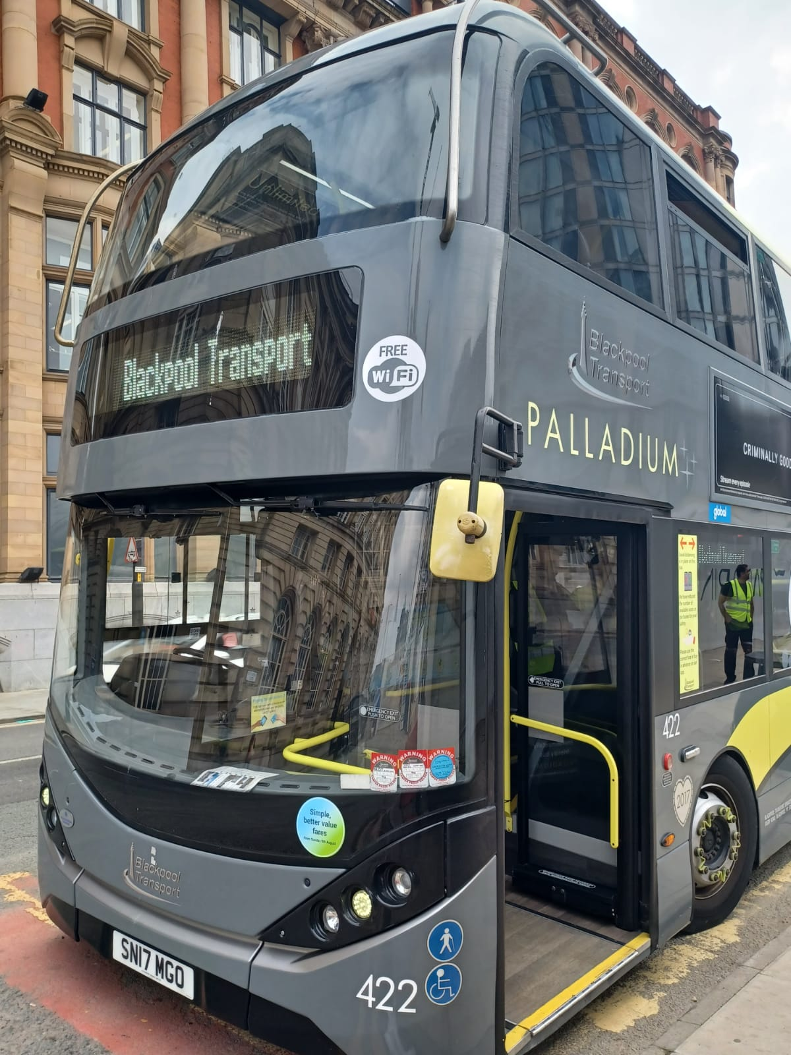
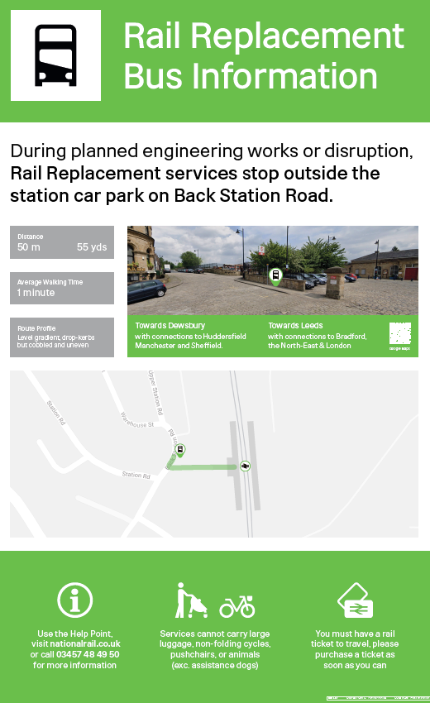
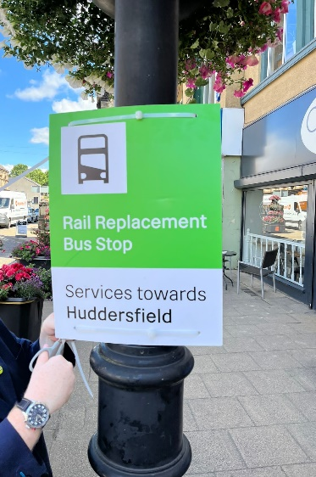
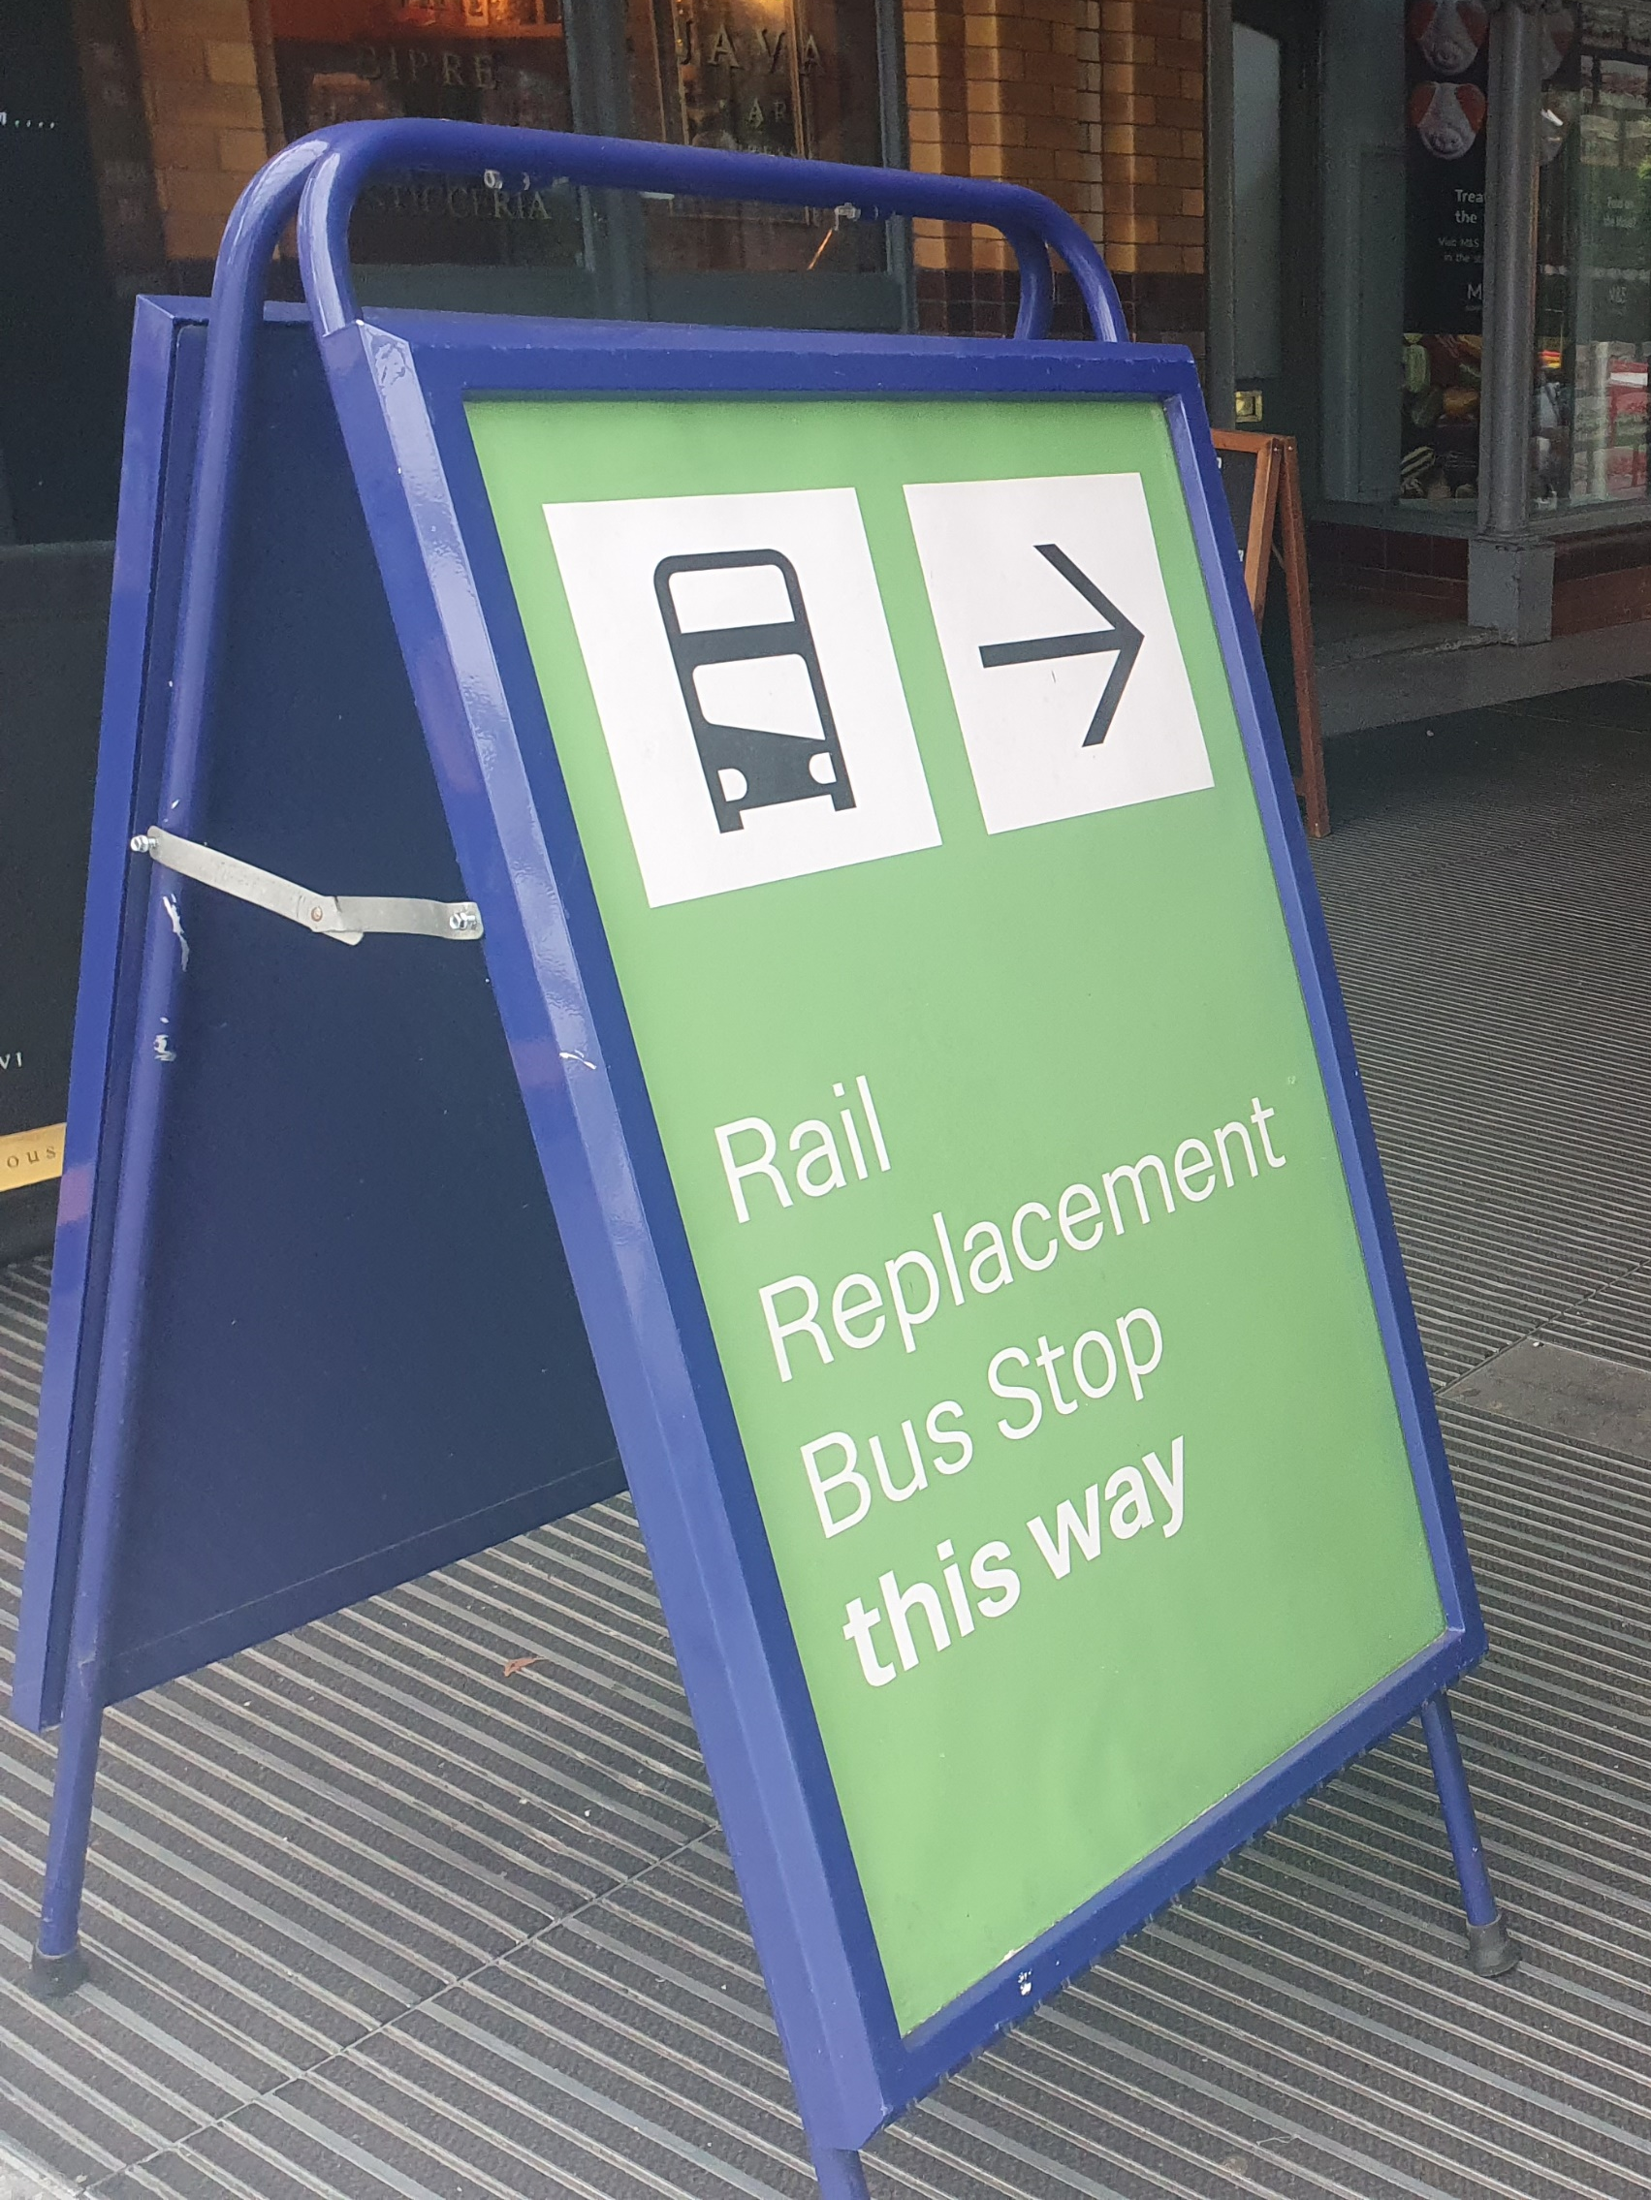
Use of Alternative Transport
Unfortunately the use of diversionary routes is not always possible so there will be alternative transport in use during the programme – the aim is high quality with clear signage to aid the customer.
Notes:
Montage of alternative transport at Manchester Victoria and signs/posters across the route.

Slide 9
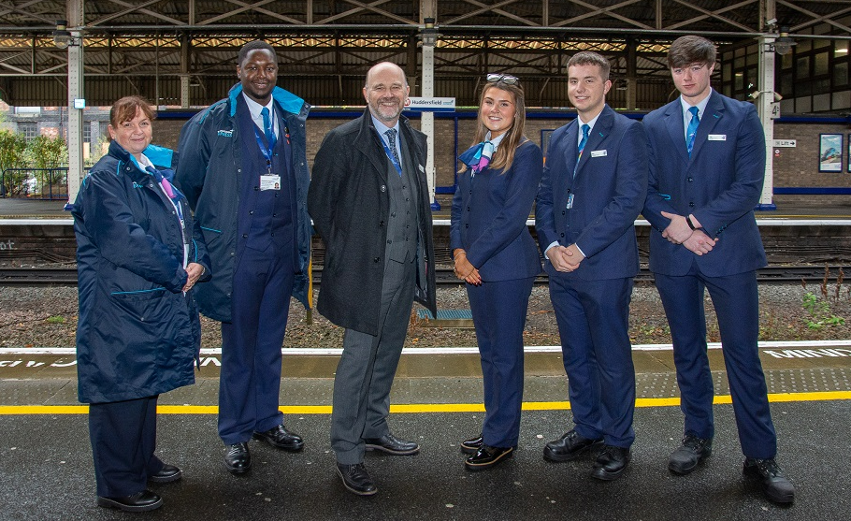
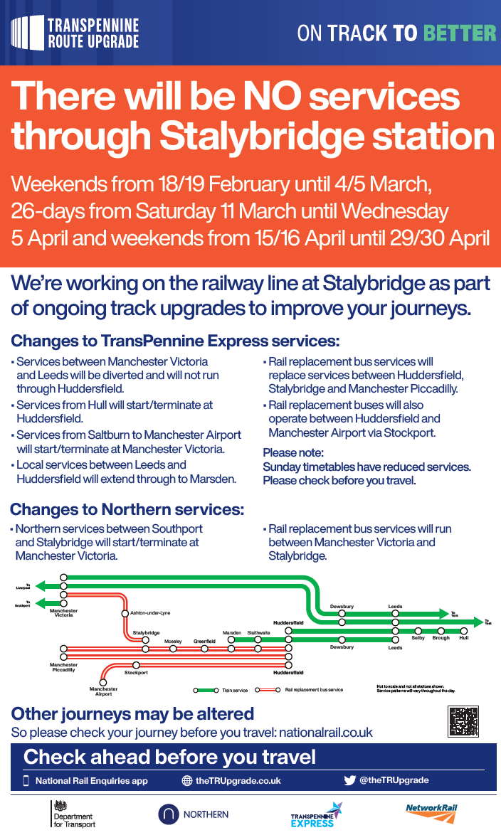
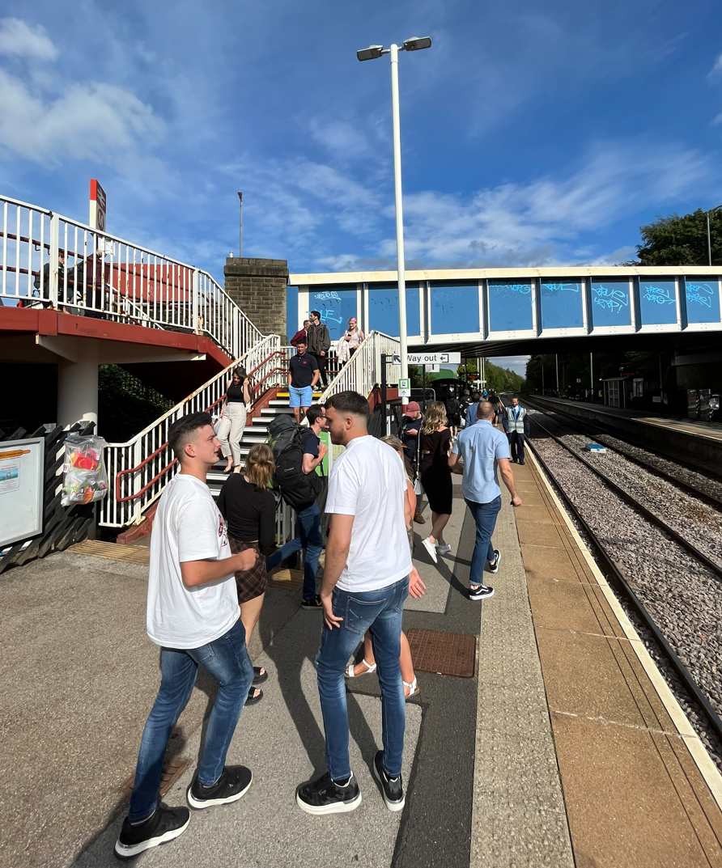
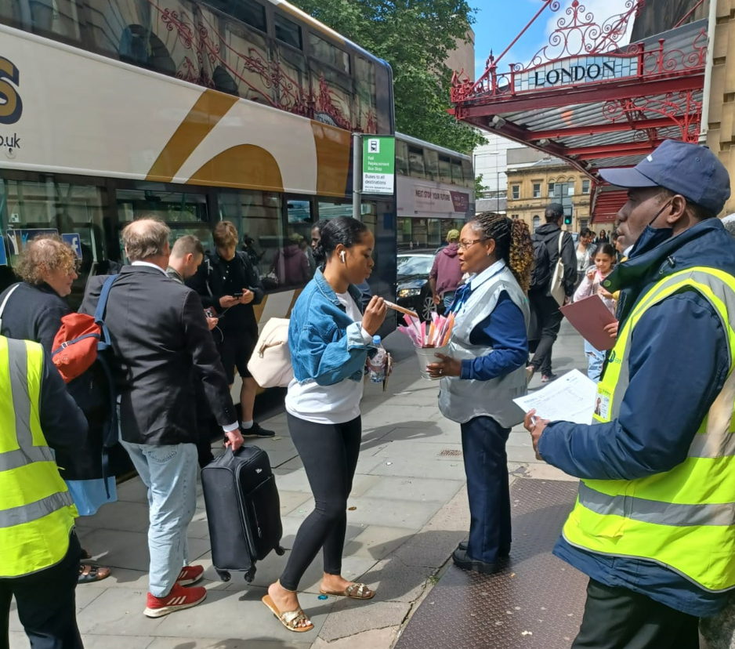
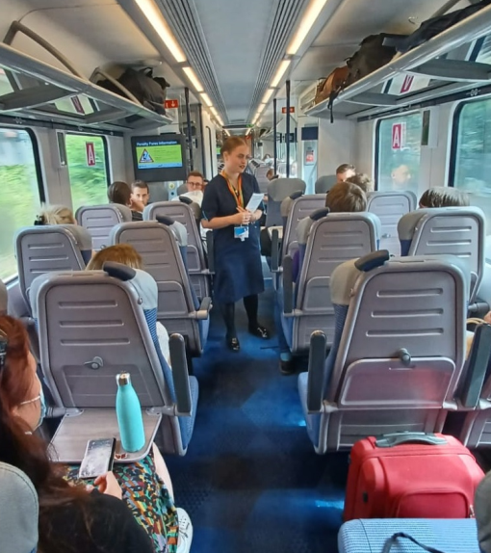
Communicating to Customers
Through all TRU will communicate to its customers through a dedicated team of Customer Delivery Managers on trains, on stations and where alternative transport is required with a lead role providing co-ordination at key locations between all parts of the industry.
Notes:
Montage of picture demonstrating talking to customers and Matthew Golton…..

Slide 10
Thank you

