Slide 1
West Coast Partnership
Business Update – TravelWatch North West
March 2023

Slide 2

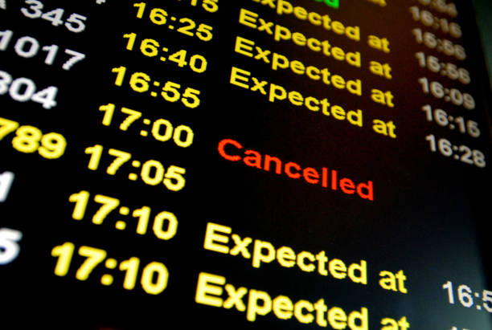
Avanti West Coast - bringing
people, places and possibility together

Slide 3

December 2022 Timetable
Significantly more seats and services across the network - 1,789 services, 146,000 seats (typical week).
Moved from short-term planning to a more stable long-term plan.
Manchester back to 3tph.
Provision for 2nd Liverpool service and Liverpool South Parkway.

Slide 4
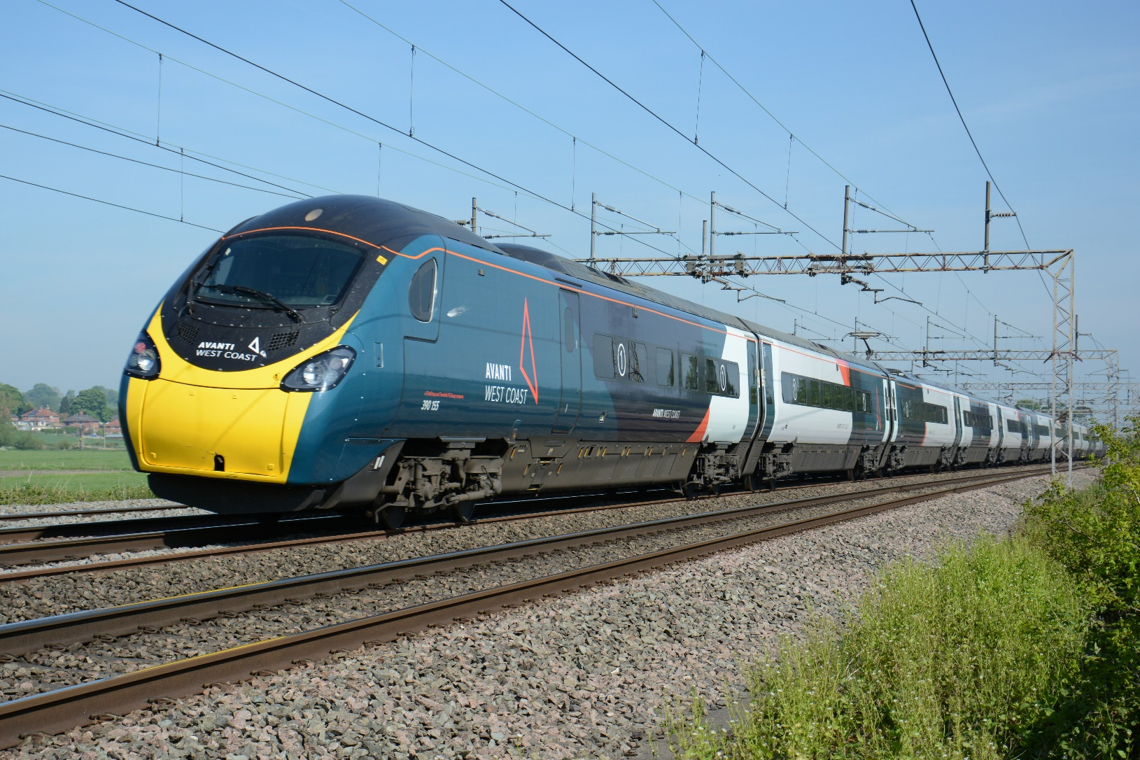
Performance
Challenges – industrial action, infrastructure, weather, sickness.
Steadily improving picture across the network – reduced cancellations and overcrowding.
Still work to be done.
May 2023 - adding resilience and flexibility for Hitachi fleet.

Slide 5
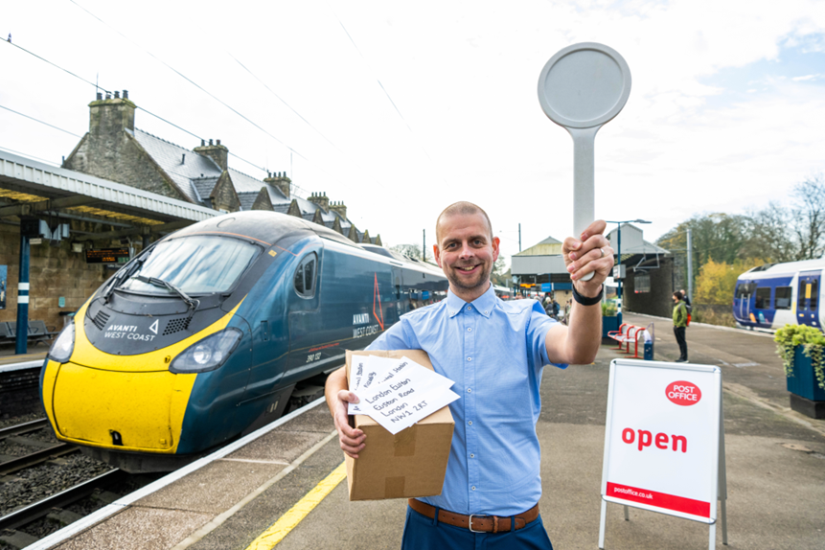
Station Development
  Wigan - enhancements to frontage of station and improve walking links.
  Stockport – working with Stockport Council and Network Rail to improve accommodation, retail space and passenger facilities.
  Oxenholme – outreach Post Office opened at station - trial to establish demand.

Slide 6

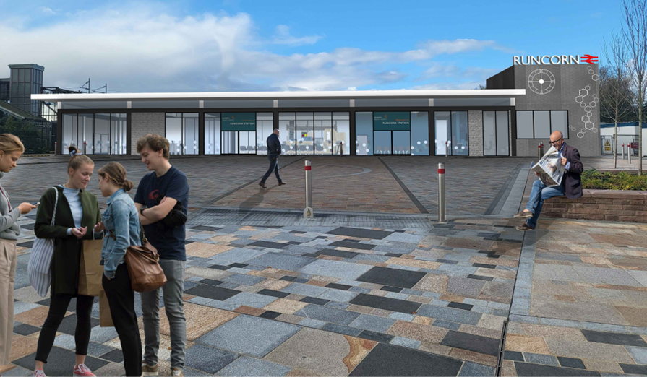
Station Development
Manchester Piccadilly - Cycle Rail grant secured from Sustrans for new cycle parking across four locations at Manchester Piccadilly.
Runcorn Station - comprehensive redevelopment of station improving facilities for passengers and customers.

Slide 7
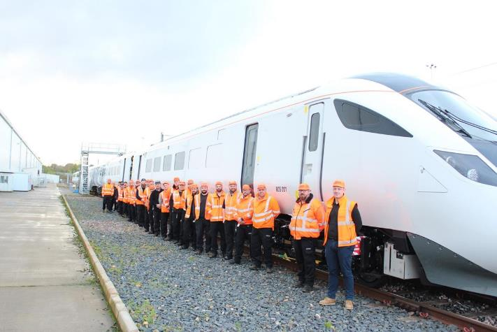
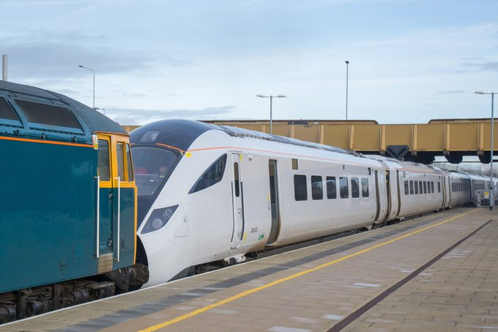
Hitachi
New fleet of electric and bi mode Hitachis (£350m) will enter into service this year.
Will serve North Wales, Liverpool and Midlands.
Predicted carbon emissions reduction in using new fleet is 72%.
First train has moved to Oxley depot for line testing and for full fit out.

Slide 8
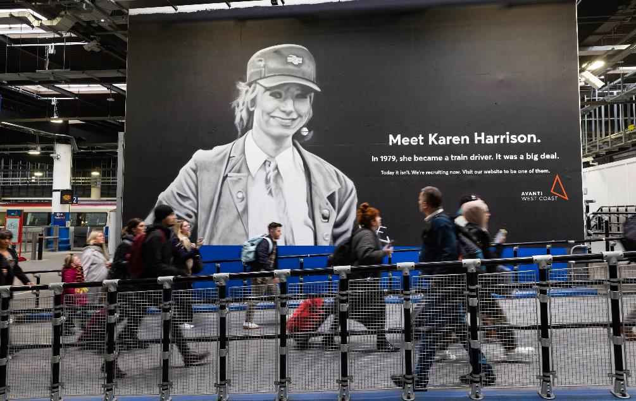
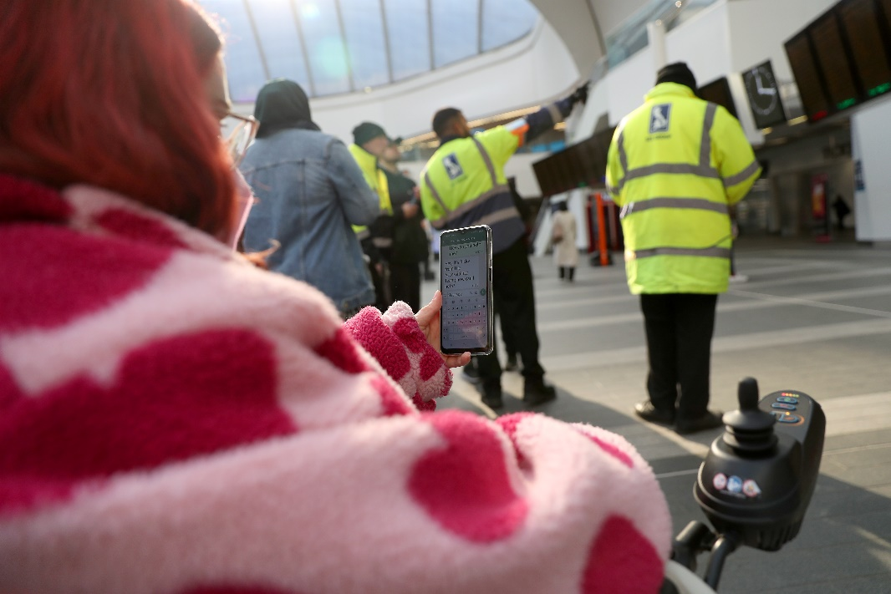
Driver Recruitment
2023 will see Avanti West Coast’s biggest ever driver recruitment push.
50% of Avanti West Coast’s driver recruits will be women by 2030.
Applications opened on 28 February.
Travel Companion
Dedicated communications channel providing disabled customers with instant help during their journey.
Uses WhatsApp to connect passengers to specialist support – 07980 037 037.
Safety net if the unexpected happens.

Slide 9
Thank you

