Slide 1
Merseyrail: Delivering a railway our
city region can be proud of
Jane English
Acting Managing Director

Slide 2
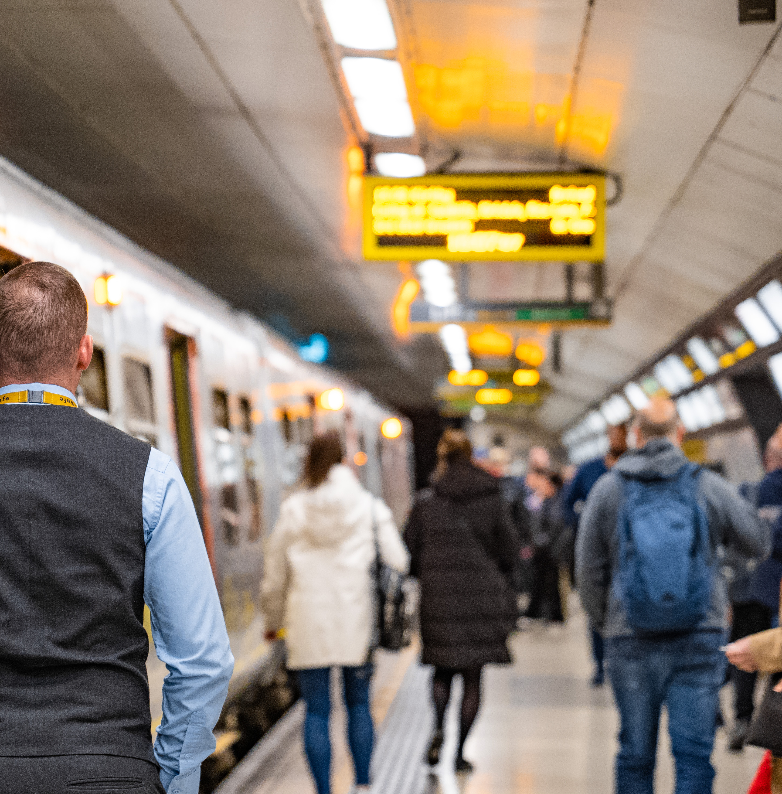
Current performance
A challenging period of extreme weather, industrial action and skip stopping across the network
Working in close partnership with stakeholders, we have managed to overcome many of these issues
The last six weeks have seen our performance return to the pre-pandemic levels

Slide 3
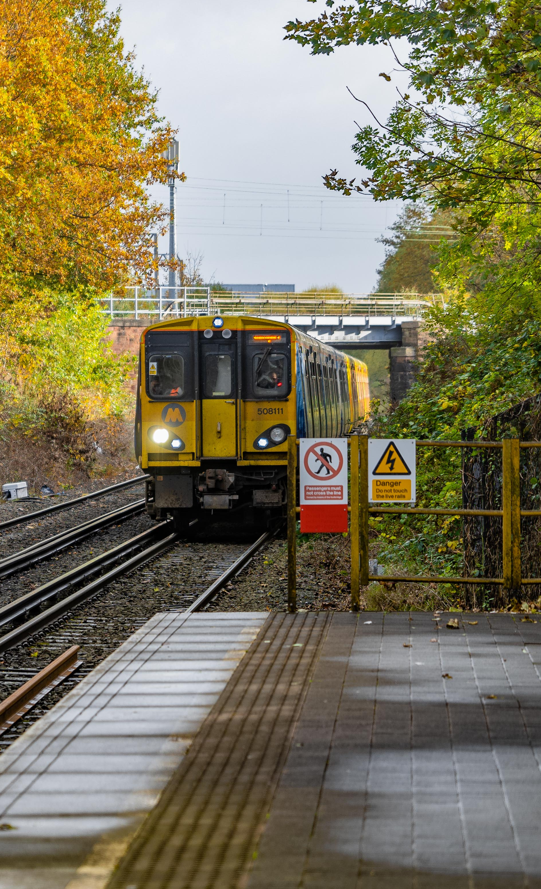
Current performance: Why skip stopping?
To improve the reliability of services and reduce levels of disruption seen before the measure was introduced.
This will mean a more reliable service for all passengers.
Reducing the frequency at the two stations with the lowest footfall means we can improve the punctuality of services on this part of the network as a whole

Slide 4
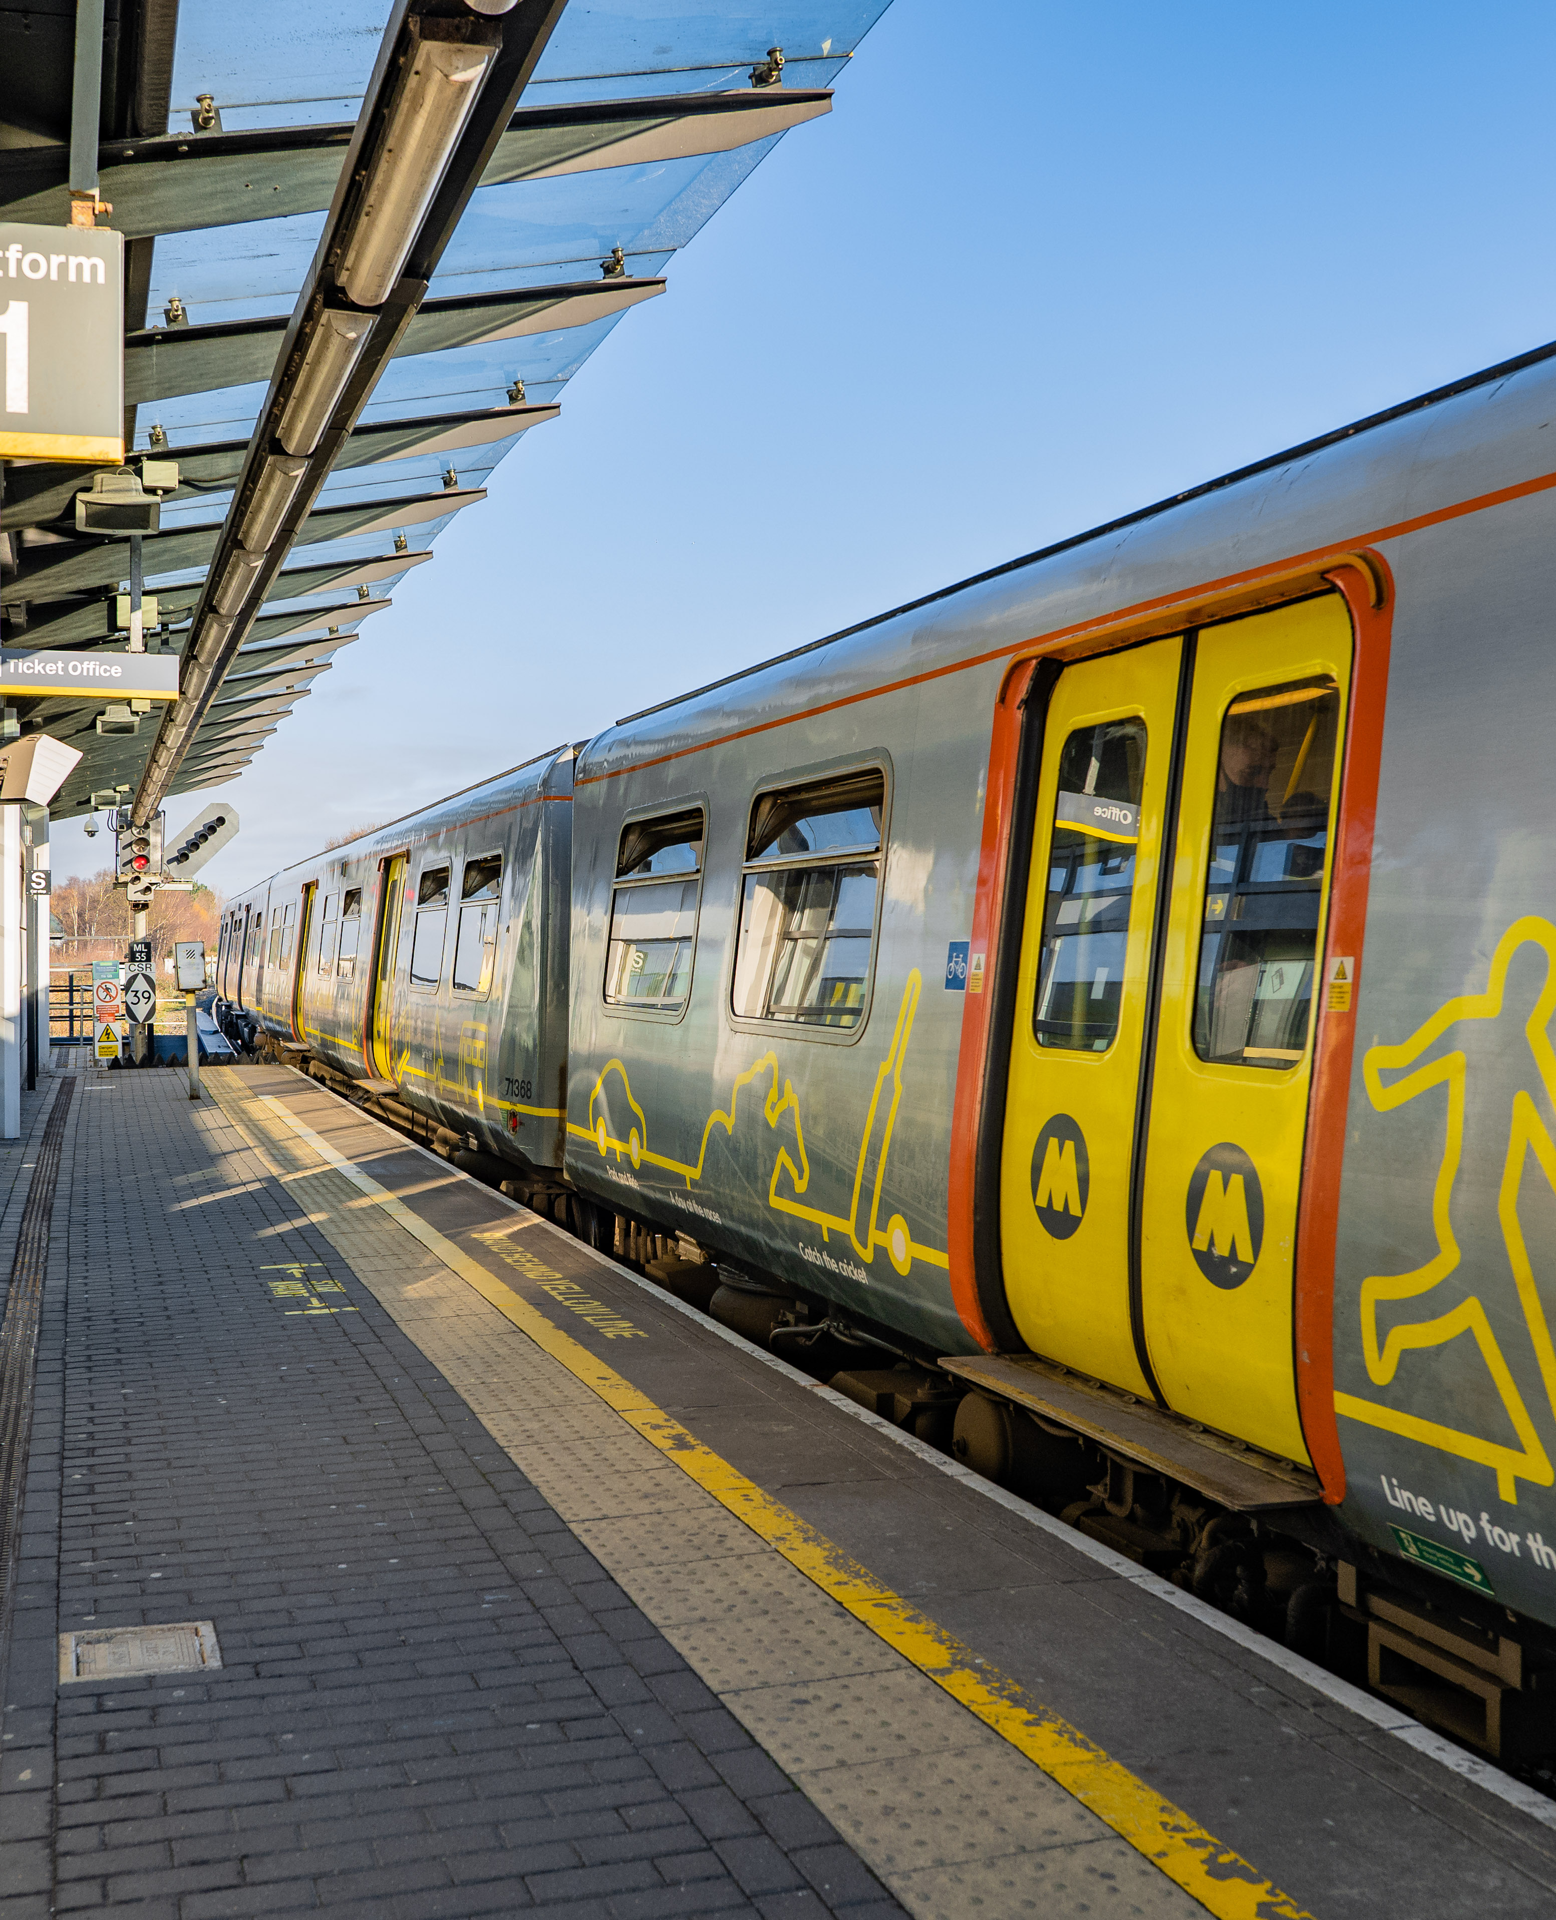
Industrial action and our response
We are not on strike!
RMT Union – early July agreement secured, ending several years of negotiation
UK national strikes impact Network Rail staff, who we rely on to operate signalling
However, we are still able to provide an hourly service on strike days

Slide 5
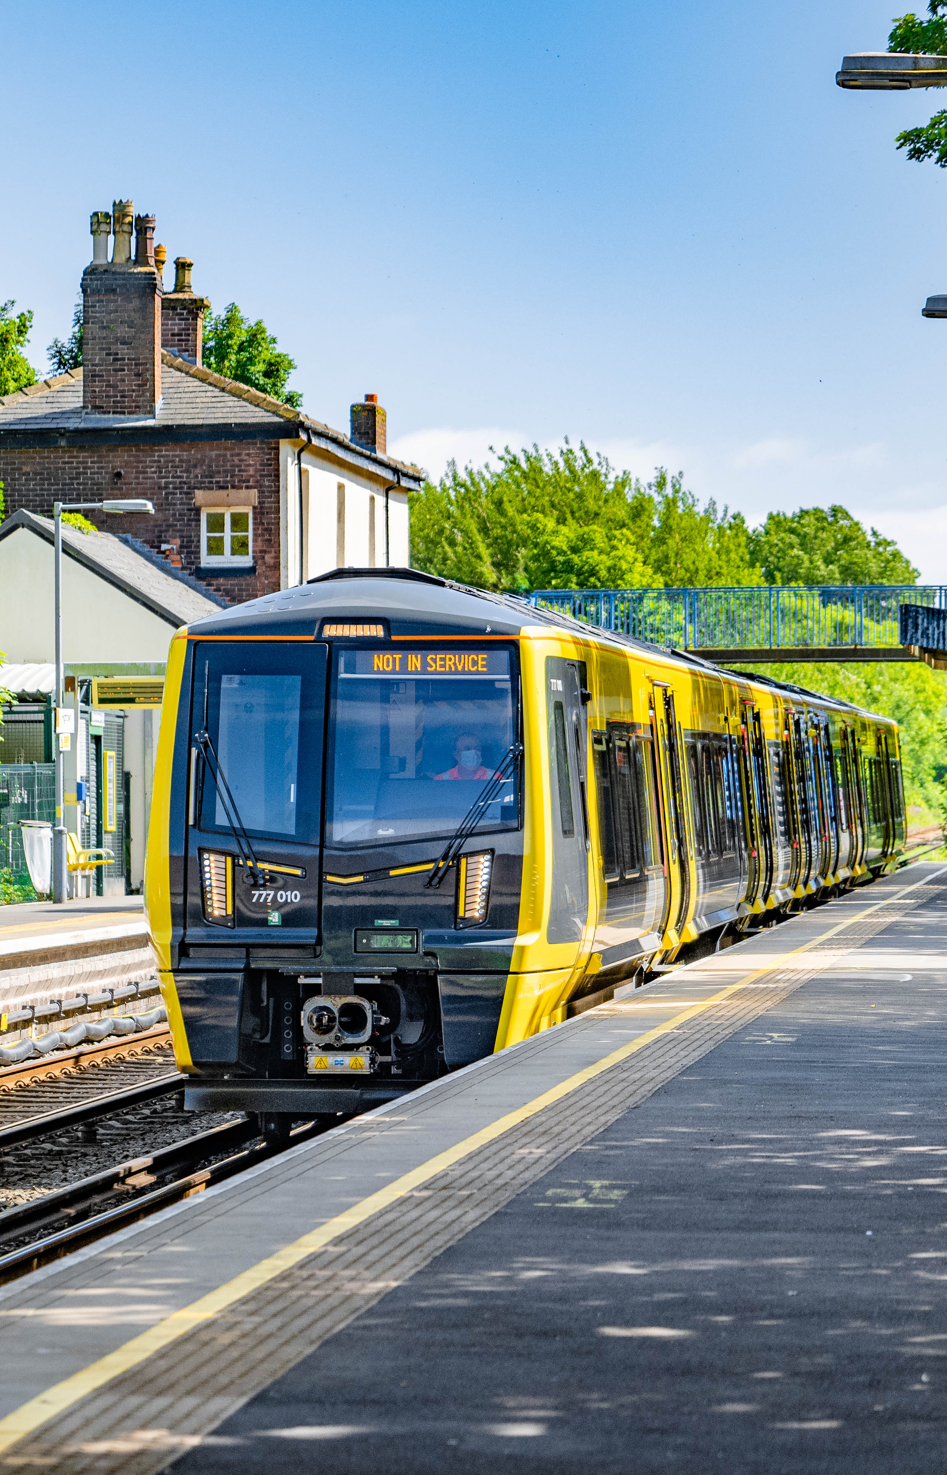
New trains
New trains currently being built and delivered from the manufacturers in Switzerland and Poland
17 now in Liverpool City Region and being tested for performance and endurance
Roll out of new trains to begin
end of the year. Battery-powered units give option of opening new routes in the longer-term

Slide 6
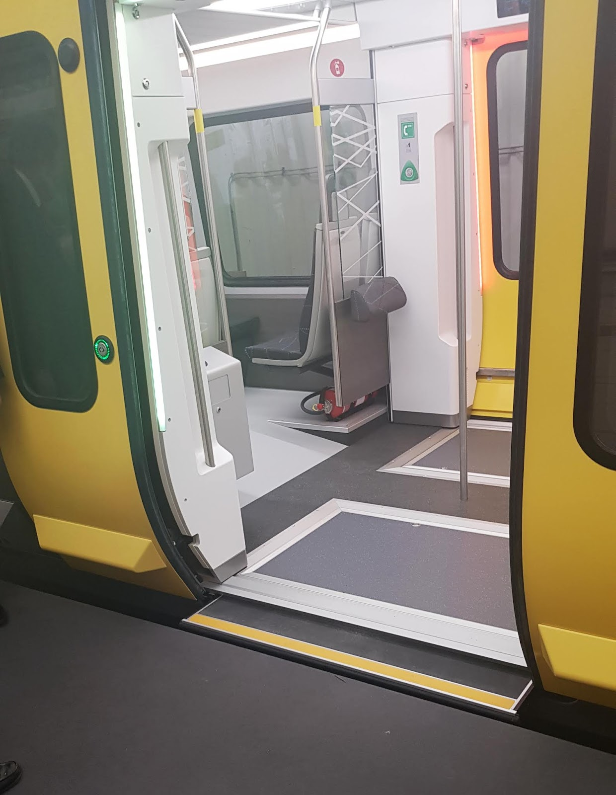
New trains will mean
Level-boarding to and from every platform on our network
More space for cyclists to store bikes, more space for disabled passengers or people with children’s buggies.
Increased passenger capacity

Slide 7
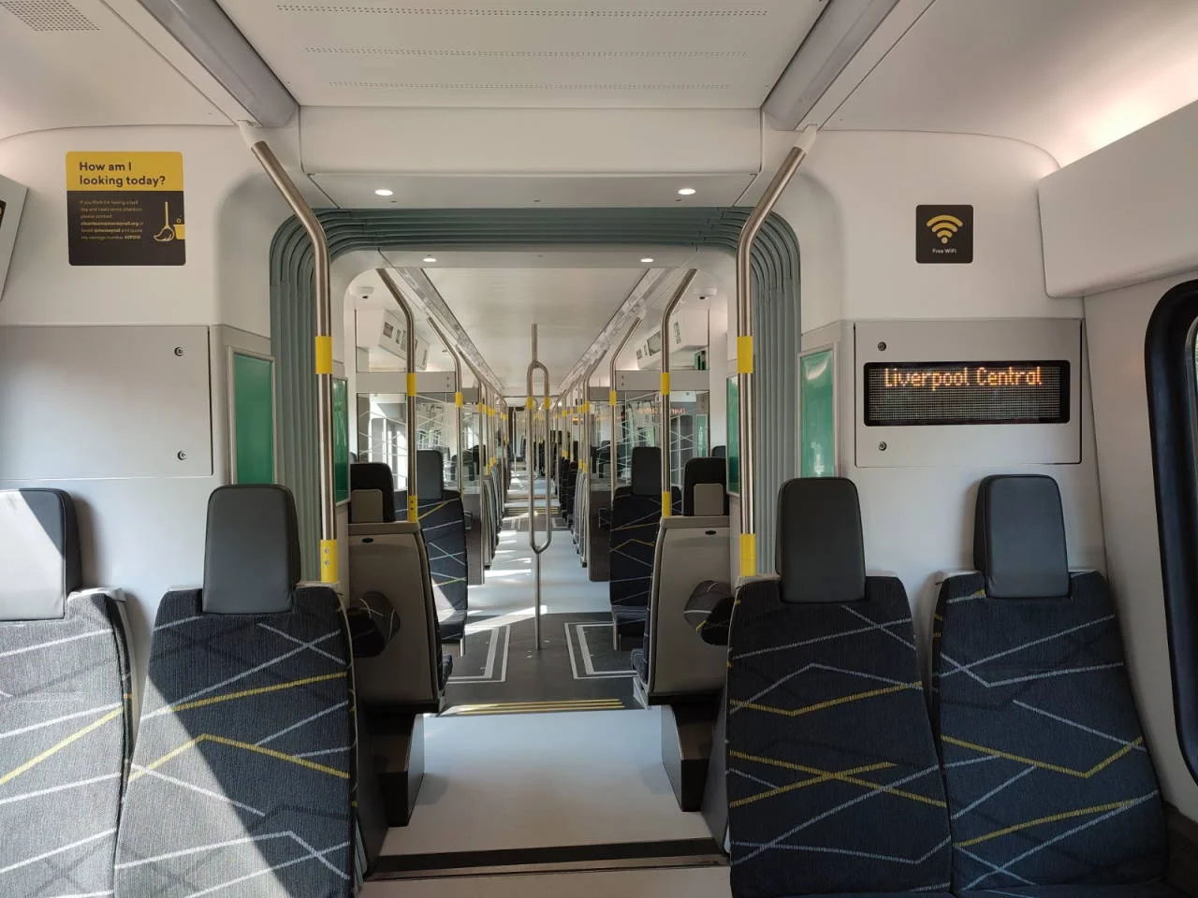
New trains: What you will notice
Quieter performance
Smoother ride
Air conditioned carriages
Plugs for charging phones
Modern, light and airy, with good visibility right down the train

Slide 8
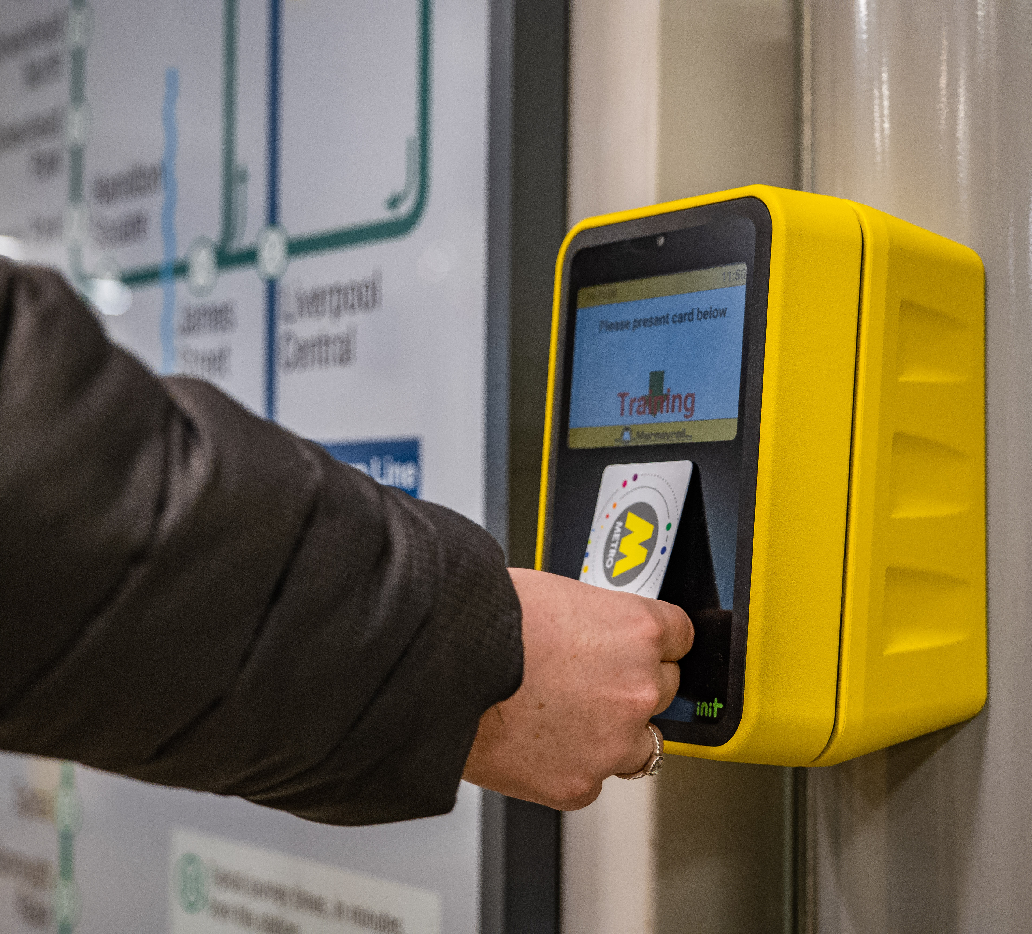
New ticketing
Passengers want the quickest, most convenient way to access our services, and we’re working hard with Merseytravel to ensure Liverpool City Region gets the best ticketing system in the UK

Slide 9

New ticketing
We have already introduced a tap and go system for Merseyrail Only Railpass – covering weekly, monthly or annual passes. So there’s no need to queue at stations on a Monday morning!

Slide 10
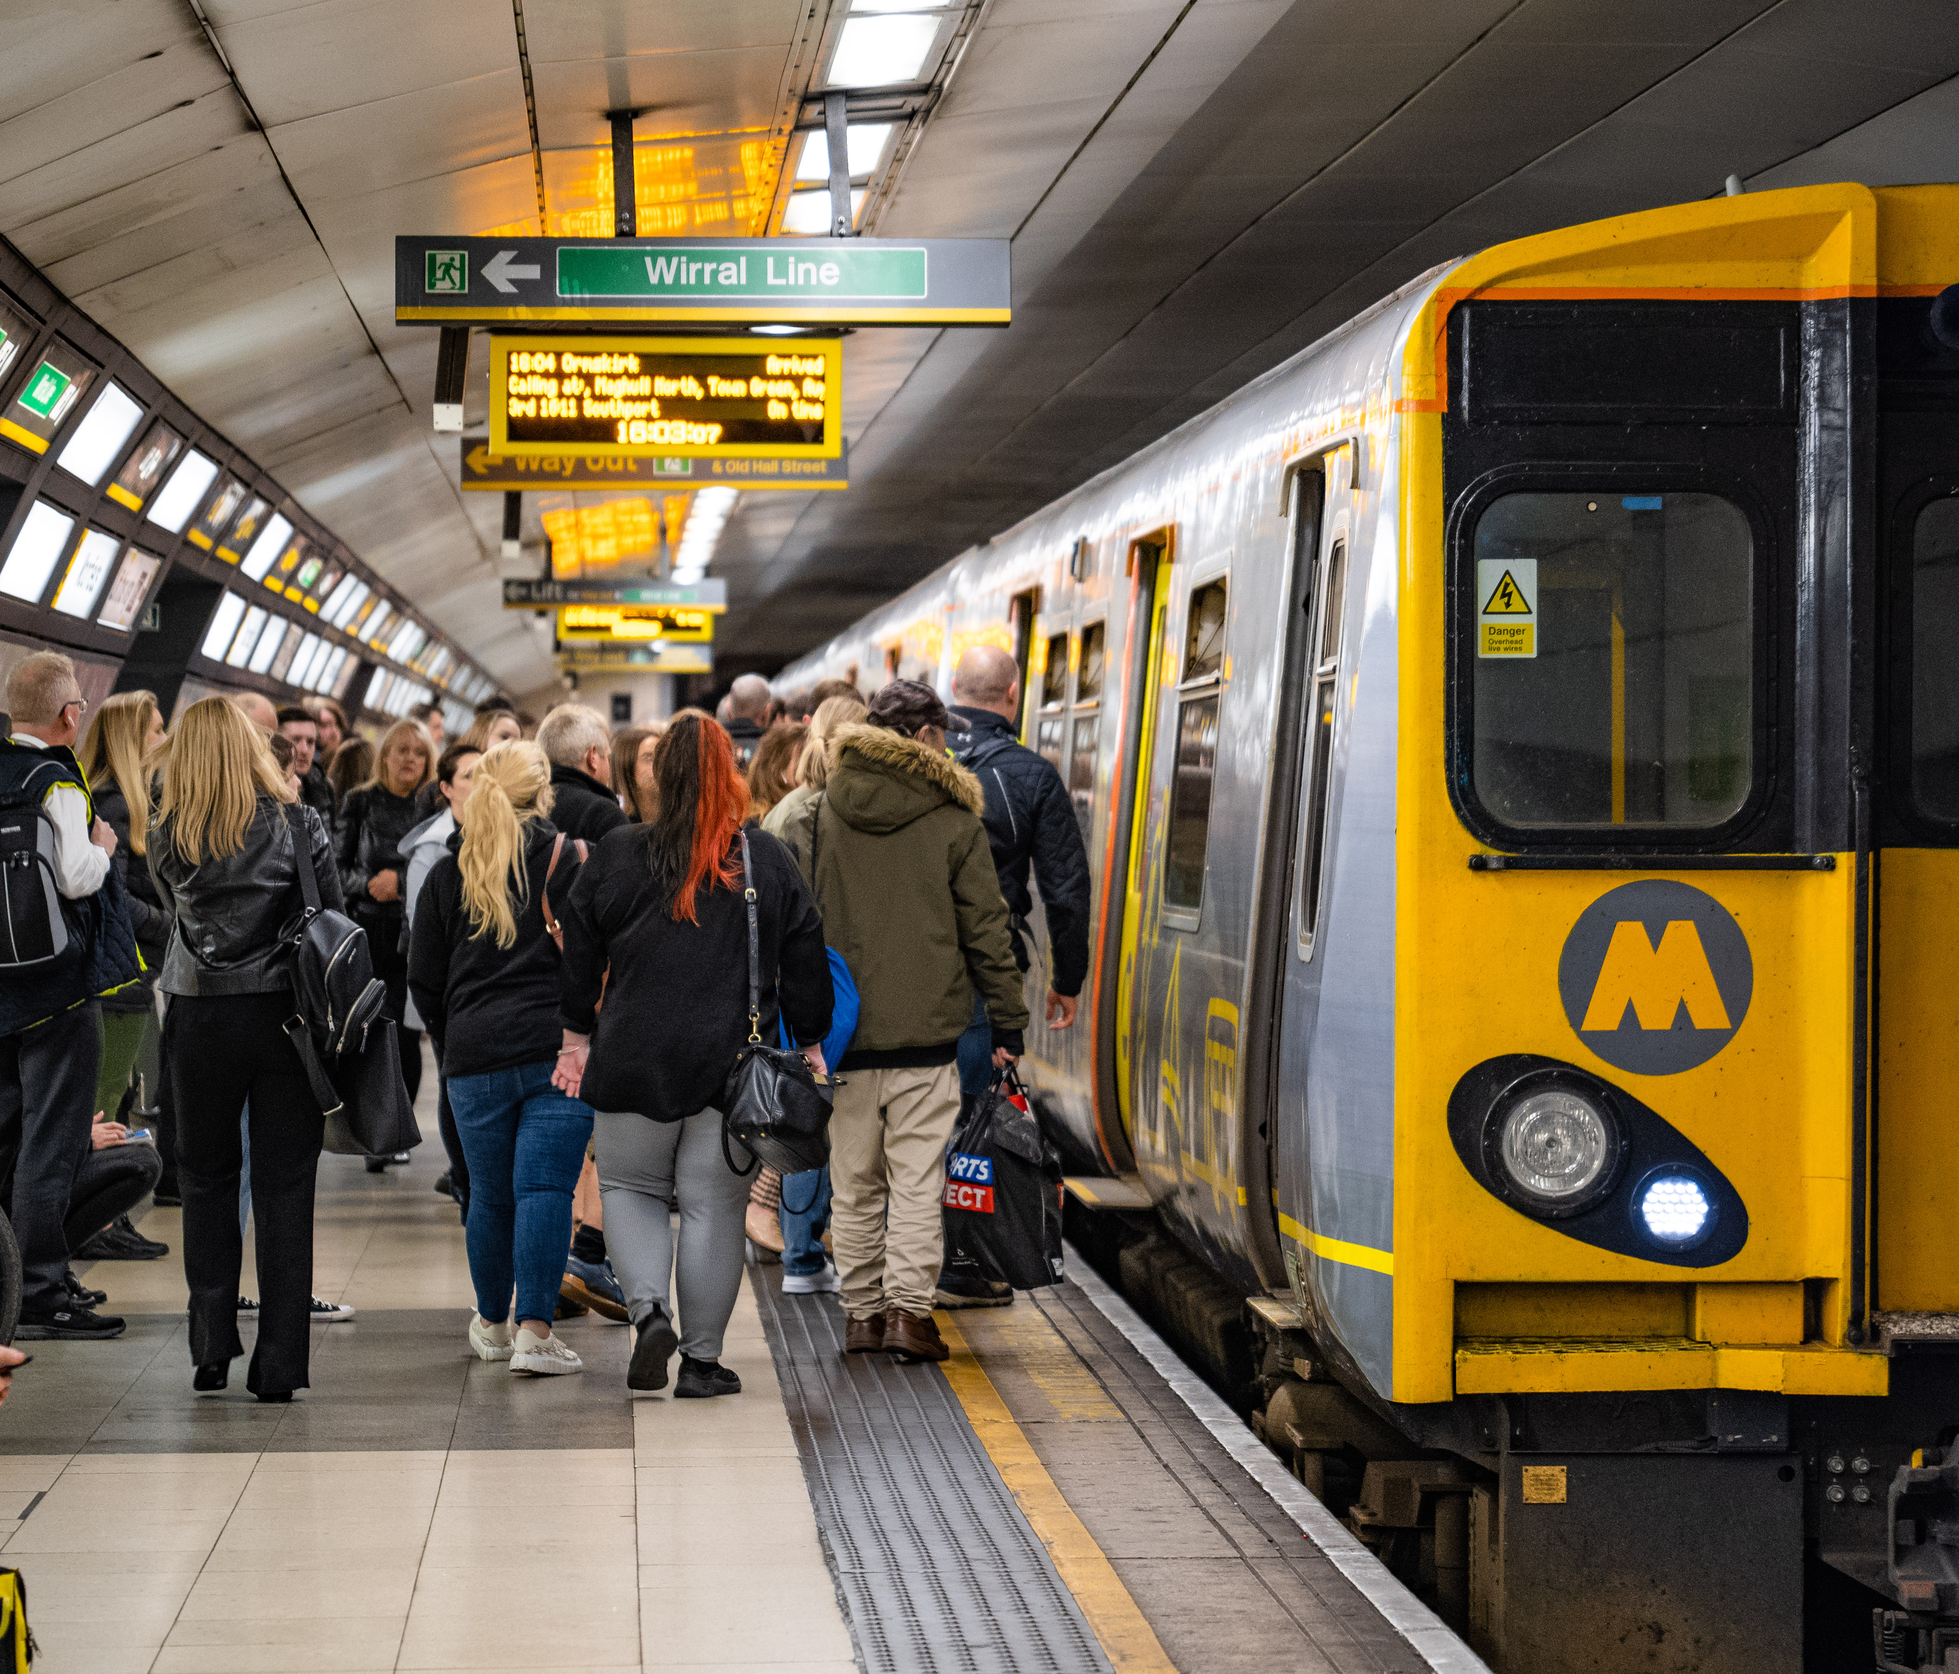
New ticketing
We are working with Merseytravel to introduce a new tap-in, tap-out system similar to the one that exists in London.
We will also be introducing barcode ticket technology.

Slide 11
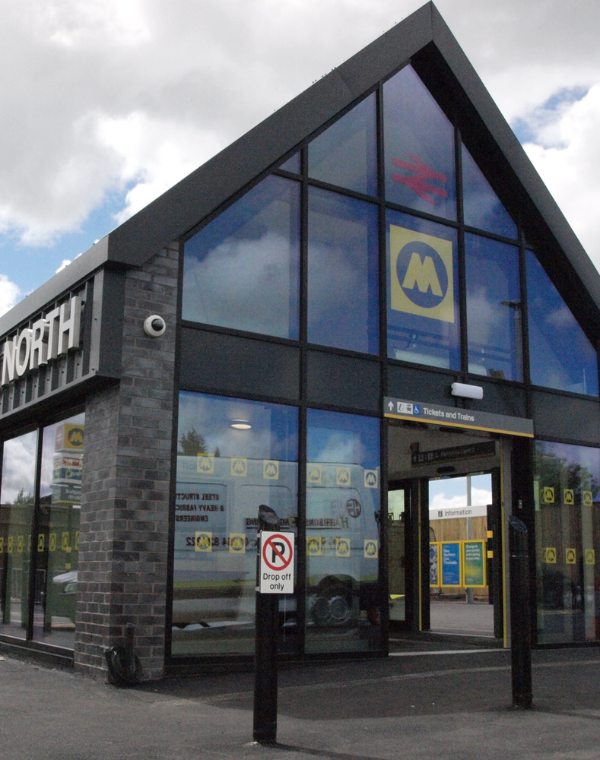
New stations
Expanding and growing the Merseyrail network is key to the continued success of our network.
In recent years we have opened Maghull North station, serving a large residential area that was previously isolated from Maghull Station.

Slide 12
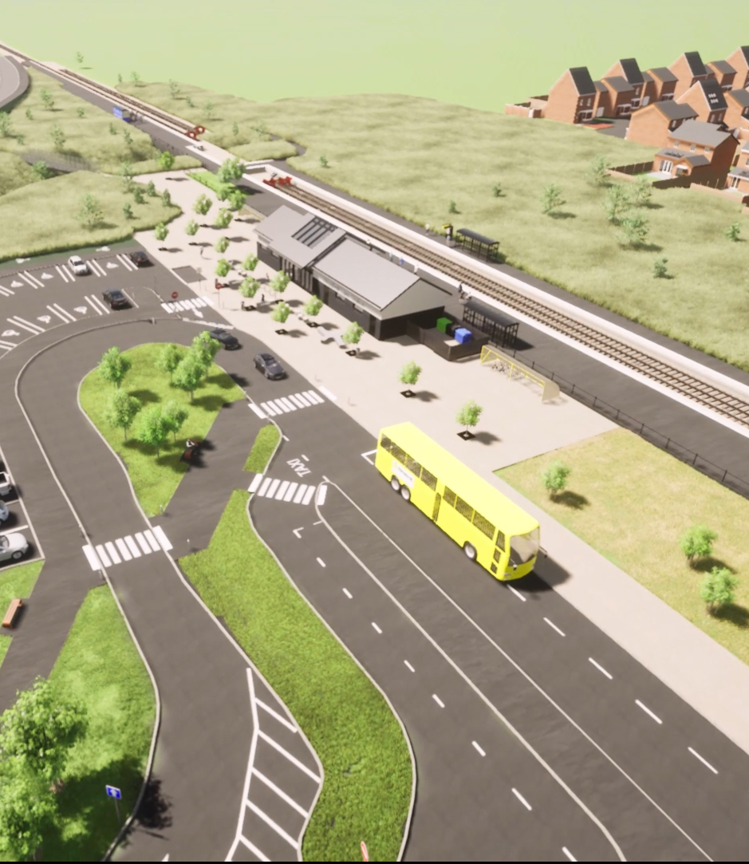
New stations
In Kirkby we will be opening Headbolt Lane station in Summer 2023.
Huge leap forward for Tower Hill, an area of massive housing growth in recent years.
Opportunity for this line to be extended to serve Skelmersdale – largest UK town with no rail service.

Slide 13
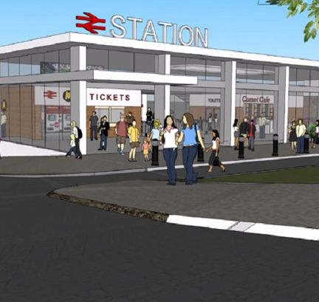
New stations
Also scheduled for addition to our network is Liverpool Baltic – the reopening of a station that has remained closed for over a century.
This new station will help boost the dynamic Baltic area of the city.

Slide 14
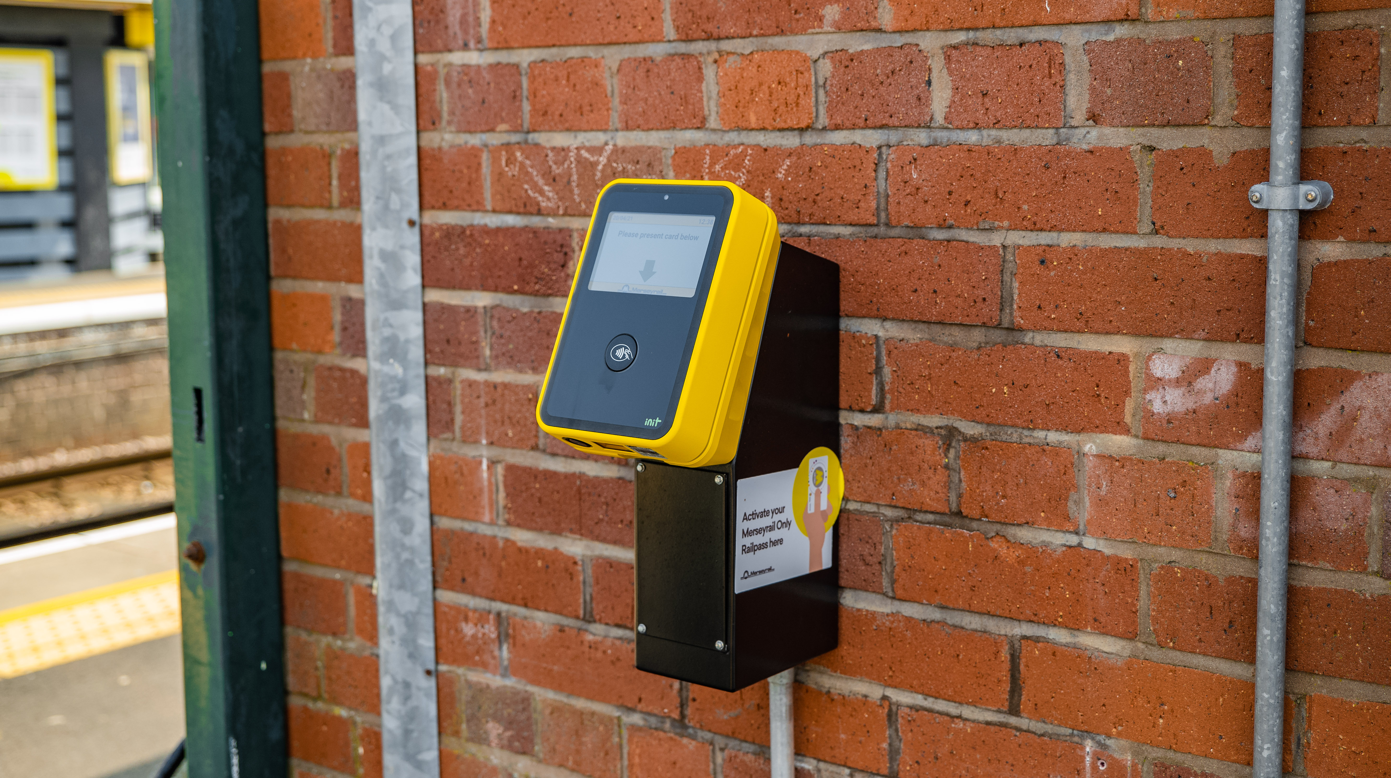
New website
From next year we will also be launching a new website.
The website will provide the support that all the other ticketing modernisation projects will be built on.

Slide 15
Any questions?

