Slide 1
Transport in the Liverpool City Region
Liam Robinson
Portfolio Holder for Transport and Air Quality
Liverpool City Region Combined Authority
20 October 2022

Slide 2
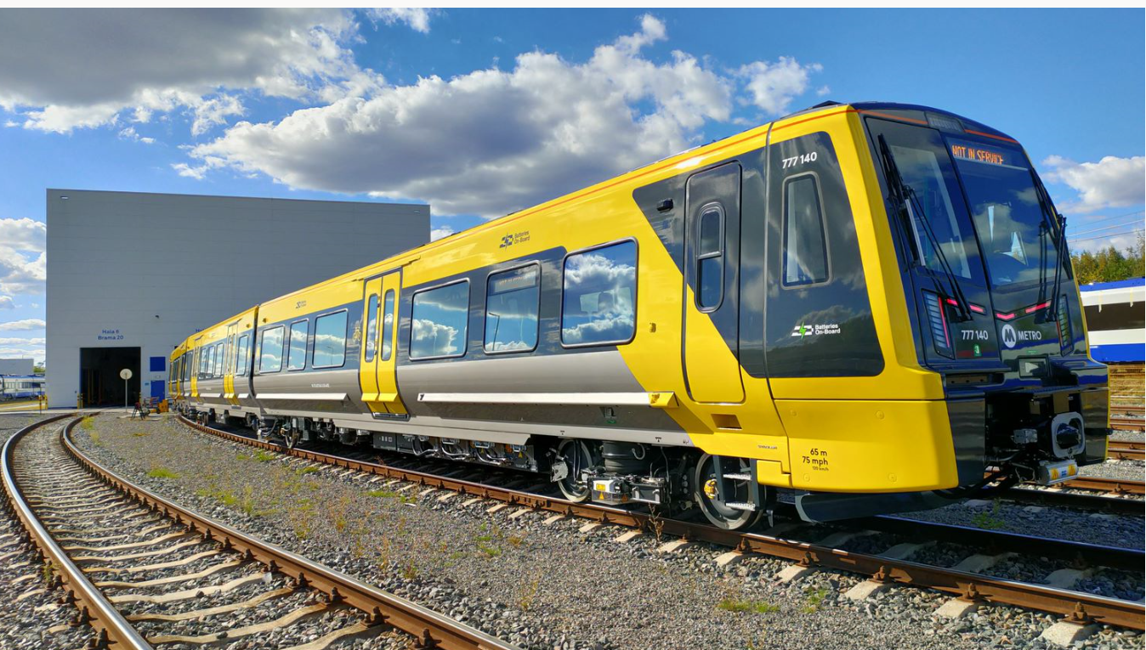
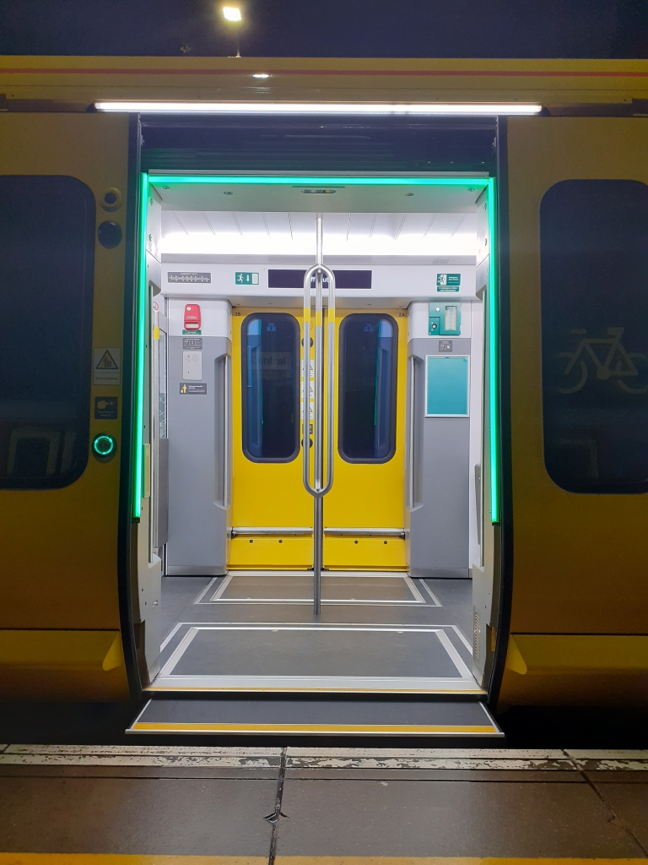
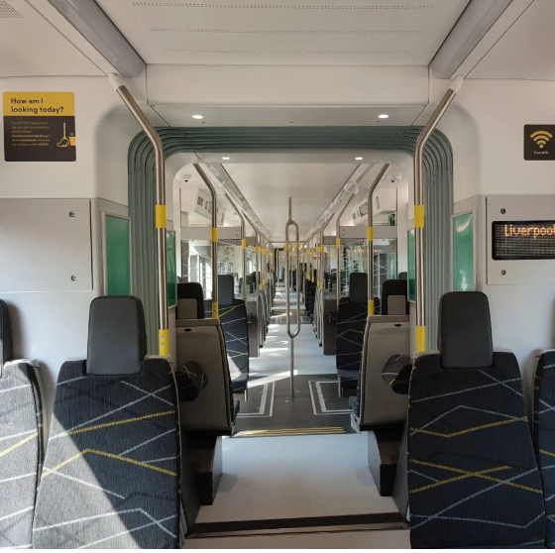
Rail Network
Affordable:
Develop Smart Ticketing solutions to cover wider travel to work areas and local leisure markets, including use of Tap and Go – to give users cheapest fares for their journeys
Integrated ticketing covering bus and rail
Special offers e.g. for apprentices, students to enable people to access jobs and study
Merseyrail fares and tickets have been pegged with RPI since 2003
Accessible:
Class 777 incorporates sliding step technology providing level access from the platform onto the train making it fully accessible without the need for ramps
Modern Reliable Trains:
The Merseyrail Network will be service by new rolling stock, Class 777 which is currently being introduced into service
Safe and Secure:
All trains to have on-board staff from first to last service
All stations meet Secure Station standards and are fitted with CCTV & Help Points
All car parks upgraded to Park Mark standard
New trains designed to be clear and spacious with through carriage design to improve passenger feeling of security. On-board real time CCTV links to control centre and there is an on-board help point
Sustainable:
For our new station, Headbolt Lane, a decision has been made not to extend the 3rd rail, but to utilise latest battery drive
Independently Powered Electrical Multiple Unites (IPEMU)
Catalyst for future regeneration of the city region

Slide 3
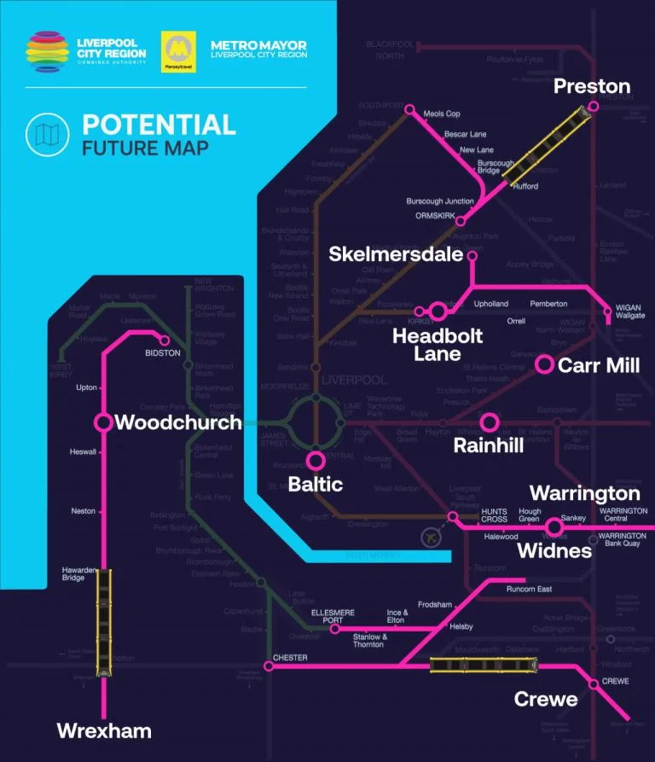
Merseyrail for All
Battery Trial Successful – will fund via CRST allocation
Headbolt Lane New Station planning application passed and work now on site
Looking to accelerate MOU with DfT on local control of the infrastructure
Will look towards future option of Merseyrail in the public sector
Investigate options to re-map some Northern local services into Merseyrail

Slide 4
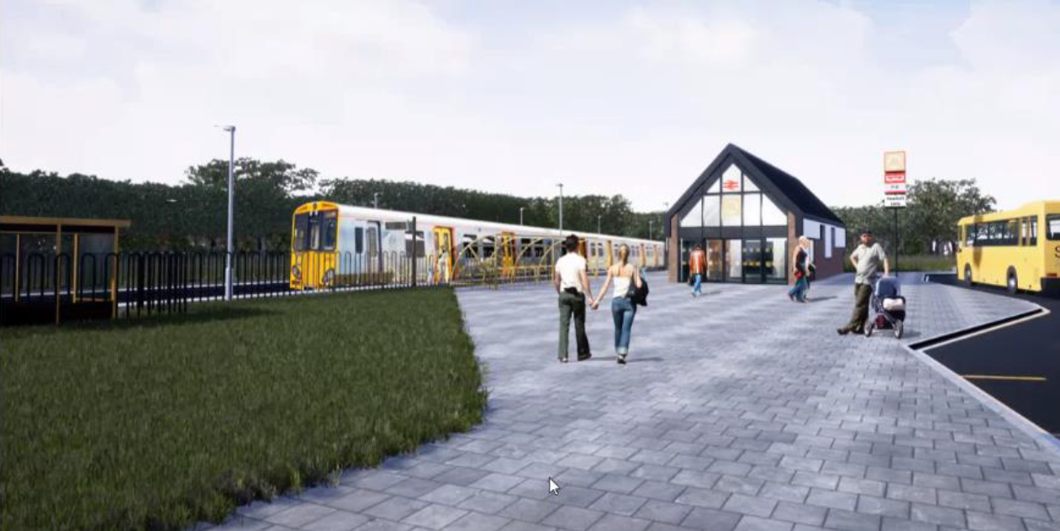
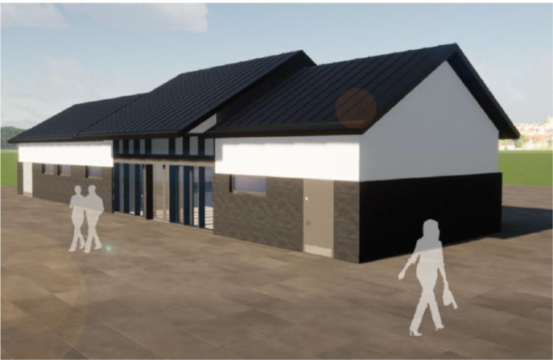
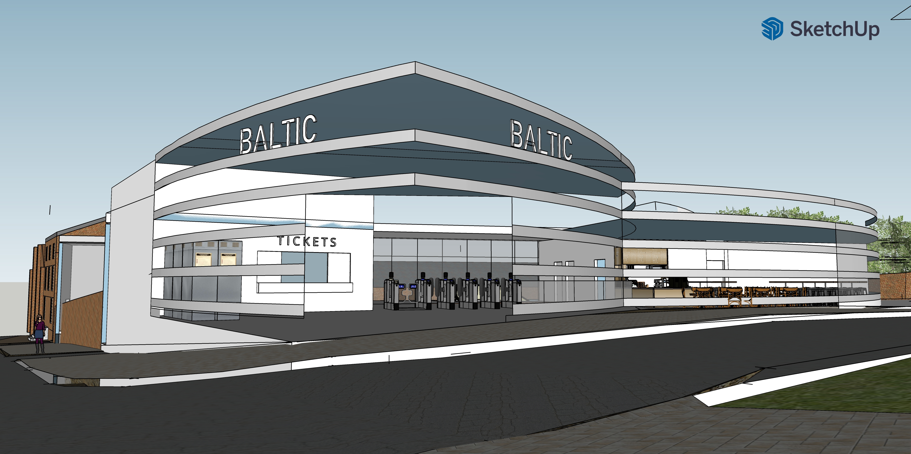
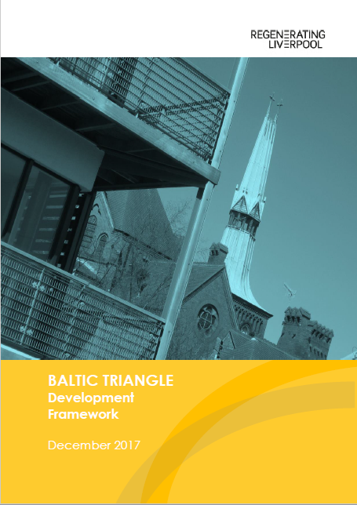
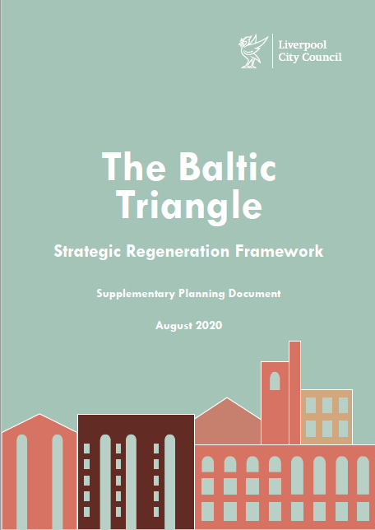
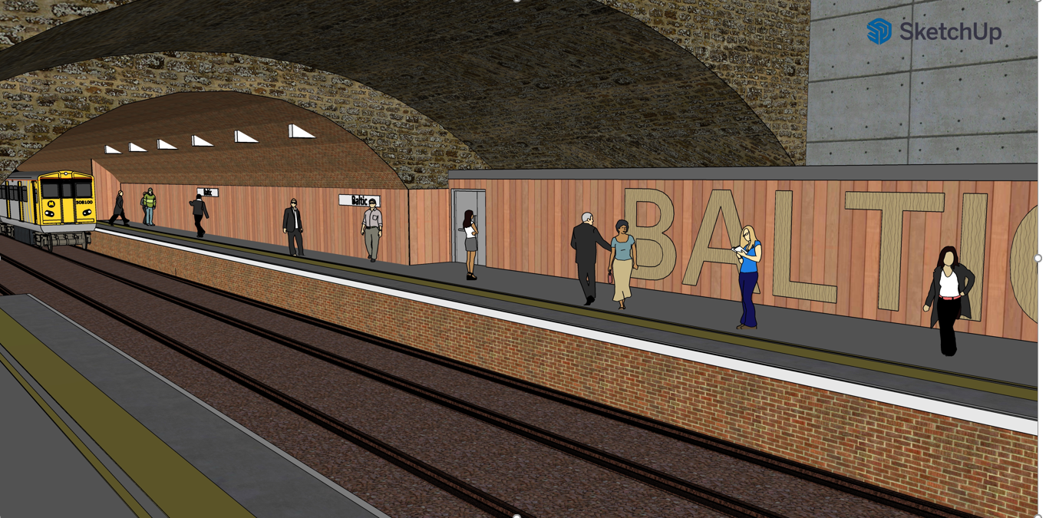
Network Development
Headbolt Lane:
Currently we are on site constructing Headbolt Lane station, which will be the model for ho we can use new stations to bring regeneration to an area
Through the new station, we will provide new links to job an education opportunities for an area of the region which has high level of deprivation and XXXX
Baltic Station:
Working with Liverpool City Council the development of a new station to service the Baltic Triangle area of the Liverpool city centre will provide a catalyst for further regeneration of the area
The station will support access to the developing the large number of creative and high tech opportunities as well as supporting the growing leisure developments

Slide 5
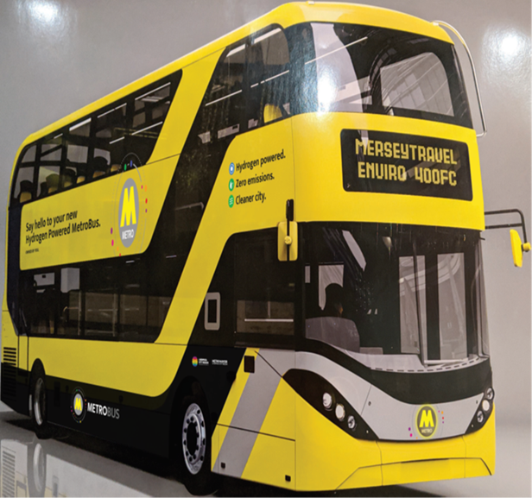
Buses
As part of the 2015 Devolution Deal, Mayoral CA gained new powers and options for delivery of bus services. This included the ability to move to a London style regulated modal (franchising) to end the de-regulation imposed in 1986
Publicly controlled network – gives us the ability to focus on what local leaders want to prioritise.
New powers delivered by Bus Service Act 2017. To utilise these powers a Treasury style business case had to be completed. Work commenced in 2017 and is now nearing completion.
Bus Franchising an Enhanced Partnership options evaluation. Business Case showed Franchising as the strongest option.
Work designed around the vision for Bus that came from LCR Big Bus Debate engagement exercise
Aside from Manchester, no other part of the UK is as advanced on Buses Devolution as LCRCA
Introduced £2 single adult bus fare - any bus, any operator, on all bus journeys wholly within the Liverpool City Region
Statutory consultation to follow
Covid has had a huge impact on travel an all business case work has now been reviewed in light of this
Audit commenced

Slide 6
Hybus Pictures: Designed in line with Passenger Feedback
Upper Deck Next Stop Screen
Next Stop Screen
Seatback Pods
Interior
Seats

Slide 7
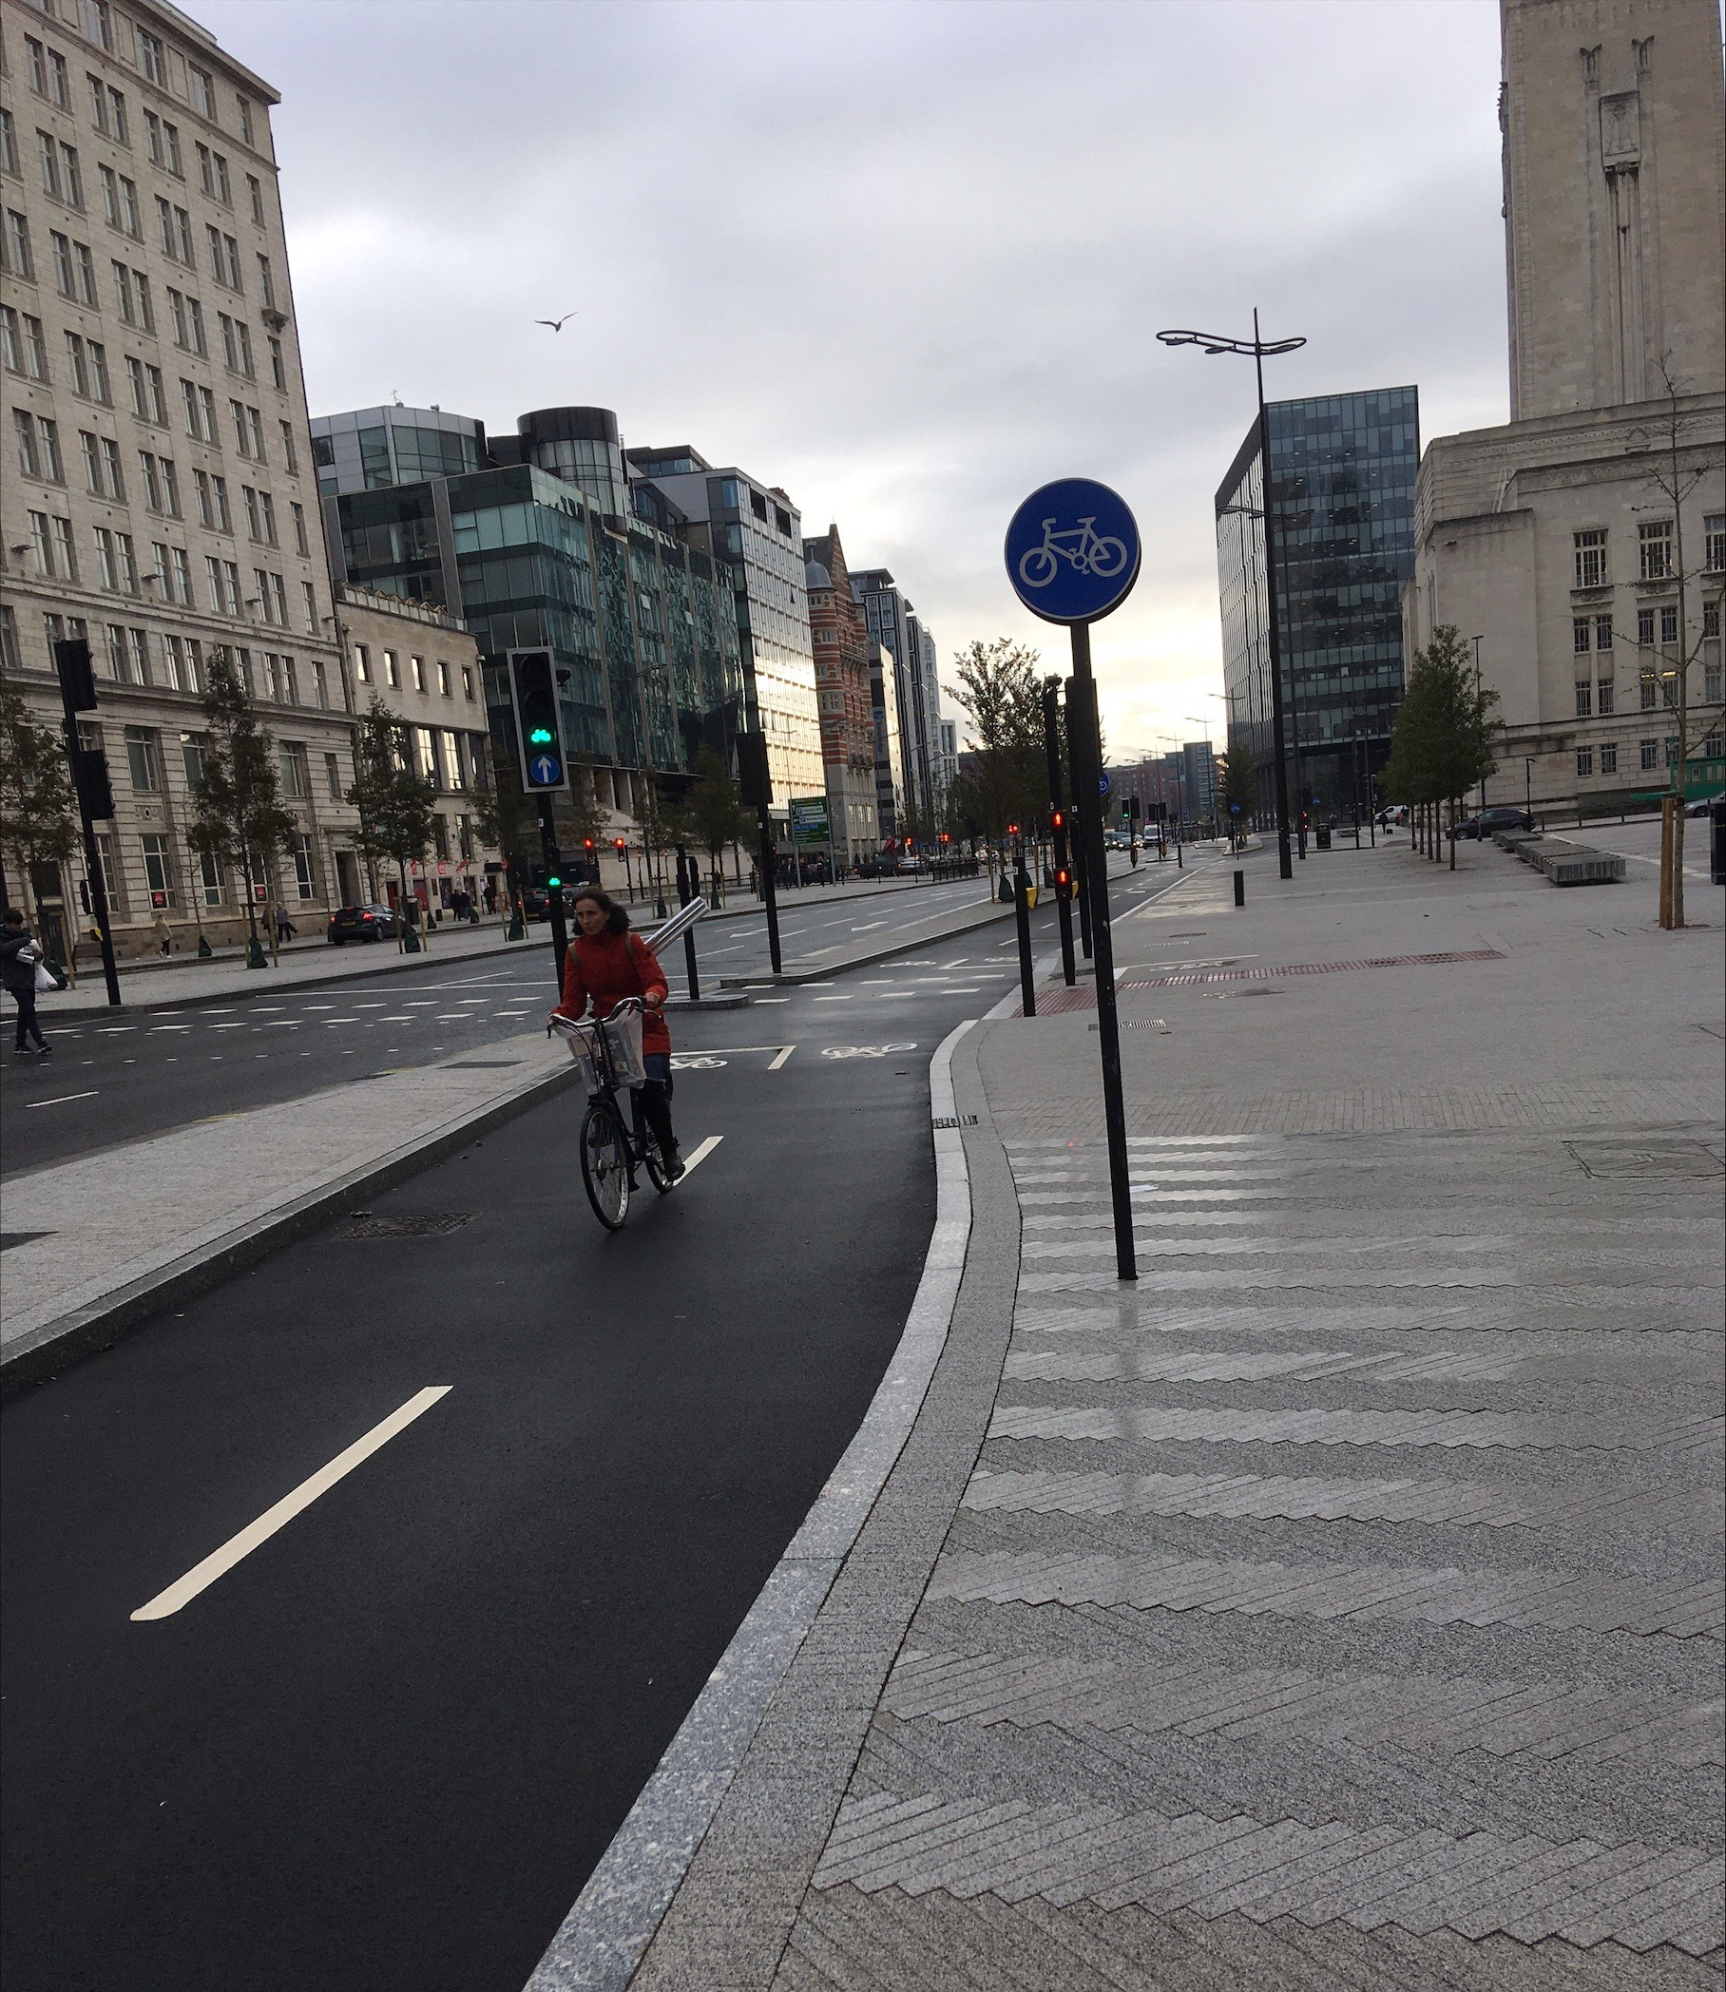
Active Travel
Circa £200m of our CRSTS settlement has been identified to support active travel in the region
Work has begun on a 600km network of cycling and walking routes
31 key routes have been identified across the city region to accelerate rates of cycling and walking
Major behavioural change campaign: ‘The Best Vehicle For Short Journeys Is YOU’

Slide 8
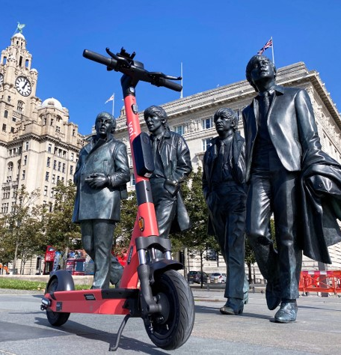
Pioneering New Approaches Case Study: E-Scooters
The city region has hosted a e-scooter trial since October 2020 partnering with company Voi
Recent data shows 27,742 rides happening and 11,700 car tripos being replaced per week
This translates to roughly 5,200kg of CO2e reduction
A recent Royal Society for the prevention of Accidents report shows that e-scooters are after than many other travel modes, with significantly lower casualty rates
It has one of the highest demand levels of any trials area in England

Slide 9
Ferries….
Watch this space!

Slide 10
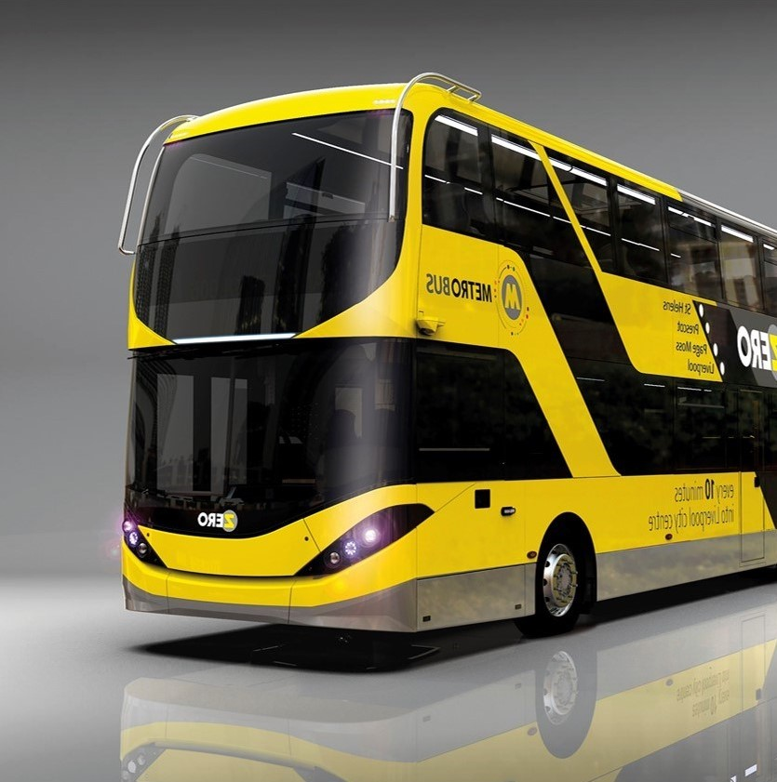
Questions?

