Slide 1
Transport Related Social Exclusion (TRSE)
Kris Beuret, Director Social Research Associates with colleagues: Elizabeth Gilliard, John Sutton, Tony Duckenfield and Templegroup
“Ways in which individuals are cut off from full involvement in the wider society due to lack of access to transport.”
TfN Report
transport-related-social-exclusion-in-the-north-of-england.pdf (windows.net)

Slide 2
The Research (2021)
Literature review
Geosocial mapping to feed into data base and App for ongoing analysis
Selection of five high TRSE areas Northeast, Leeds/Bradford, Chester/Stockport, Sheffield
Online survey across the North
Workshops, stakeholder and face to face interviews, ‘deep dive’ research
Overall – 3,000 interviews

Slide 3
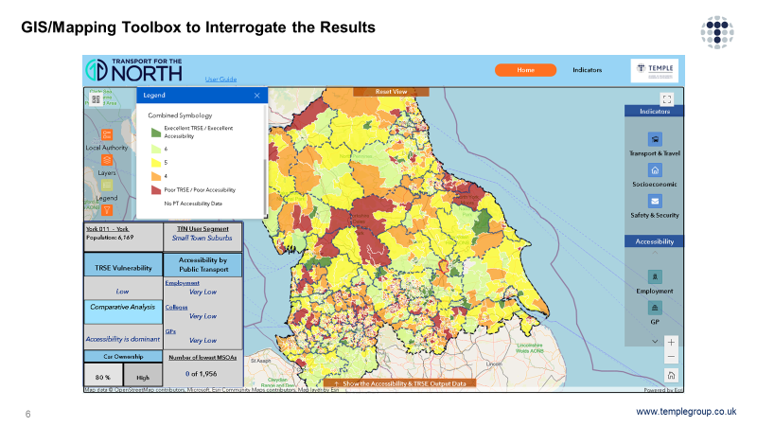
The results
3 million people in the North experience TRSE to to some extent – 3% of these seriously or is it 21%?
It depends how it is measured
Not all reasons obvious

Slide 4
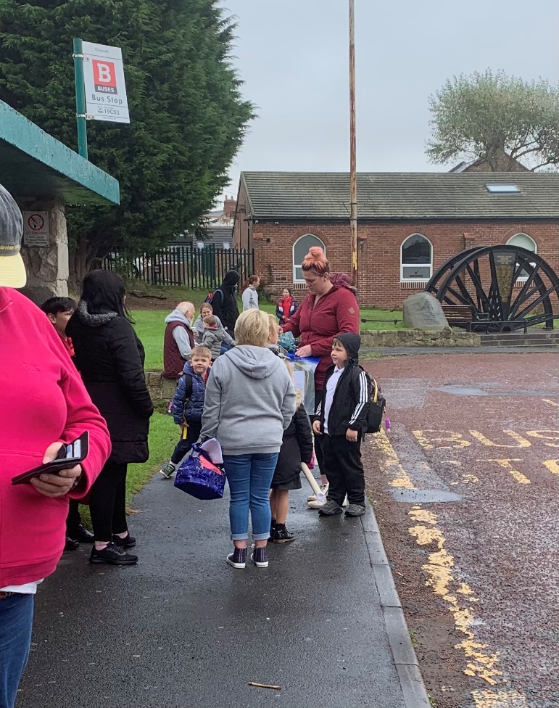
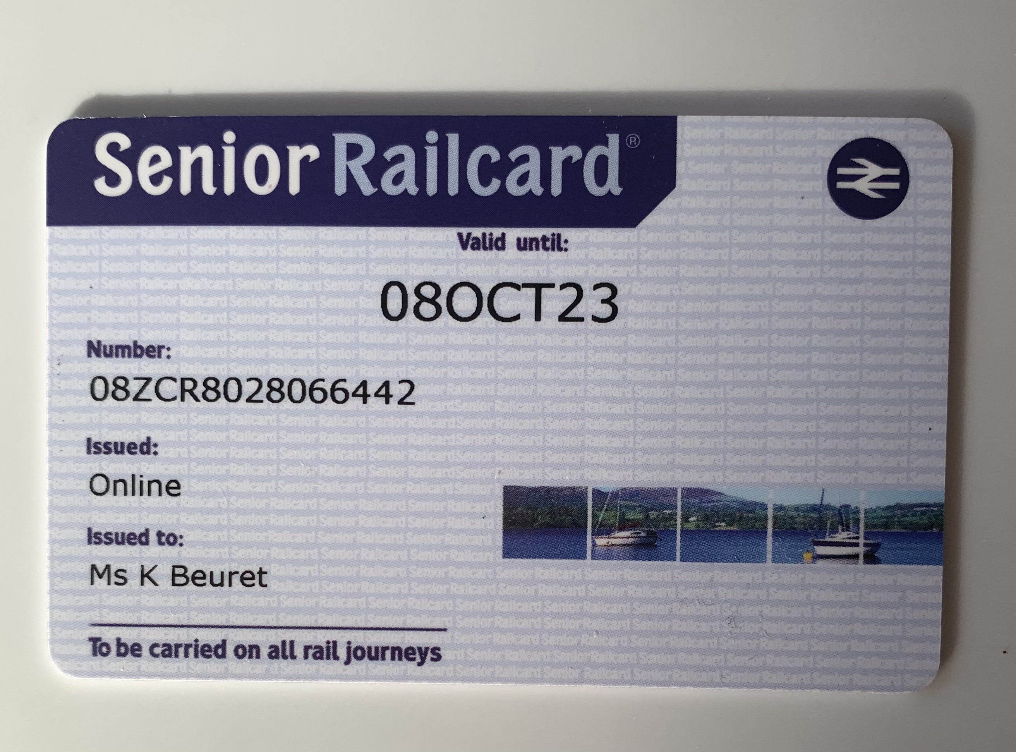
Example 1: Digital exclusion
Coldwell
Information
No wifi
Lower costs on line

Slide 5
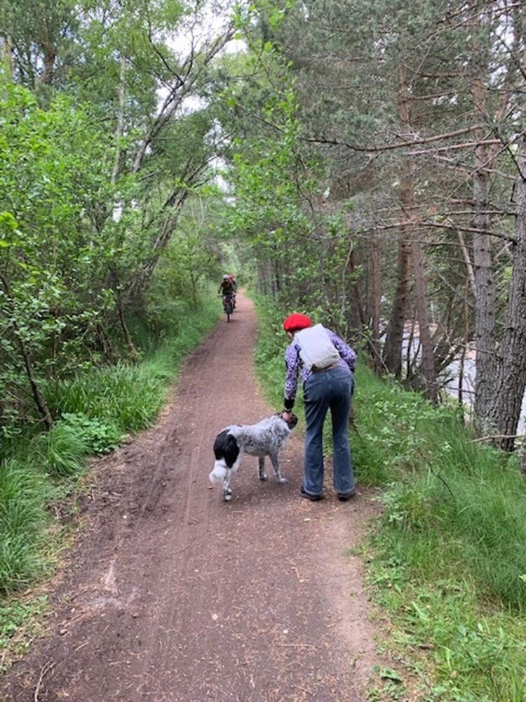
Example 2: Older drivers
Case study of the Northumberland Stone Village
Land ownership in rural areas
Compulsory purchase legislation
Policy issues
To what extent is the pattern of land ownership distorting our vision of transport in rural areas?
Nick Hayes “The Book of Trespass” and “The Trespasser’s Companion” (2022) Bloomsbury

Slide 6
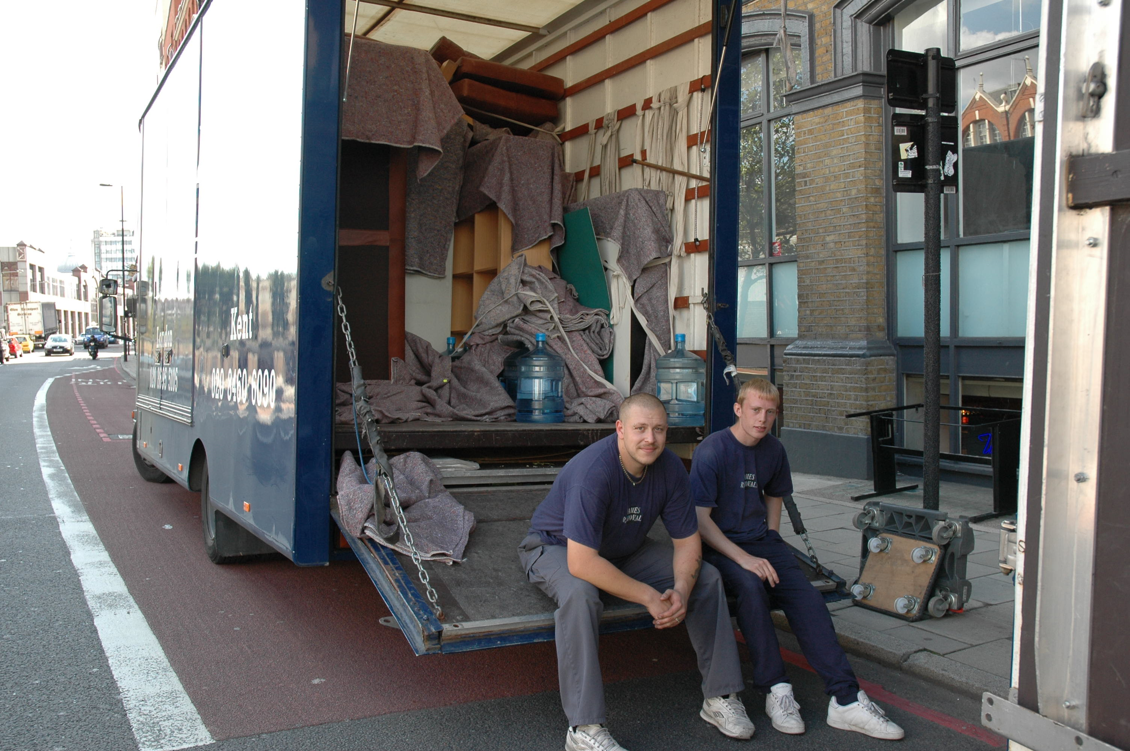
Example 3: Old cars
Legislation phasing out old cars
The impact of running an old car – MOT and insurance costs – leading to criminalisation
The impact of losing driving licence or car off the road
The debate about road pricing

Slide 7
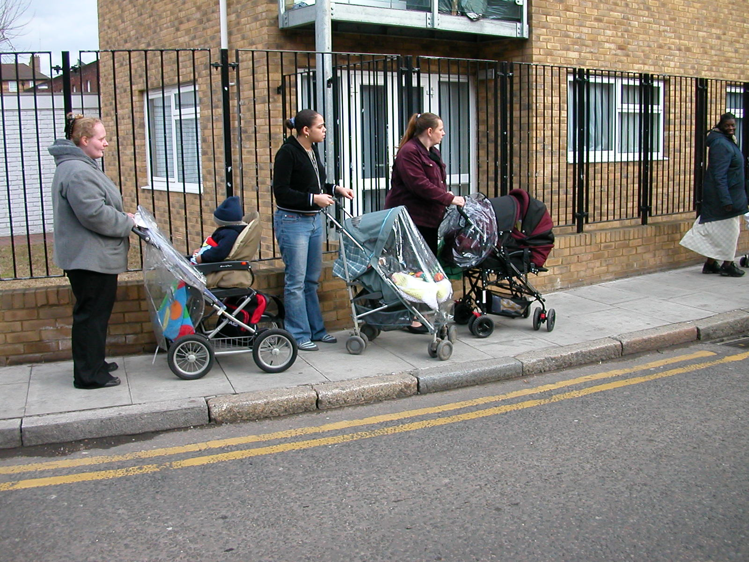
Example 4: Walking
Poor pavement maintenance
Pavement parking
Crime and security
Crossings poorly sited
Facilities too far away
Shared use

Slide 8
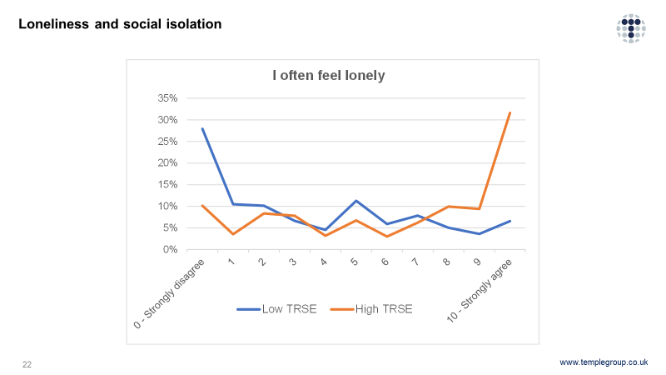
Example 5: link between TRSE and Loneliness

Slide 9
Conclusions
TRSE in the North is more extensive and far higher than expected as well as under-recorded – far more people than in the ‘obvious’ equality groups or types of place
Tool for analysis now available to all
Cost benefit and modelling guidelines underestimate impacts on TRSE groups – new methods would make a much better case for investment
Decarbonisation – TRSE groups have the lowest carbon footprint but suffer the biggest impacts
Ref “Why Travel?” Understanding our need to move and how it shapes our lives:
eds M. Niblett and K. Beuret (2021) Bristol University Press

