Slide 1
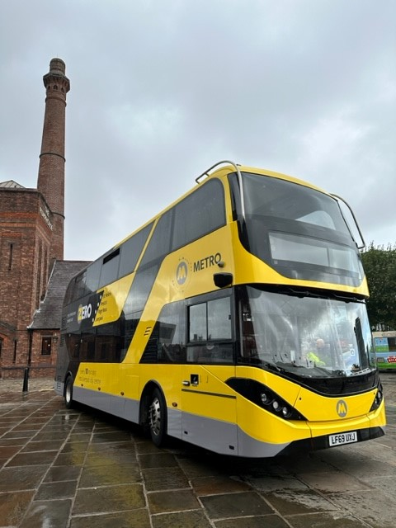
Bus in the Liverpool City Region: an update for TravelWatch NW
Matt Goggins
Assistant Director for Bus
LCRCA

Slide 2
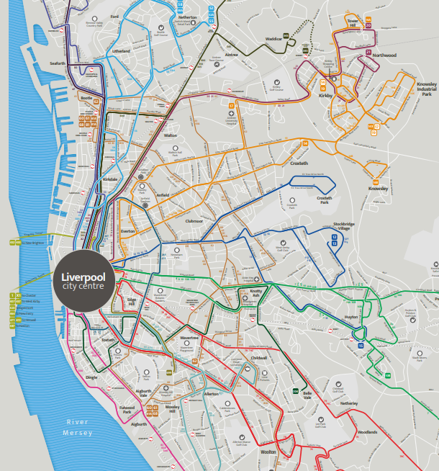
Introducing Bus
Bus in the LCR
Our challenges
Our strategy and future plans
Our key projects

Slide 3
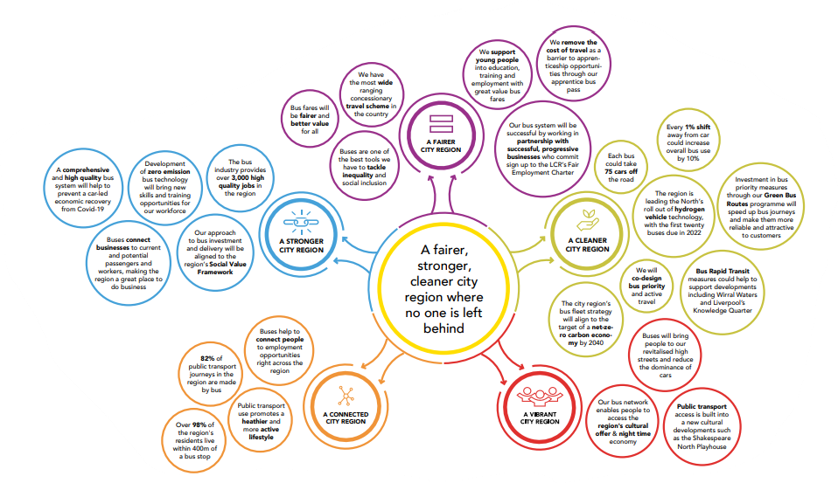
Bus in the Liverpool City Region
How buses help meet City Region objectives
Buses play a critical role in helping the region to function effectively
They help people access work, education, leisure and healthcare
82% of public transport journeys in the LCR are made on the bus
Each bus can take up to 75 cars off the road, reducing emissions and congestion
Over 100 million bus journeys are taken in the LCR every year
Over ¼ of people in Liverpool City Council area use the bus to commute to work

Slide 4
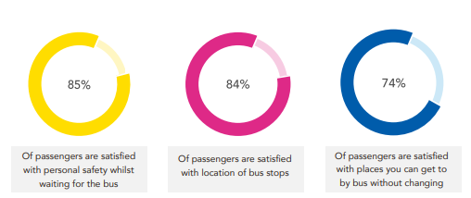
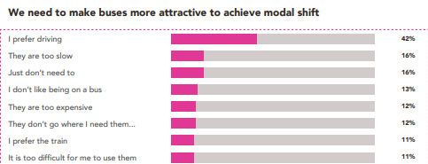
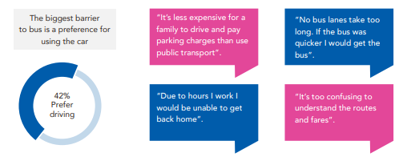
Our challenges
We conducted face-to-face interviews with people across the City Region to ask them why what they disliked and liked about buses and what could be improved
Each year, Transport Focus survey bus passengers across the UK – the LCR scored highest of all comparable areas in the most recent survey with 92% of passenger satisfied with their bus service

Slide 5
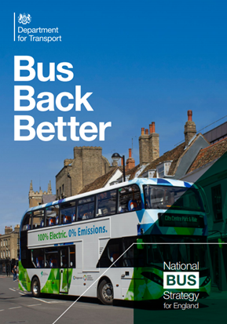
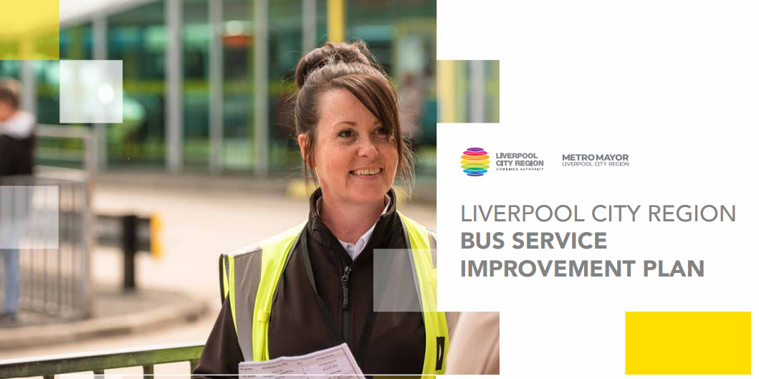
Our strategy and future plans
Bus Back Better (publishing.service.gov.uk)
The national strategy for buses is set out in Bus Back Better, published in 2021
In 2021 the LCR published a Bus Service Improvement Plan (BSIP) in response to the national strategy
The LCR’s BSIP sets out our ambitions for the region’s transport network
LCR_BSIP_2021.pdf (liverpoolcityregion-ca.gov.uk)

Slide 6
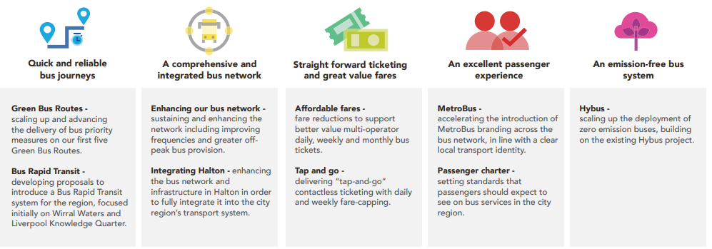
Our BSIP priorities

Slide 7
Bus projects and programmes
Our key projects and programmes are aimed at improving the bus offer in line with the BSIP:
Bus reform
Green Bus Routes
Hydrogen Bus Project
Bus Service Improvement Plan

Slide 8
Bus Reform
In the UK outside London, the bus system has been deregulated since the 1980s
This means bus services are largely specified, controlled and operated by the private sector
Operators need to make commercial returns from bus operations in this system
The public sector fill the gaps created through contracted services
There is a strong case for change from the current system
Bus Back Better: “if we are not to abandon entire communities, services cannot be planned purely on a commercial basis”
In March 2022 the LCRCA stated that bus franchising was their preferred option for reform – a final decision is expected in summer 2023
The assessment is a complex piece of work which is now concluding
Franchising would put control of the bus network in the hands of the Metro Mayor and local leaders, with operators providing services under contract

Slide 9
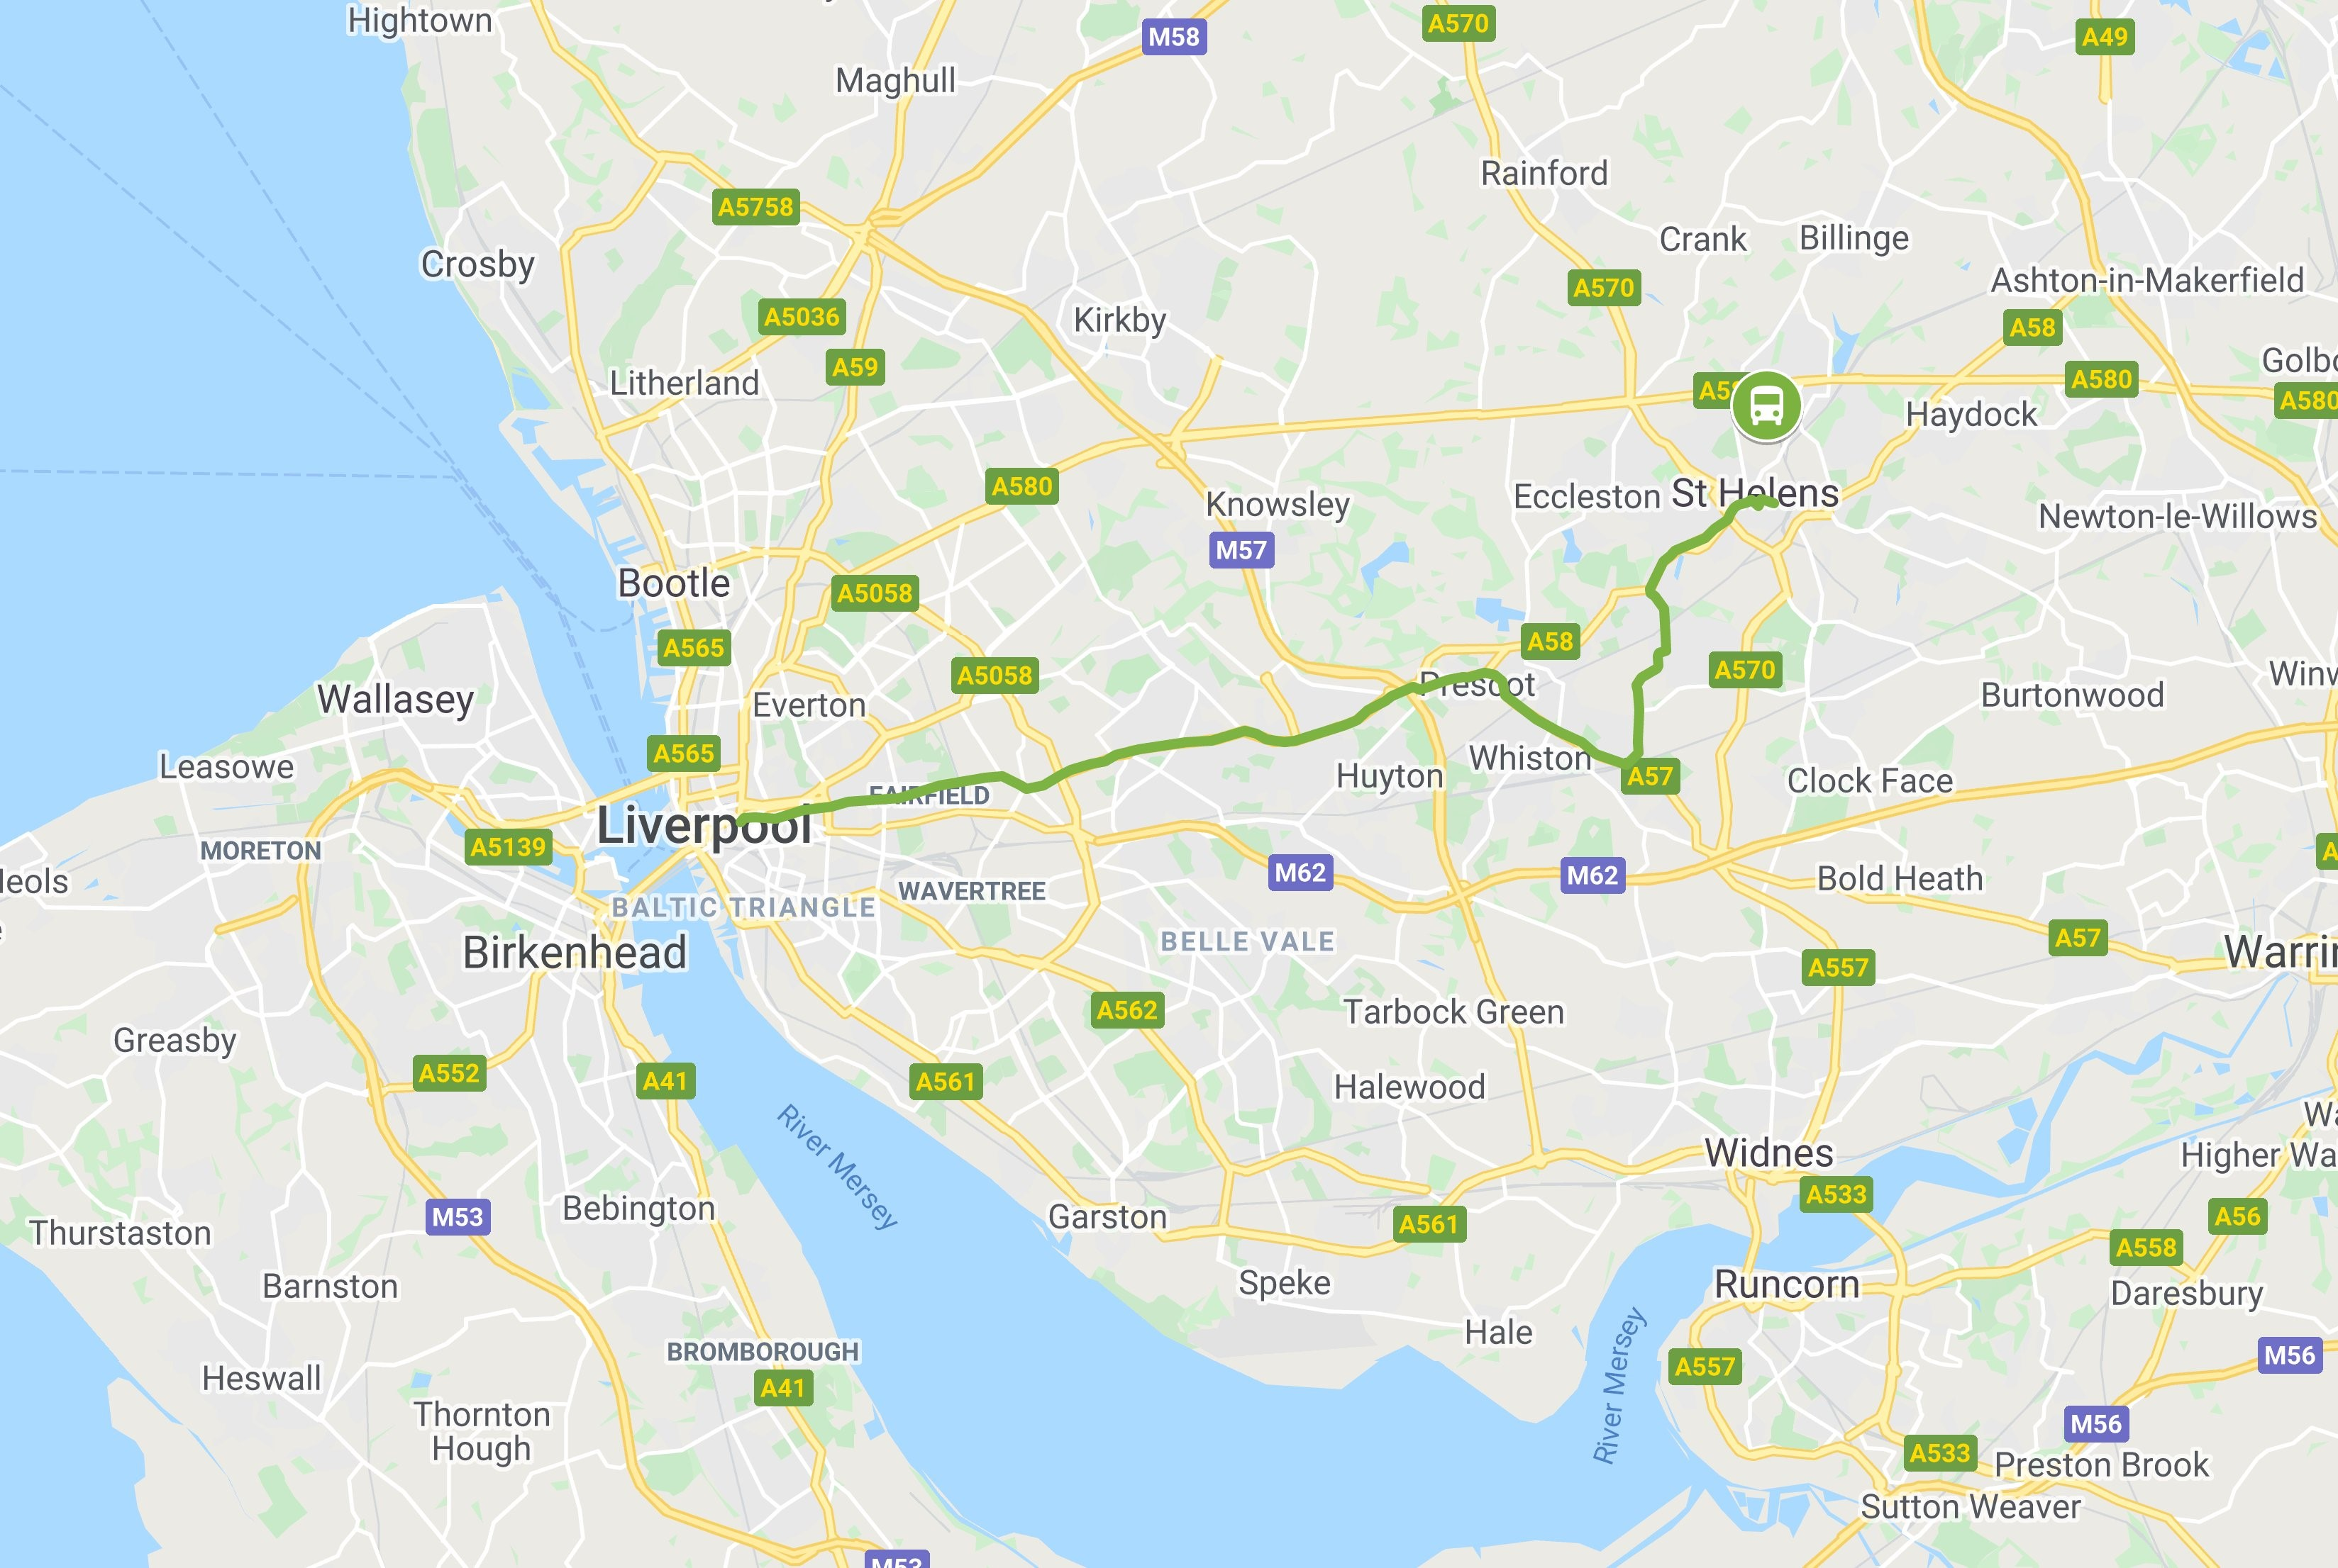
Green Bus Routes
The project will see an ambitious package of interventions delivered along the 10A bus corridor between Liverpool, Knowsley and St Helens
Up to 8 more Green Bus Routes are planned, with the 53 and 86 bus routes next to be delivered

Slide 10
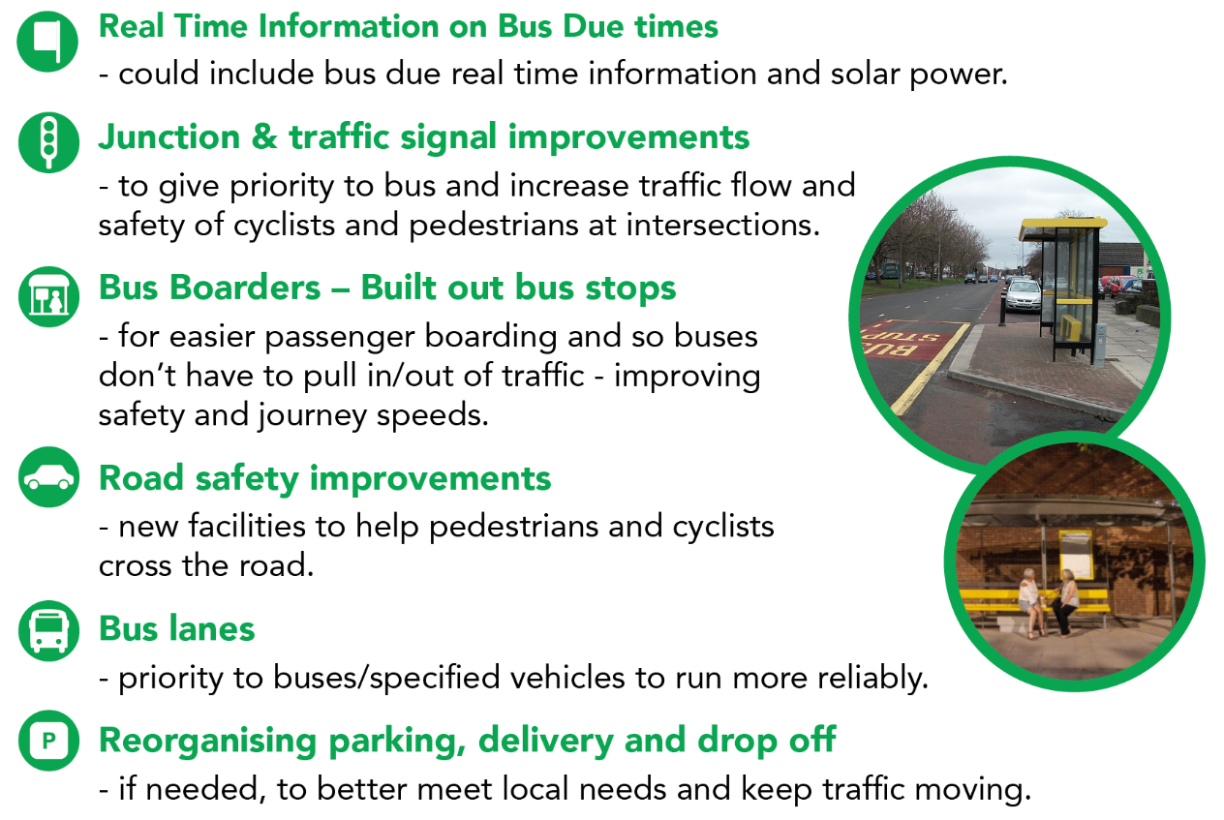
Features of a Green Bus Route

Slide 11
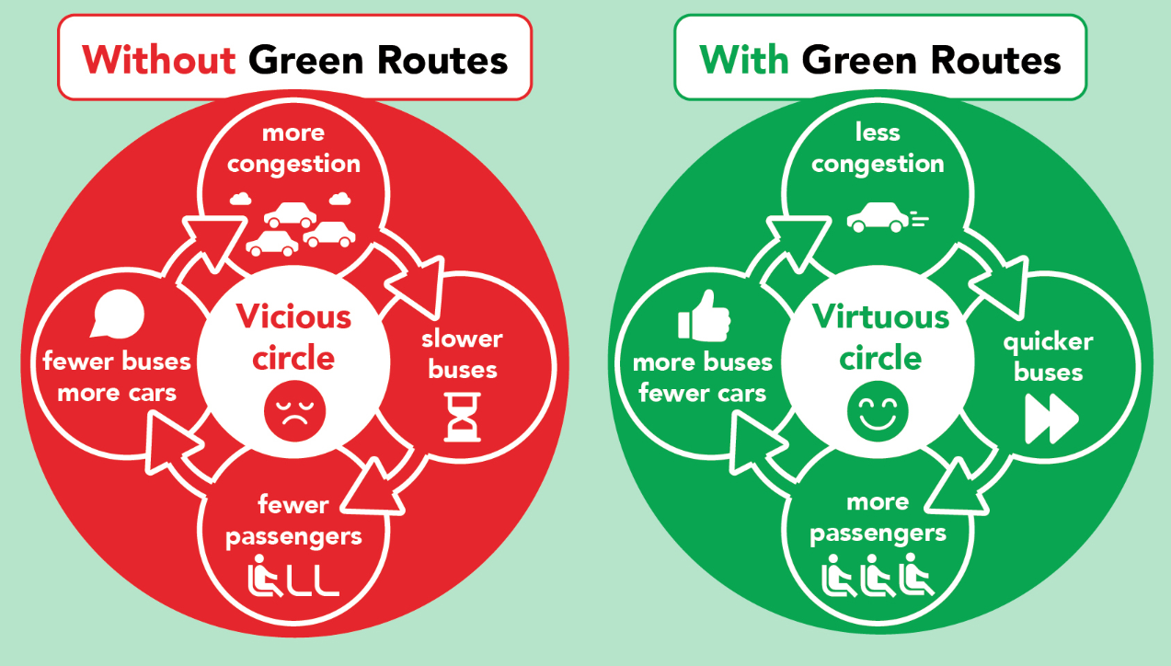
Green Bus Routes

Slide 12
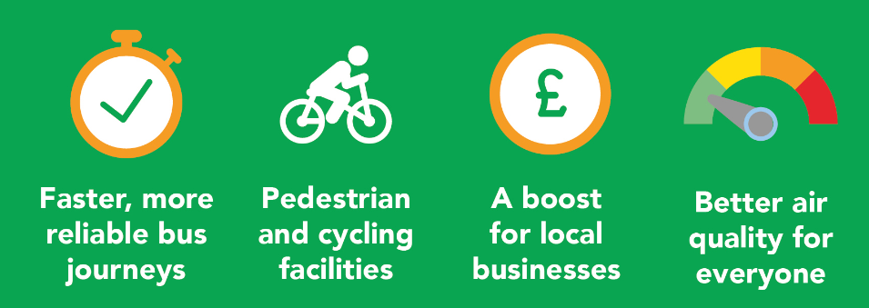
Green Bus Routes

Slide 13
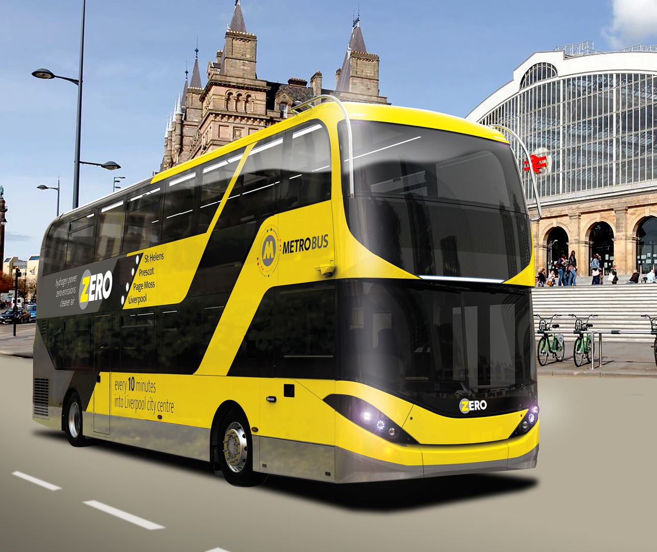
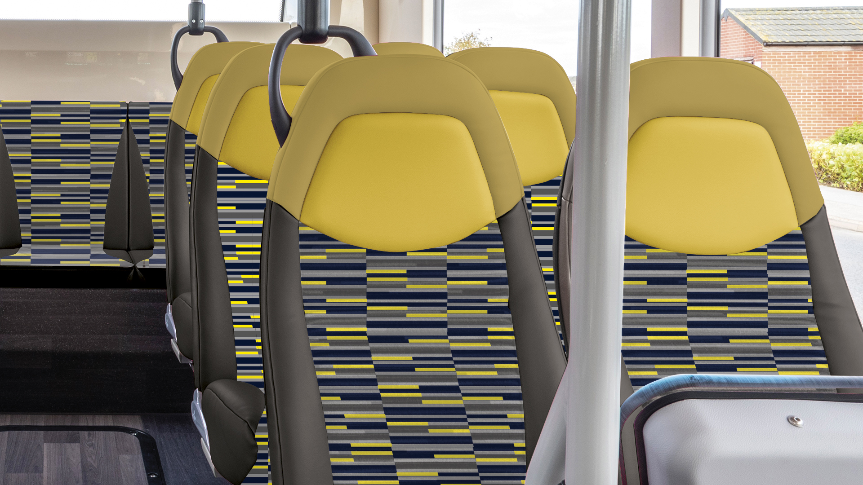

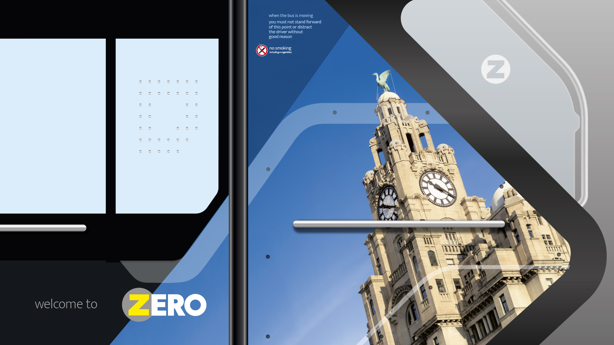
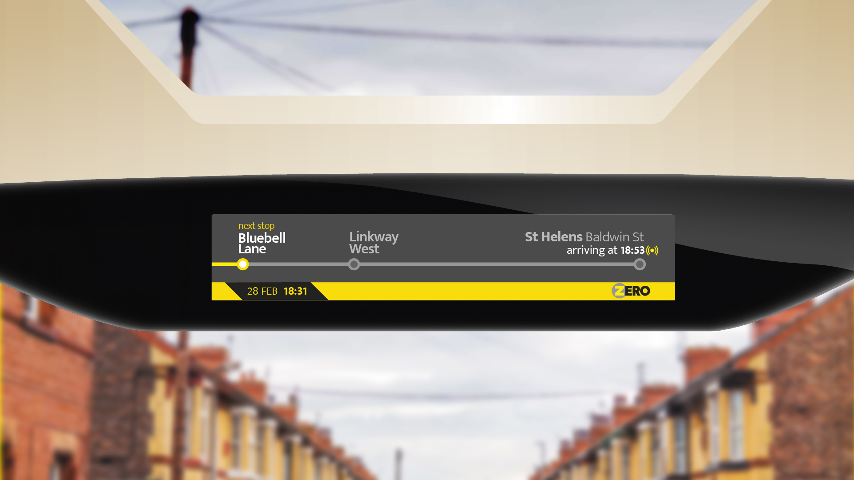
Hybus
Fleet of 20 Hydrogen buses have been procured by the LCRCA
Project delivered in partnership with Arriva and Stagecoach Refueler to be located at Arriva St Helens site
Buses are manufactured in Britain by Alexander Dennis Ltd
Hydrogen buses are zero emission at the tailpipe
All buses due to be in service in the first half of 2023

Slide 14

Bus Service Improvement Plan delivery

